Slide 1
EO-based Maritime Applications
Pedro Ribeiro

Slide 2





Deimos company slide
>300 collaborators in 5 countries
PLATFORMS New launcher technologies, new satellites
SENSORS Passive radars for oceanography, soil moisture and object detection
GNSS receivers for extreme conditions
DATA ACCESS Data archive catalogue & access Multi-mission ground segments
DATA SYSTEMS Services for data and user management
Chaining of (micro-)services, cloud deployment
EO APPLICATIONS User-driven value-added services, data processors

Slide 3
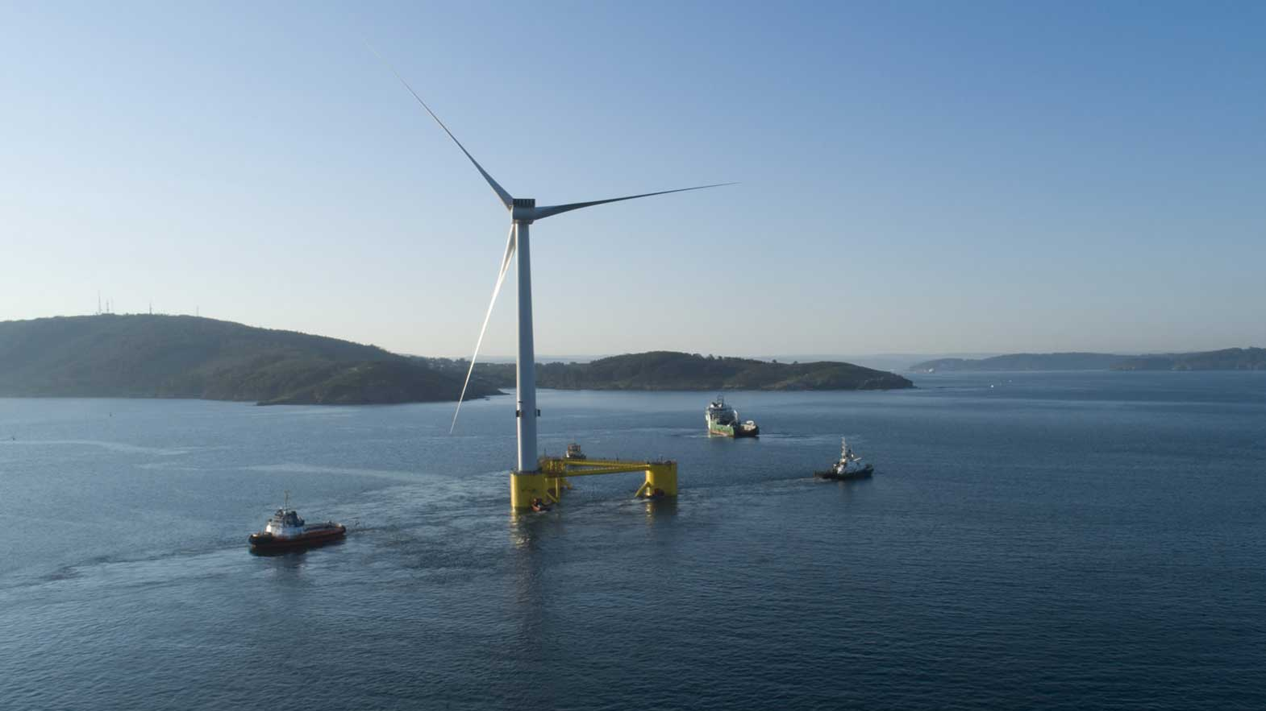





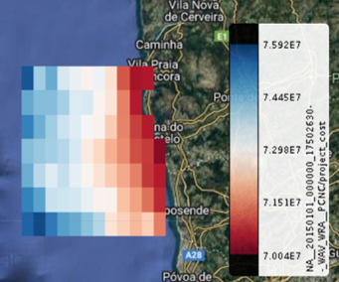
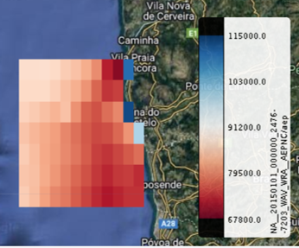
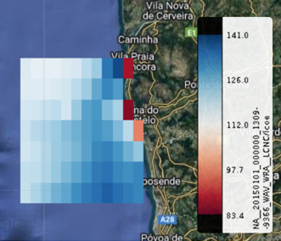

Energy Sector
wind resource assessment with standard industry indicators
+
+
Annual Energy Production
Cost Assessment
Levelized Cost of Electricity
Partners:
Image: Ocean Winds
Notes:
Annual Energy Production (AEP)
Operational Expenditure (OEP)
Capital expenditure (CAPEX)
Levelized Cost of Electricity (LCOE);
Bring together satellite data other geospatial information and wind farm characteristics

Slide 4
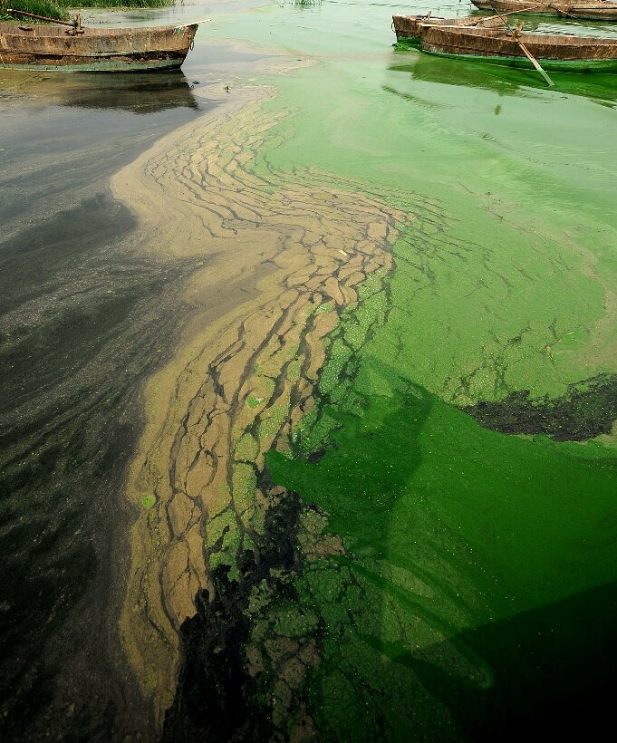









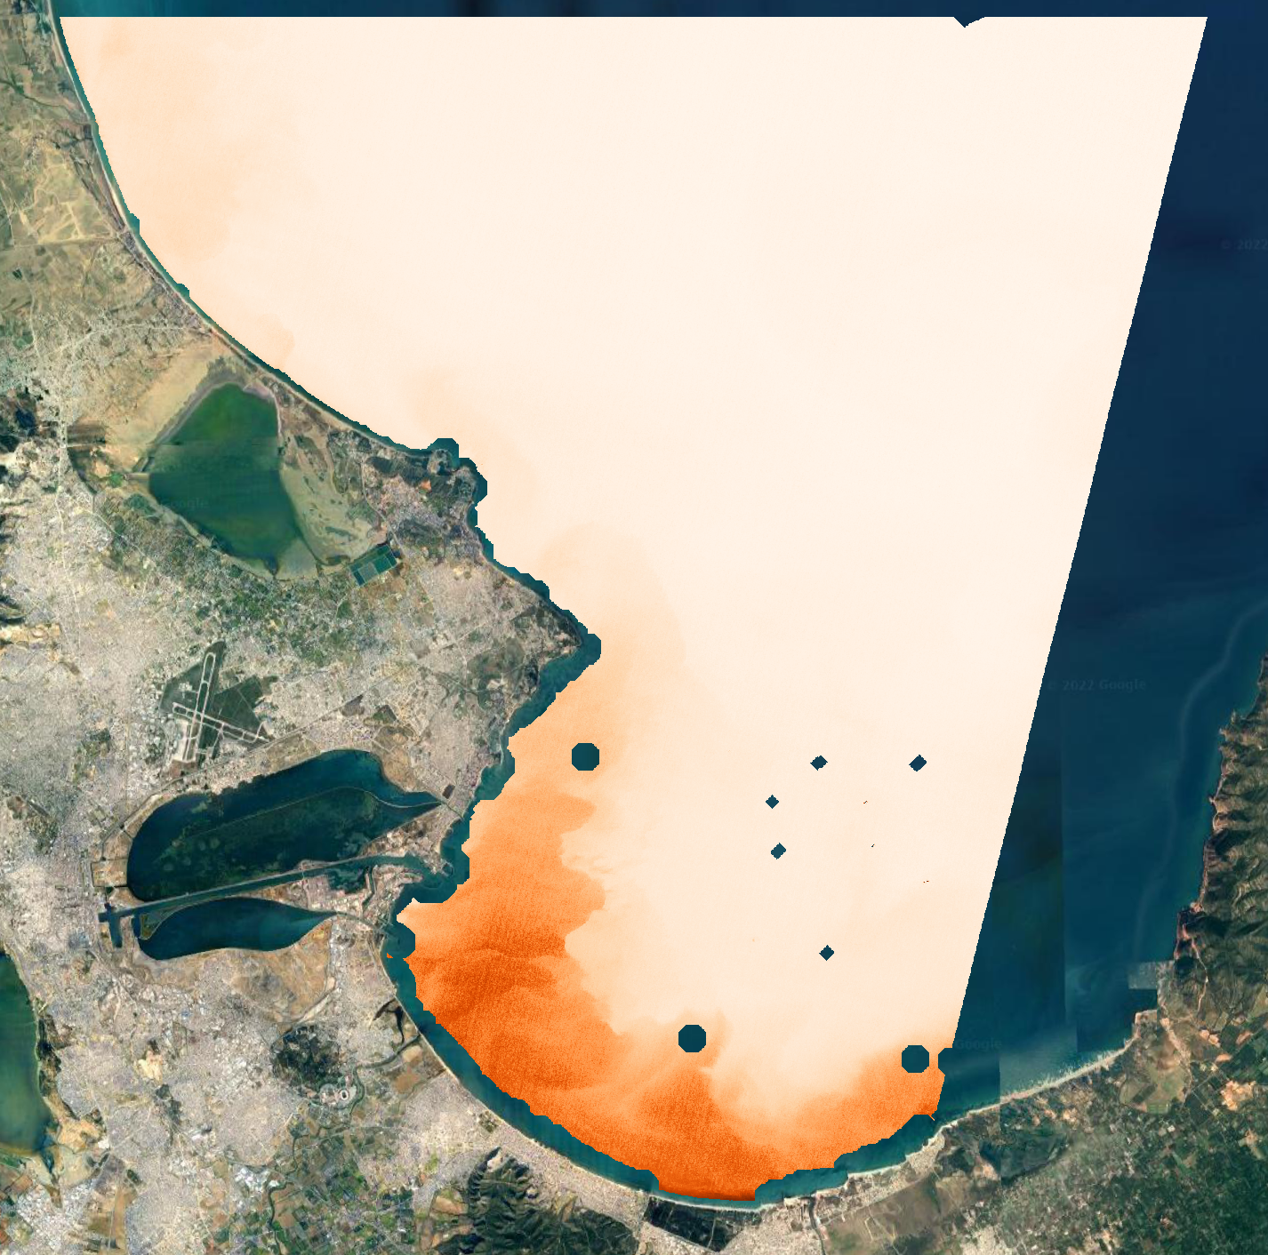
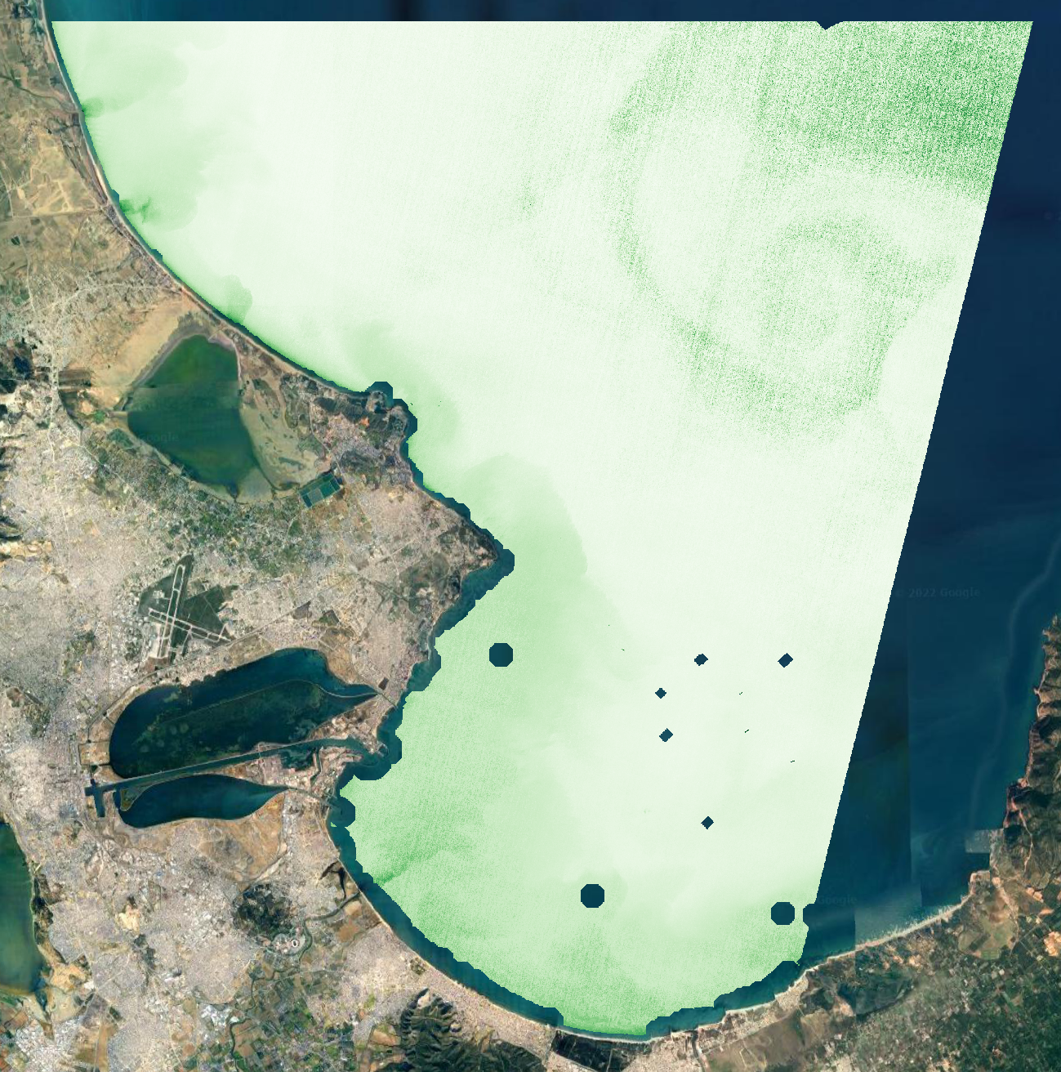

Coastal Water Quality
High resolution daily spatial data
+
+
Image: Phys.org
Chlorophyll-a and Total Suspended Matter over Tunis

Slide 5
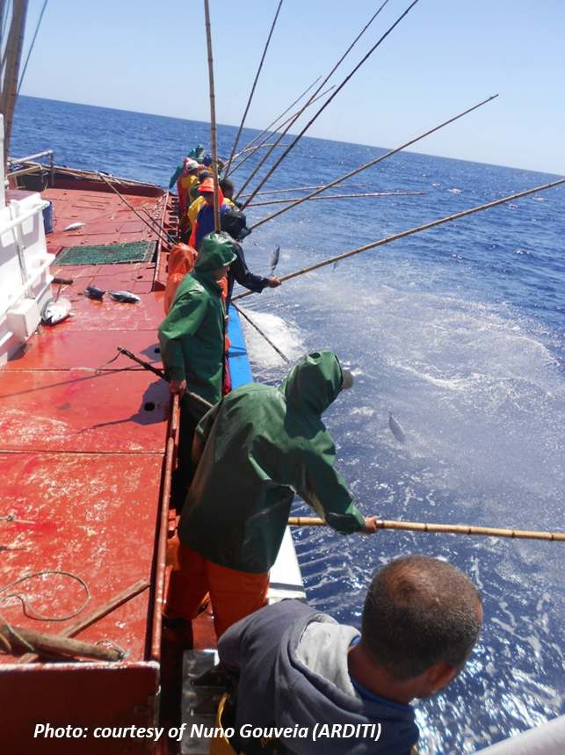


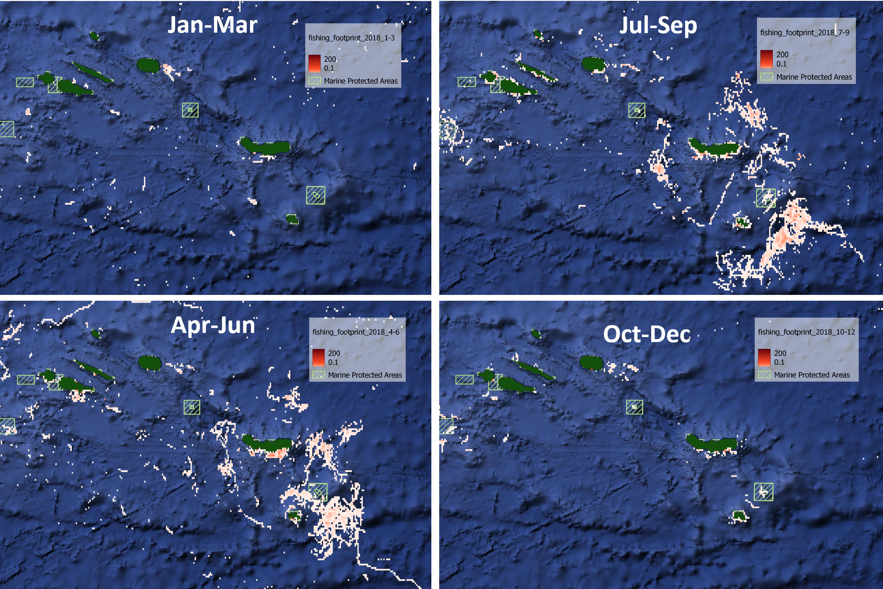
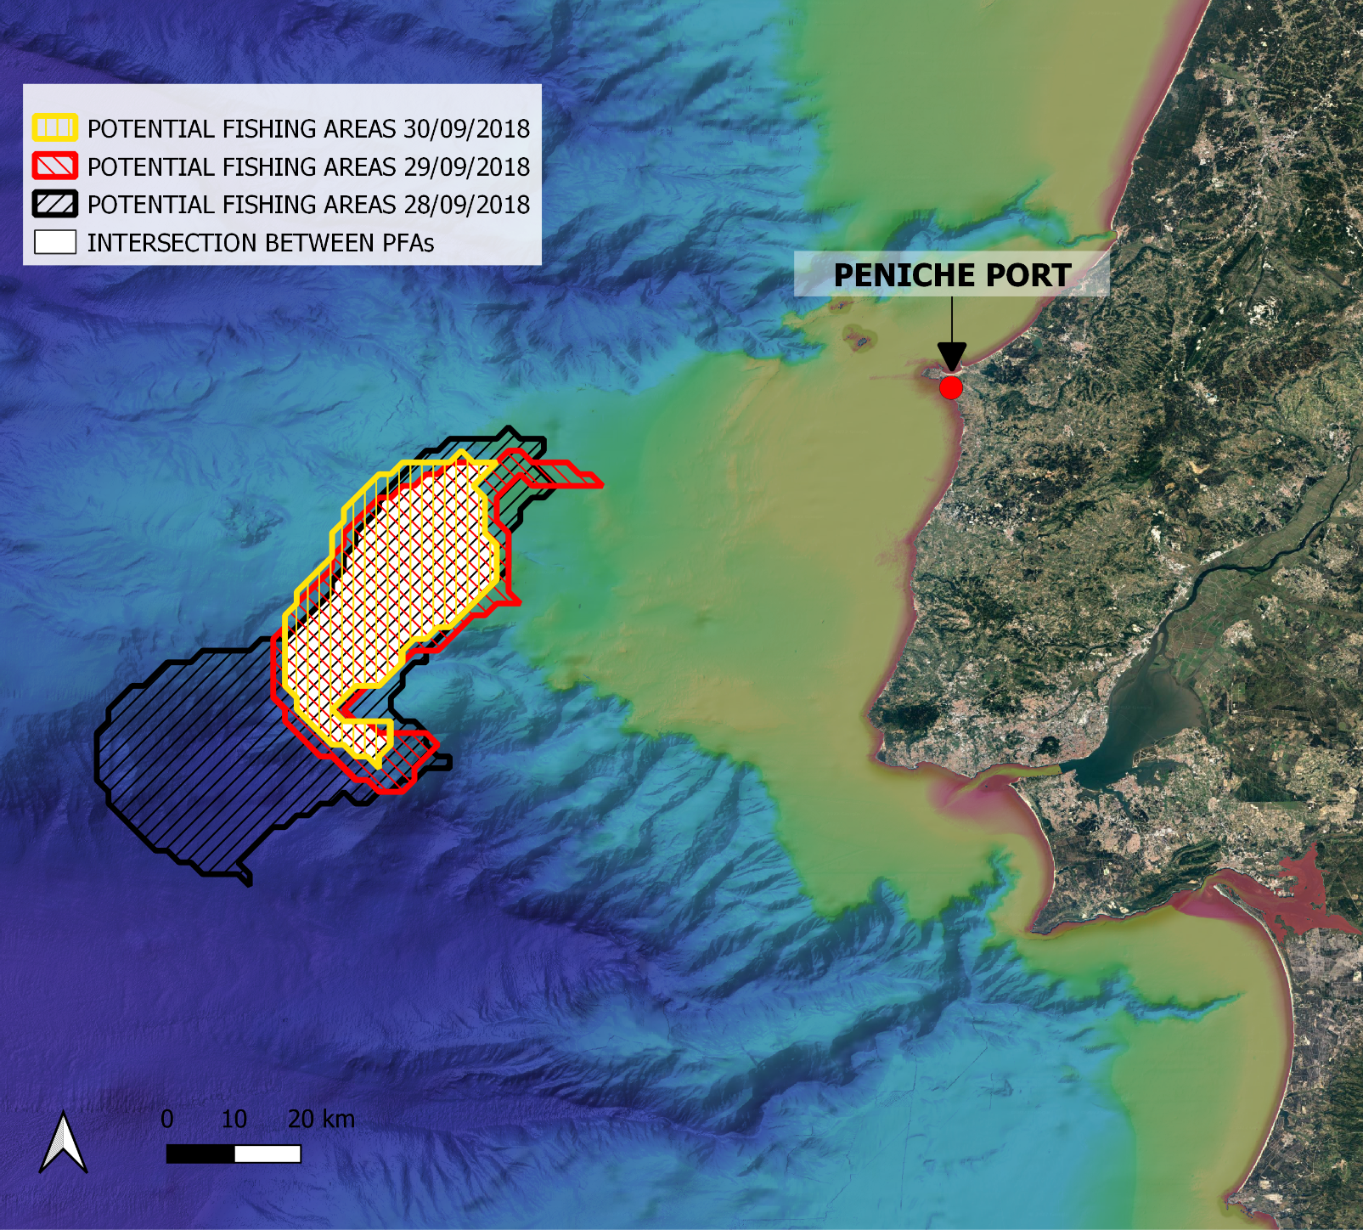




Fisheries
Reliable and timely information on fishing
AIS
Seasonal Fishing Footprint – Pole & Line fleet
Potential Fishing Areas – Pole & Line fleet

Slide 6
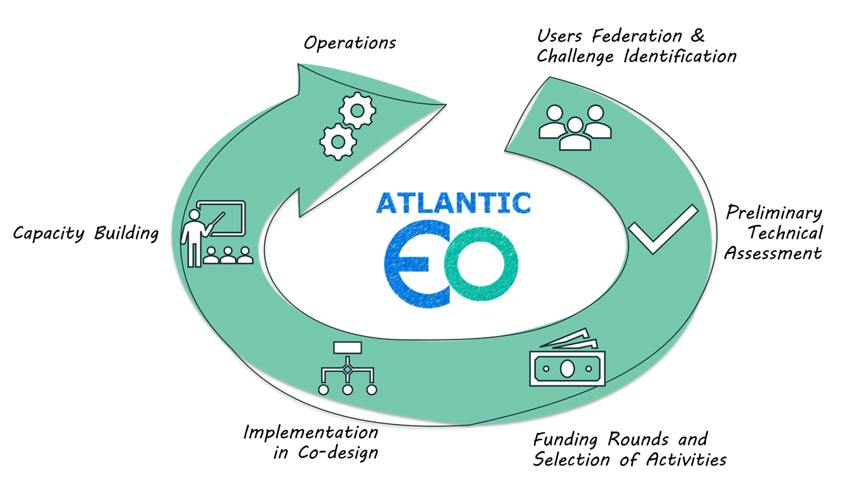

Participatory Design
Focus on User Challenges ensure impact of solutions

Slide 7



CONTACT US
DEIMOS ENGENHARIA
Avenida Columbano Bordalo Pinheiro, 75 A9 - Lisboa – PT
deimos-space.com
Elecnor Deimos
@ElecnorDeimos
@Elecnor_Deimos

