Slide 1
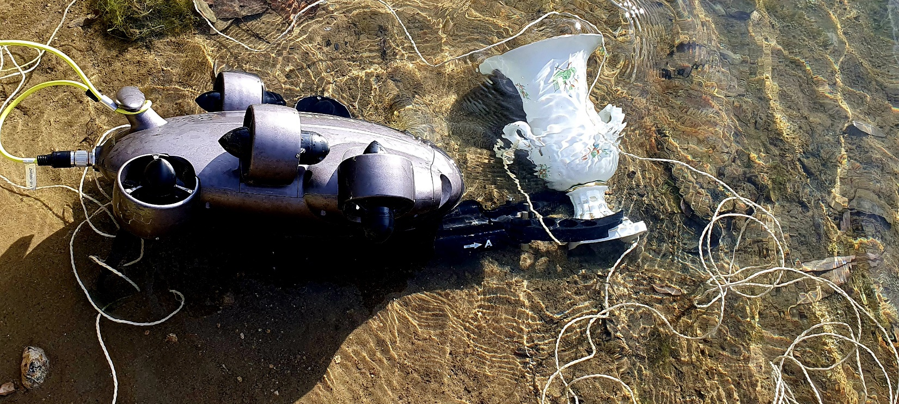
SPACE ENABLE DRONES IN DRM
Viktoria Georgina Armenian
Drone Section, chairman 18. July, 2023.
ASSOCIATION OF THE ECONOMIC AND SCIENTIFIC ORGANIZATIONS

Slide 2
UAV
vs.
AUV
vs.
UUV

Slide 3
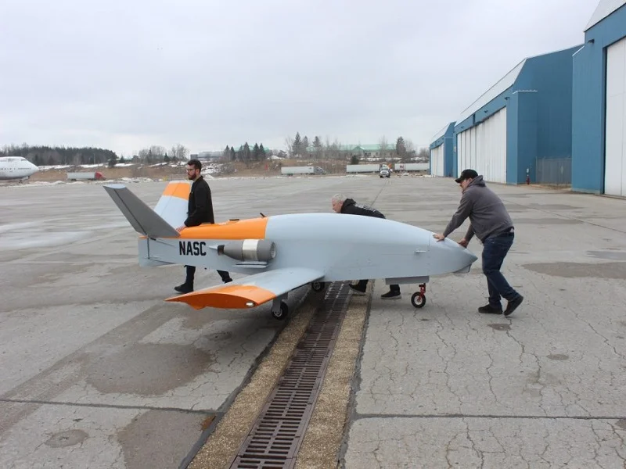
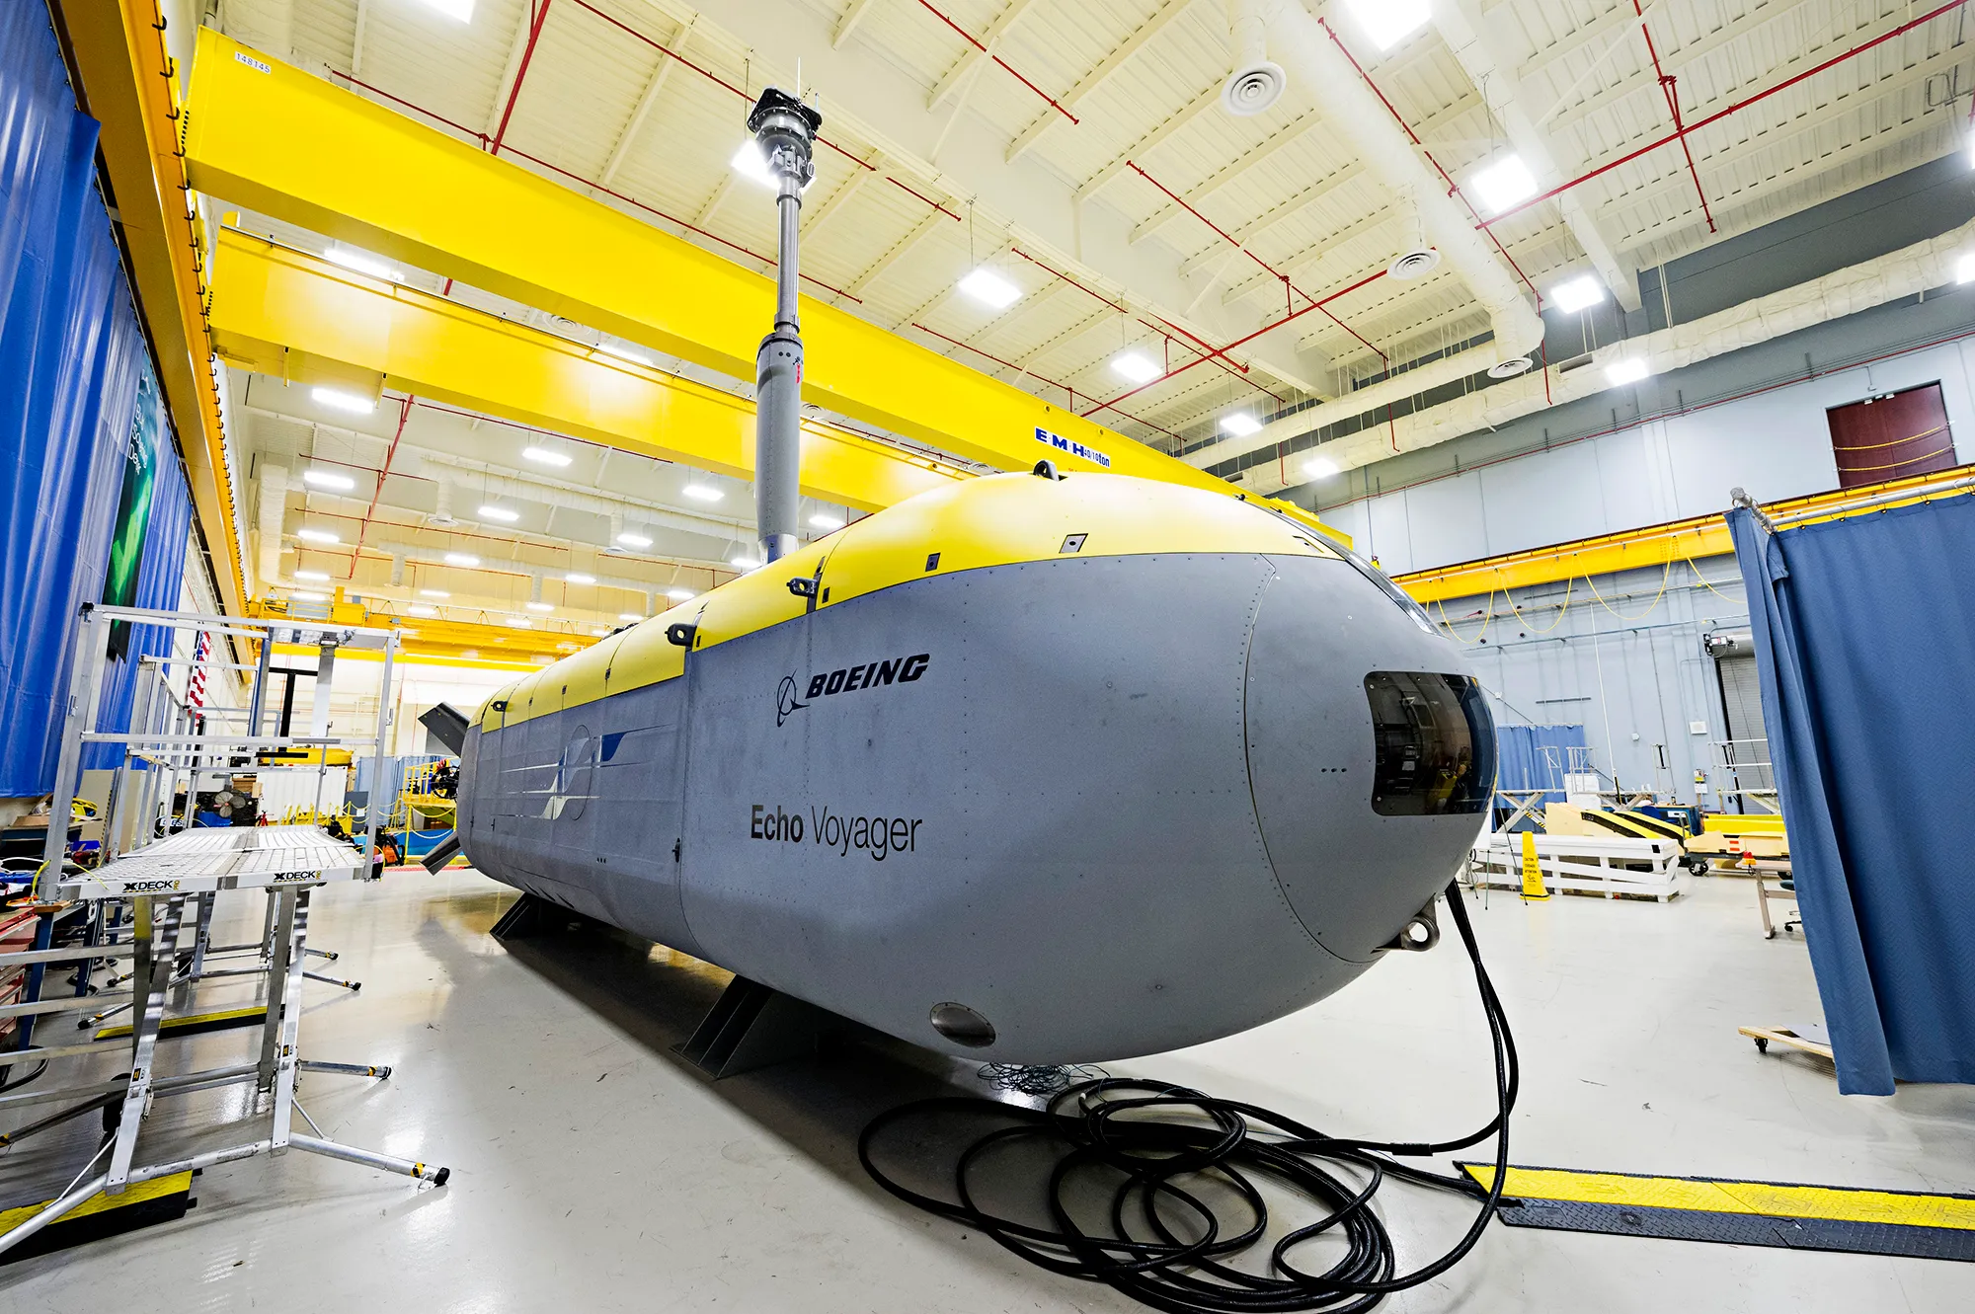

AUTONOMOUS UNMANNED VEHICLES
Unmanned Aerial Vehicle (UAV)
Unmanned Undersea Vehicles (UUV)
Autonomous Unmanned Vehicle (AUV)

Slide 4
DRONE, than satelitte user

Slide 5

SATELITTE REMOTE CONTROL 750 KM
https://www.marinelink.com/news/autonomous-containership-trialed-japan-496468

Slide 6
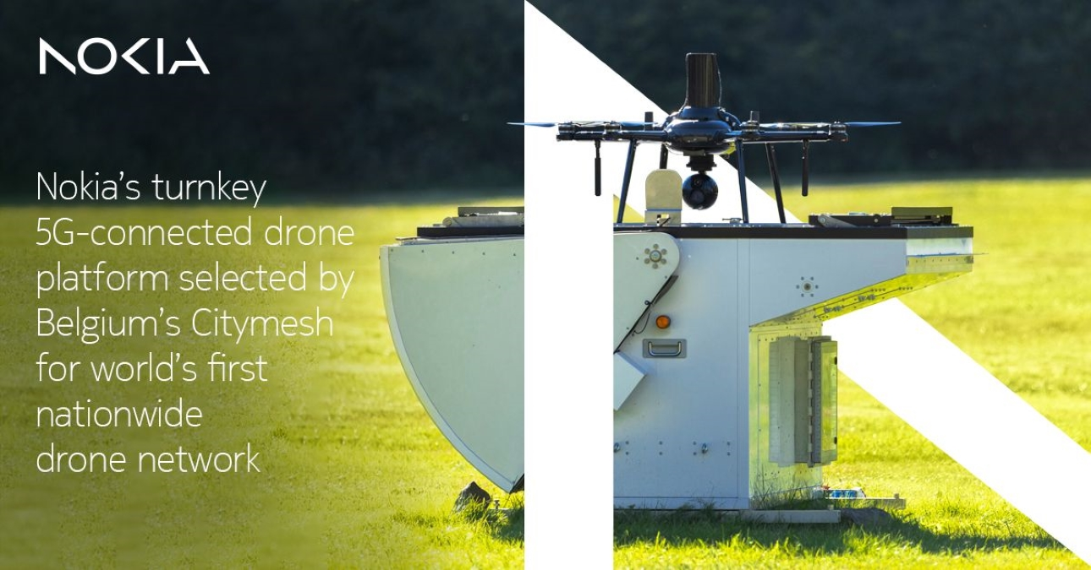
AID EMERGENCY RESPONSE with 5G/SATELITTE
https://dronedj.com/2023/05/18/nokia-5g-drone-belgium-citymesh/

Slide 7
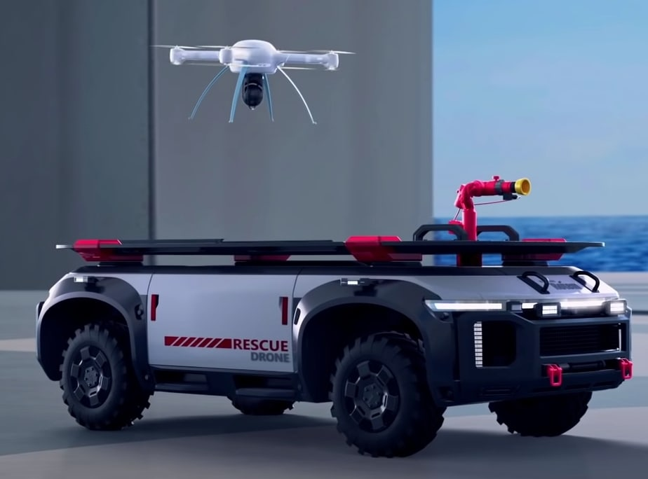
SATELITTE/5G REMOTE CONTROL
https://uavcoach.com/hyundai-hydrogen-drones/

Slide 8

NASA FINDER, NEPAL, 2015.
https://www.space.com/nasa-tech-helps-turkey-earthquake-rescue-effort

Slide 9
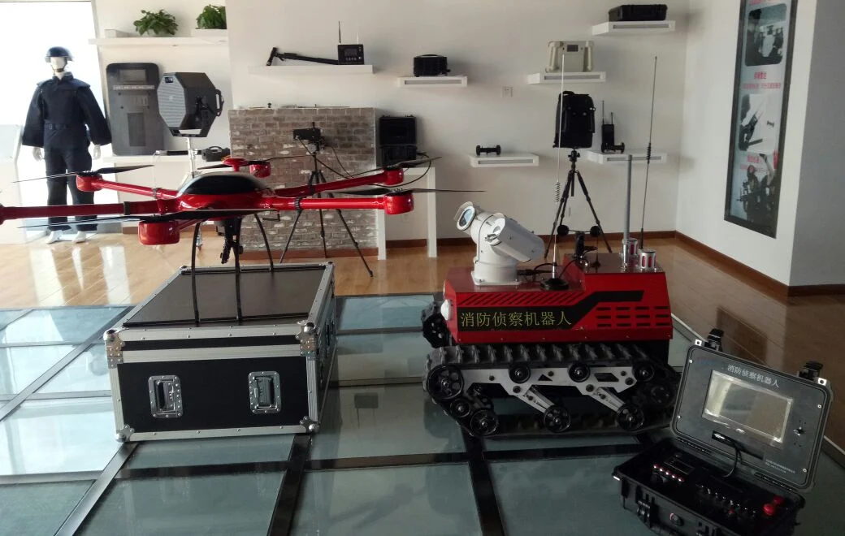
EARTHQUAKE RESCUE RADAR, 2023.
https://topskytech.en.made-in-china.com/product/dvUmcfeVaDRE/China-Breathe-Detection-Life-Rescue-Radar-Detector.html

Slide 10
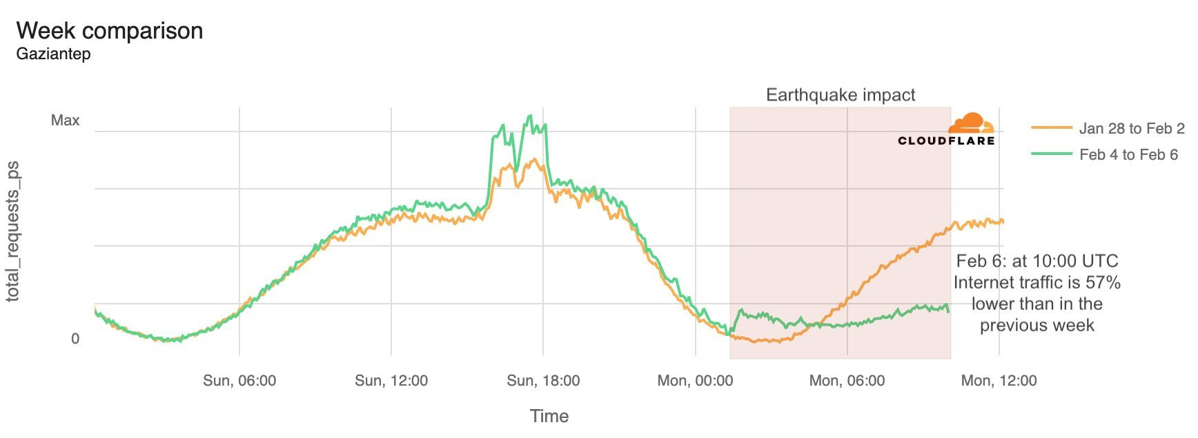
MOBILE CELL COLLAPSE
Two powerful earthquakes that struck Turkey and Syria within the space of 12 hours have killed thousands and damaged critical infrastructure.
Just north of Gaziantep, in the Kahramanmaraş Province, traffic fell by 94 percent following the second earthquake.
https://www.datacenterdynamics.com/en/news/turkish-internet-disrupted-by-devastating-earthquakes-telcos-deploy-mobile-base-stations/

Slide 11
DRONE, than satelitte service provider

Slide 12
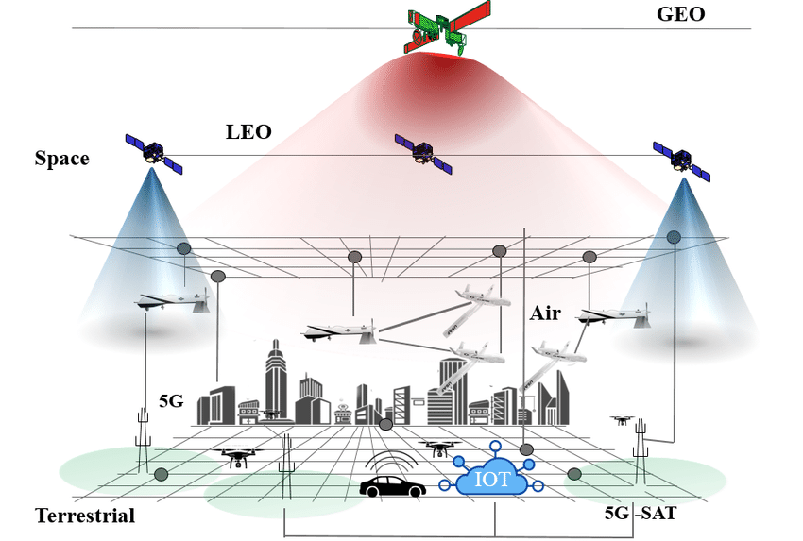
SATELLITE/5G TRAFFIC MANAGMENT
https://www.researchgate.net/figure/UAV-communication-entities-including-ground-air-and-space-segments_fig1_333919084

Slide 13
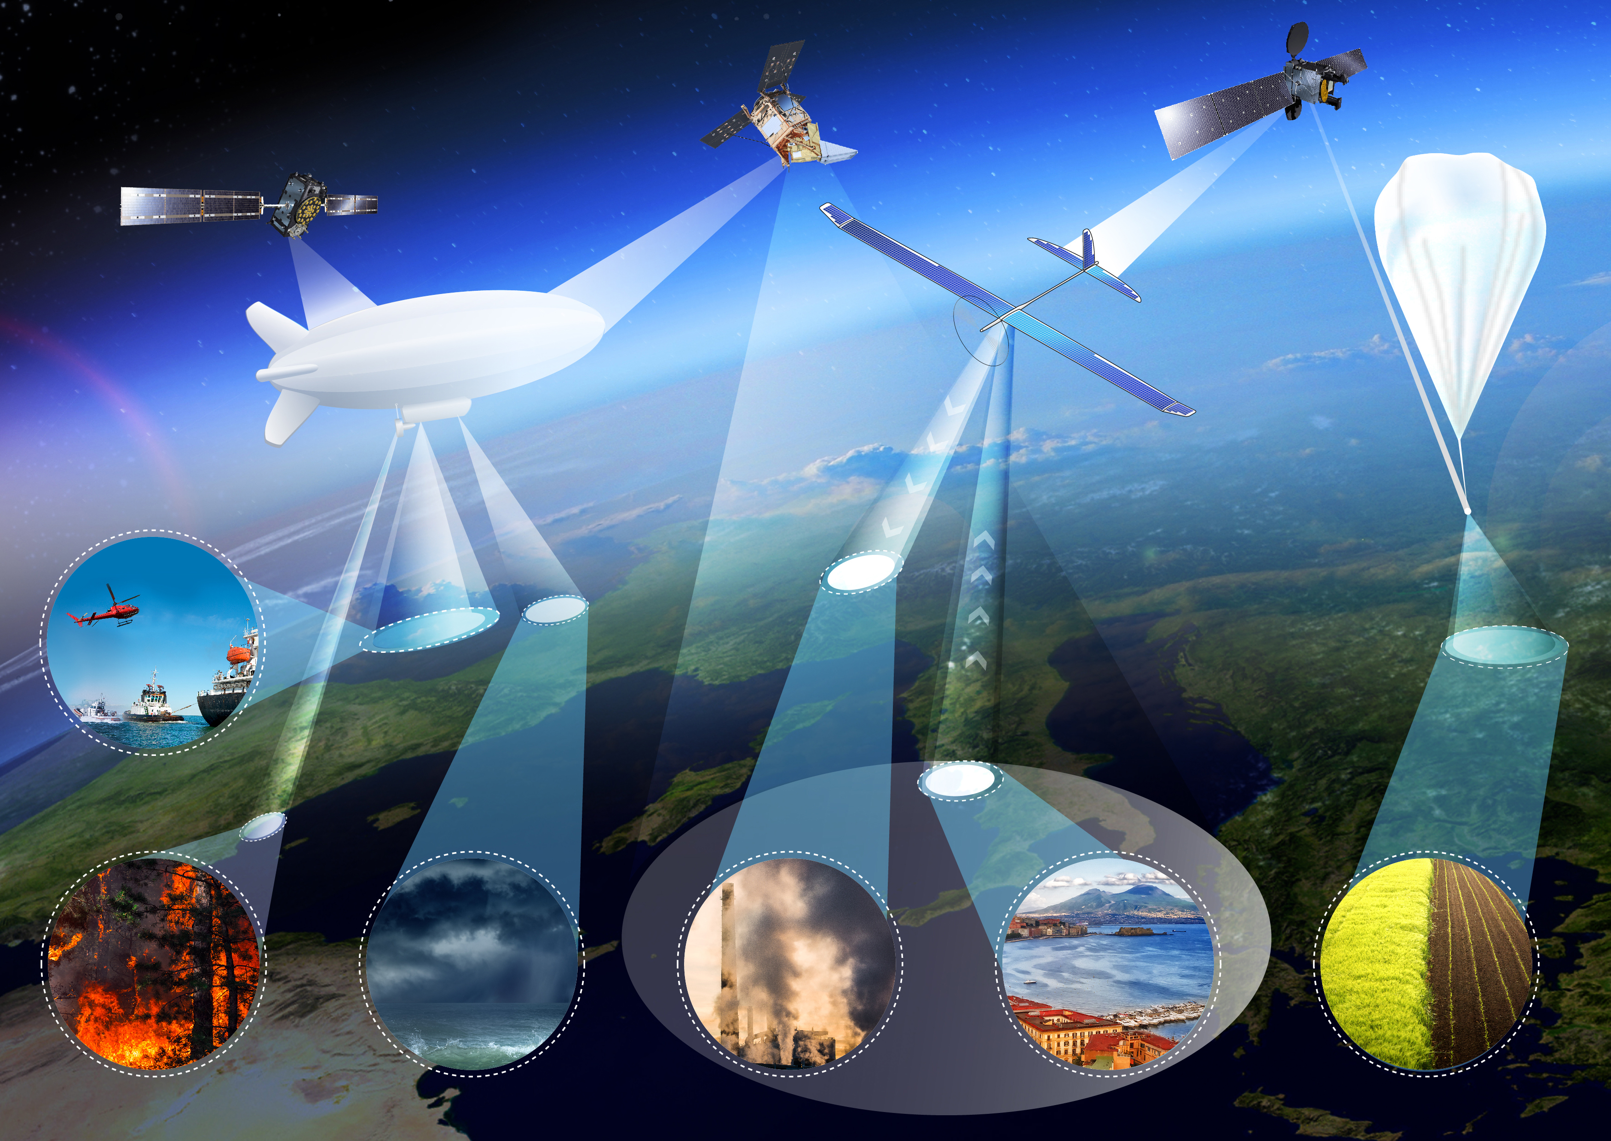
SATELLITE TELECOMMUNICATION
https://arnoticias.tv/side-chest-muscle/esa-crossing-drones-with-satellites-esa-eyes-high-altitude-xx-23191090

Slide 14
DRONE, in the space

Slide 15
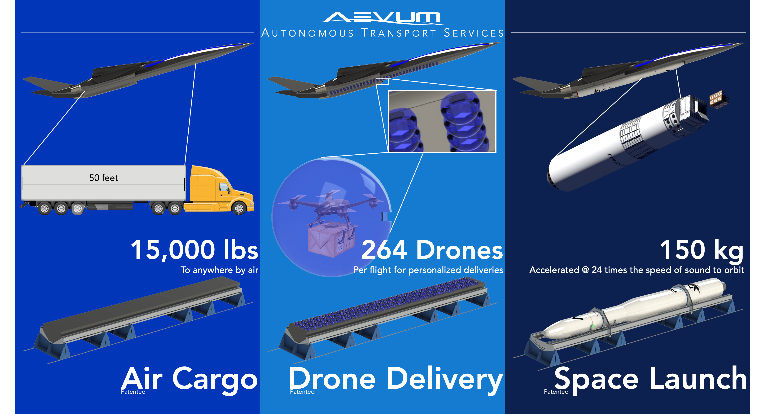
DEEP SPACE DRONE I.
https://techcrunch.com/2021/05/18/aevum-is-building-a-modular-autonomous-drone-for-space-and-terrestrial-deliveries/

Slide 16
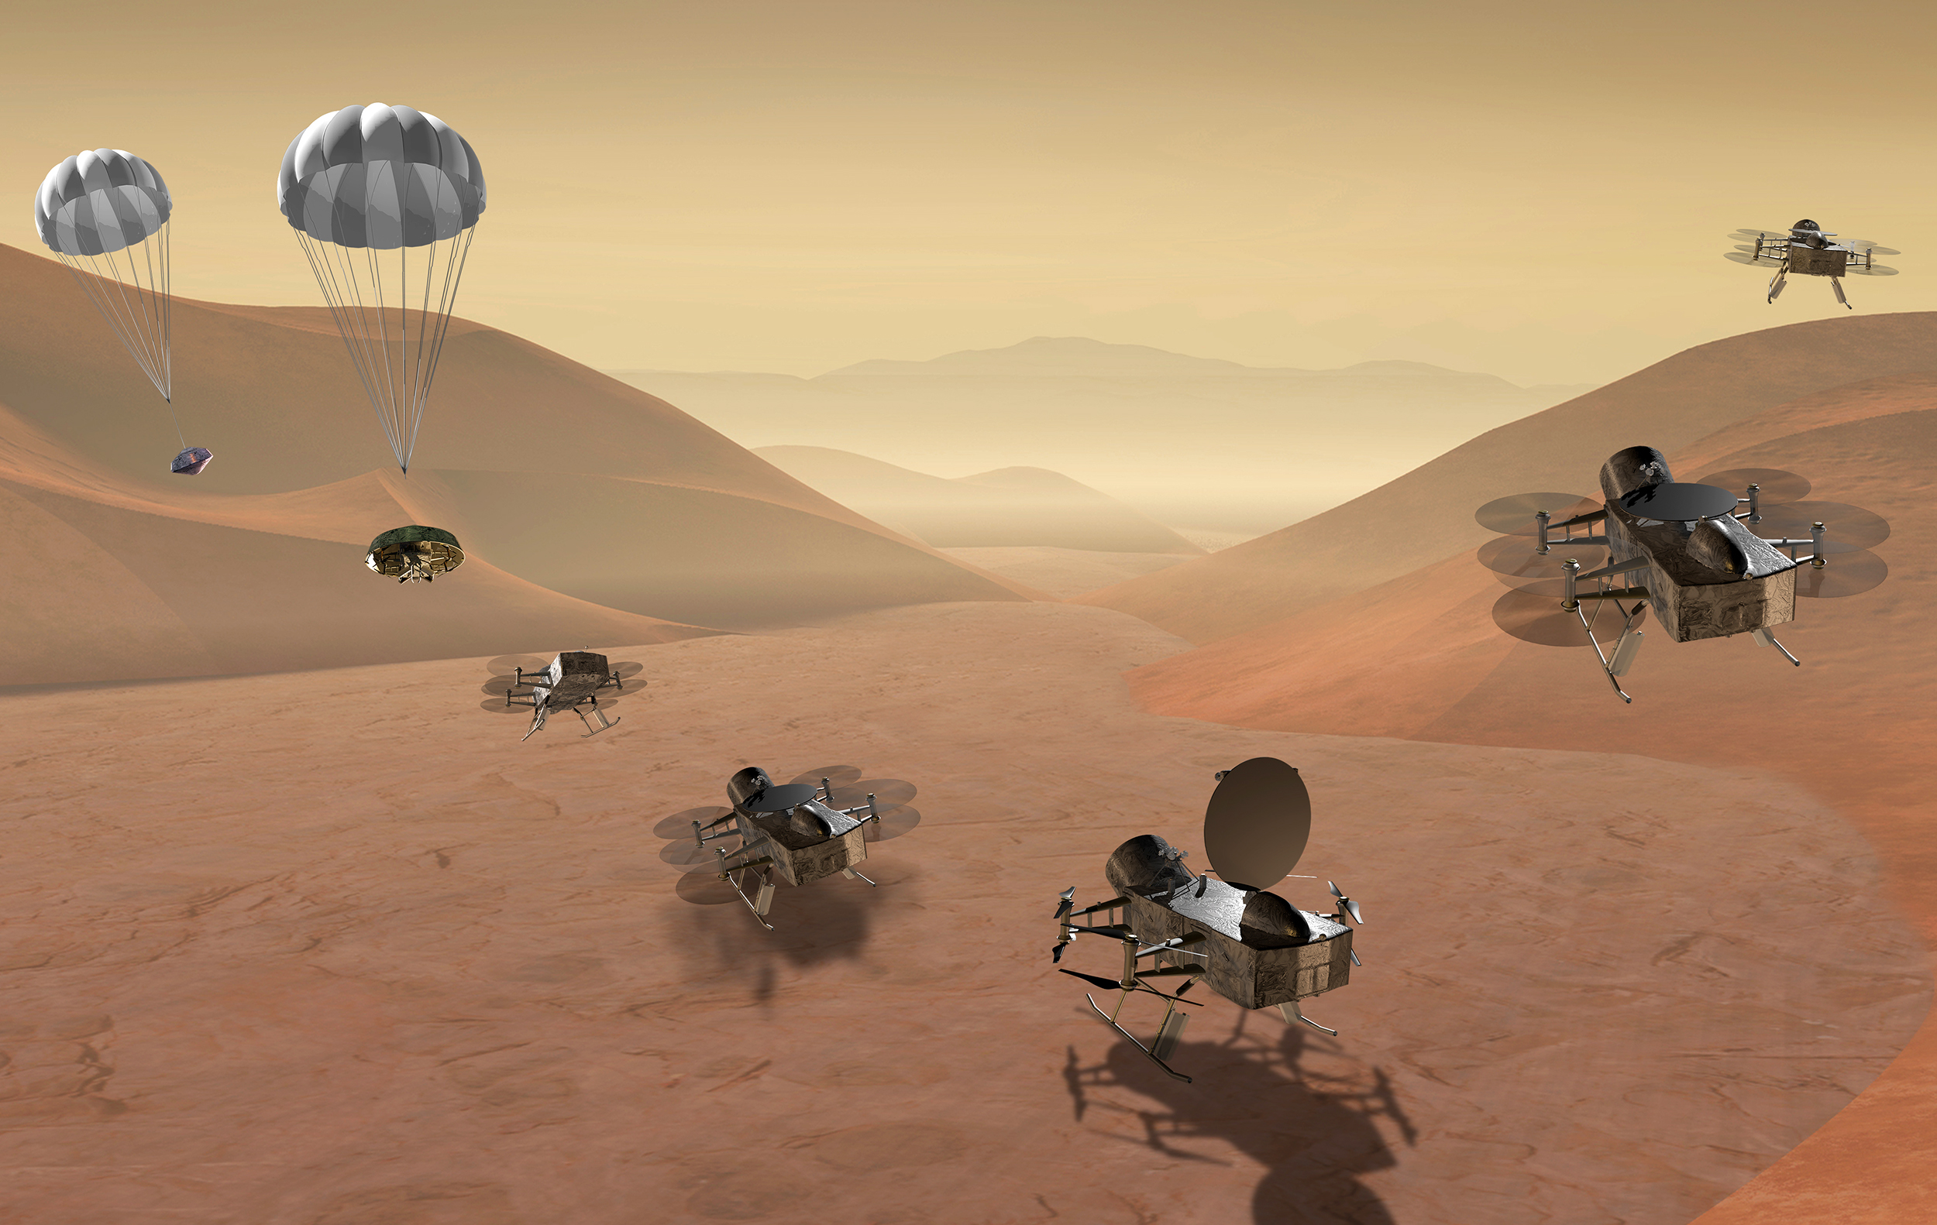
DEEP SPACE DRONE II.
https://www.nbcnews.com/science/space/flying-space-probe-will-look-life-saturn-rcna1740

Slide 17
THANK YOU VERY MUCH YOUR ATTENTION!

