Slide 1
Emergency Management & Humanitarian Aid
Satellite-based Services for DRM – in beautiful Budapest 18/07/2023
Vasilis Kalogirou, PhD, Market & Downstream Innovation

Slide 2
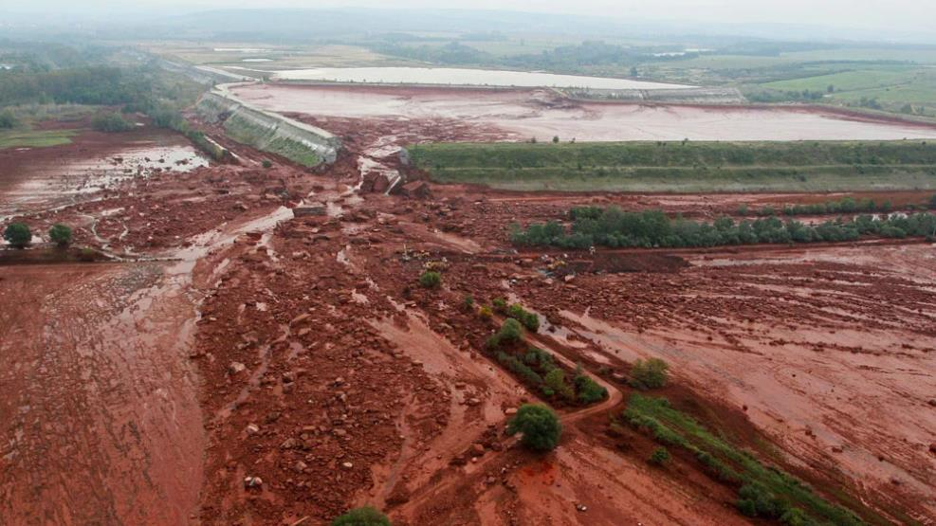
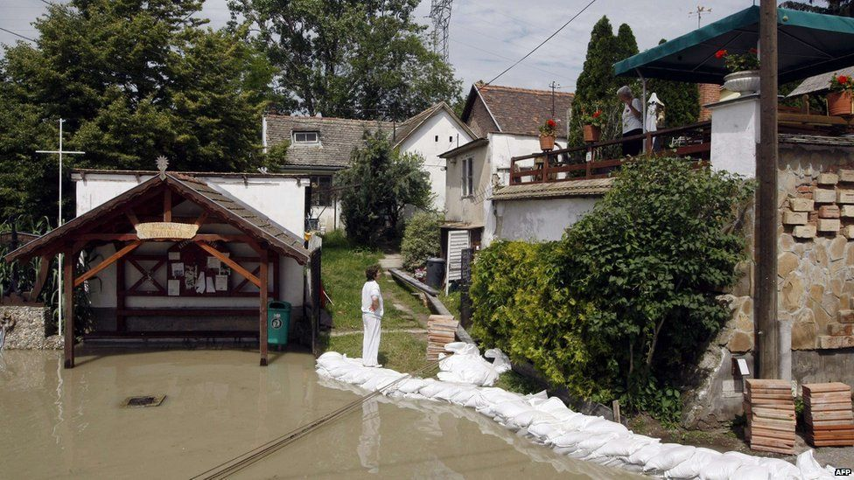
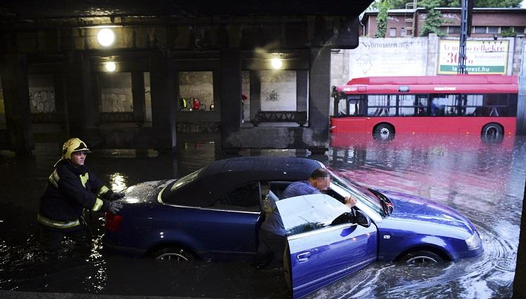
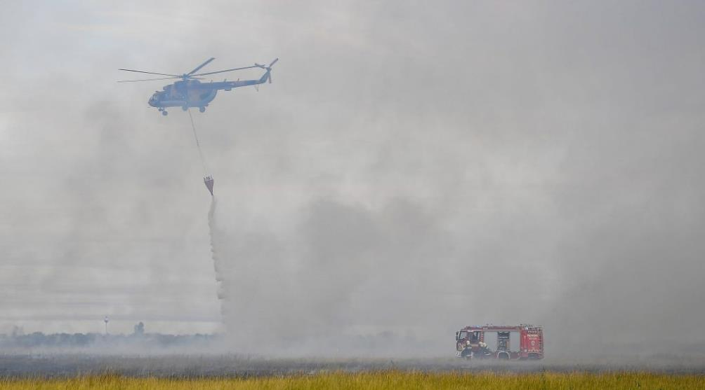
2010
2013
2013
2017

Slide 3



EU Space Programme for disaster management applications
Copernicus
Operational Copernicus Services -> Emergency Management Service, C3S etc.
Galileo/EGNOS
Supporting downstream development with cloud-based infrastructure
Navigating responders (and vehicles/drones) on the field
Receivers accurately detect earthquakes, landslides, land deformations etc.
Enable crowdsourcing applications (geo-tagged images)
GOVSATCOM/IRIS²
Connectivity to first responders and humanitarian aid actors, enabling secure and resilient communication and data transmission services
Delivering a treasure of free, open and accessible Copernicus data to understand and quantify risk - detect and monitor hazards

Slide 4


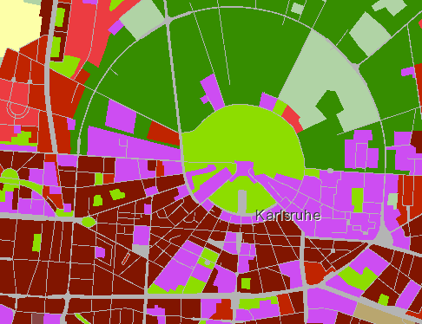
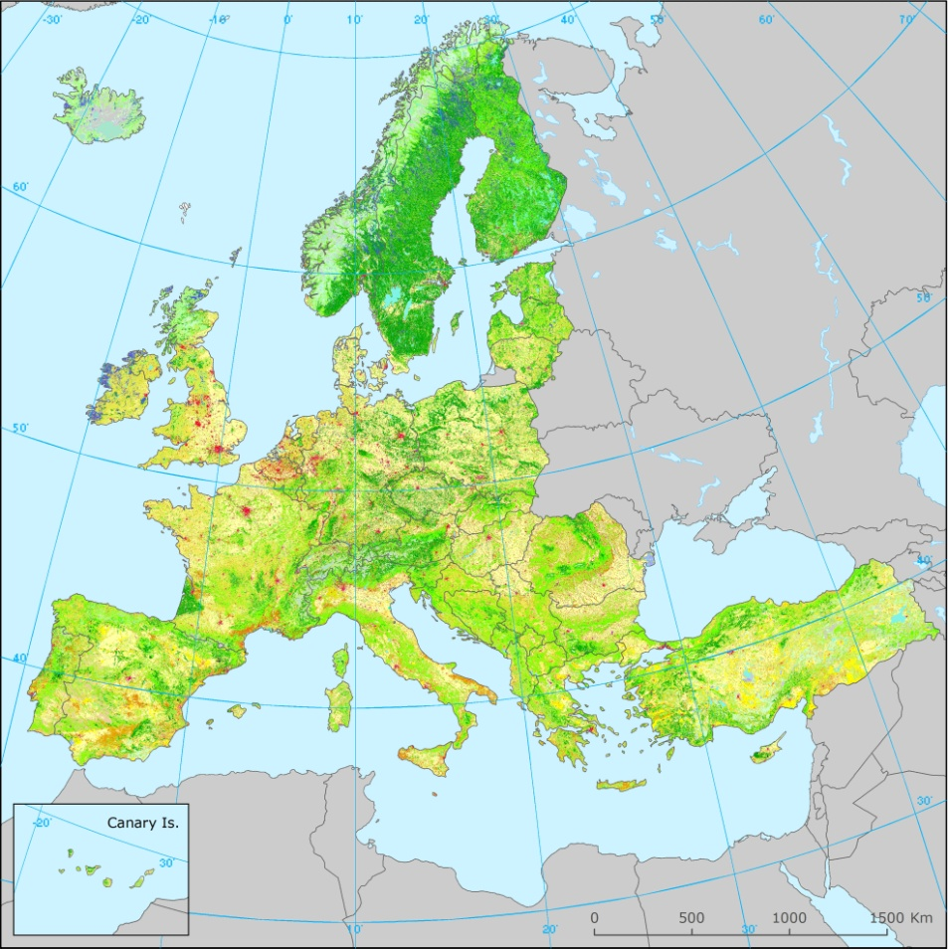

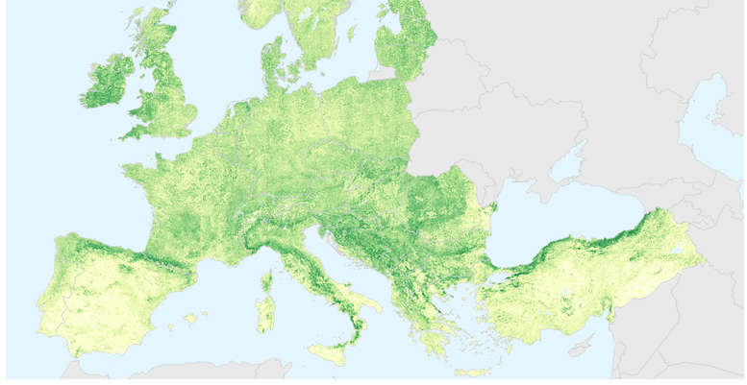
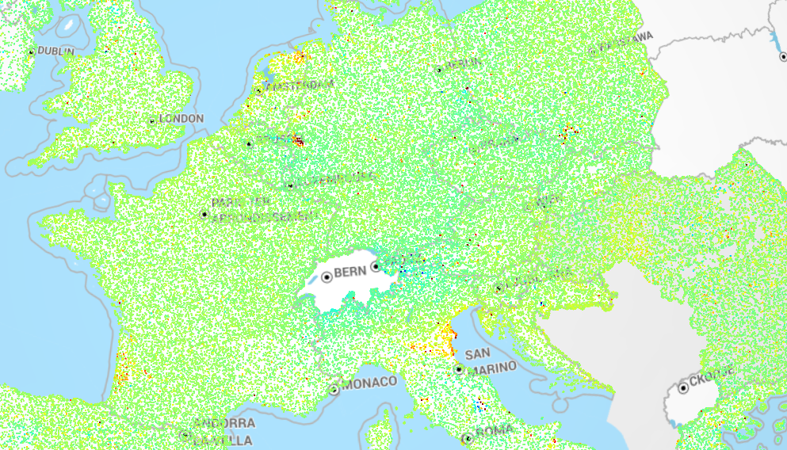

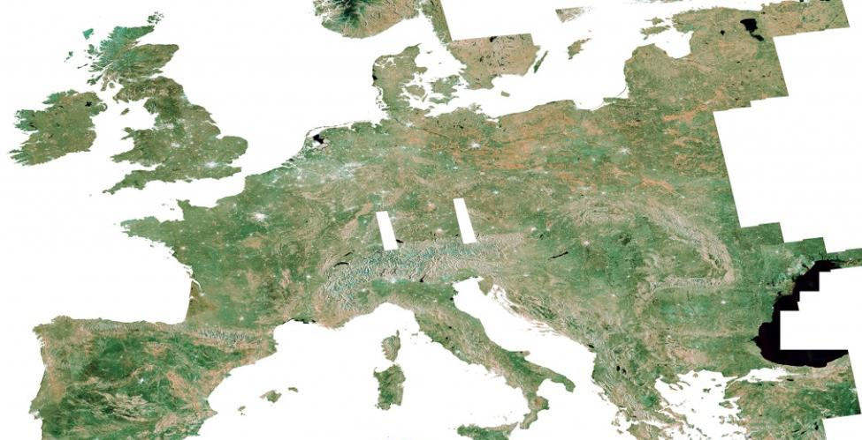


Copernicus for DRM
Emergency Management Service
Land Monitoring Service
Preparedness: forecasts
Response: rapid maps & monitoring of events
Recovery & prevention: risk assessment for specific hazards and post-disaster recovery maps
Priority Area Monitoring
Land Cover & Land Use mapping
For further information:
JRC-LIST-E1-MAPPING@ec.europa.eu
Biophysical Parameters
European Ground Motion Service
Climate Change Service
Image mosaics, In-situ, Ref.data
High-quality climate data through Climate Data Store (CDS)
Observations – forecasts - projections
For further information:
copernicus@eea.europa.eu
For further information:
climate.copernicus.eu

Slide 5
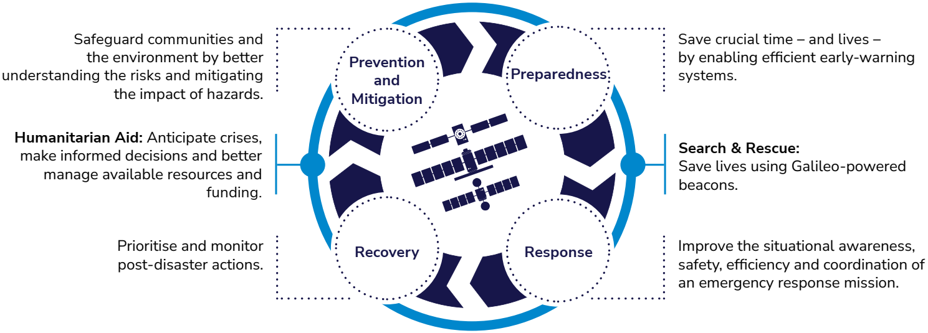
Emergency Management & Humanitarian Aid Market Segment
Notes:
Segment-level objectives
Foster and reinforce wide adoption of all relevant EU Space Programme components, by the EMAid actors;
Support market offer in the EMAid segment with the creation of innovative downstream applications that leverage EU Space Programme components, and their synergies;
Guarantee comprehensive EMAid market and user knowledge, as a fundamental base for collaboration with other stakeholders and as a principal input for objectives above.

Slide 6
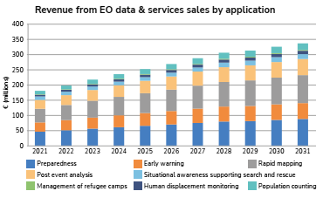
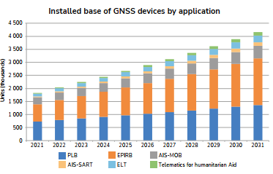
EMAid: An expanding market

Slide 7
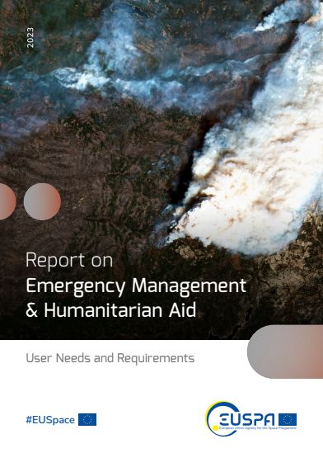
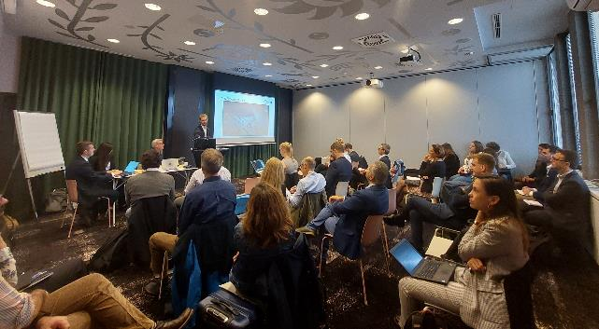
Connecting with user communities EUSPA User Consultation Platform
2nd Call
UCP 2022 -> 500 participants
Sessions on Emergency Management & Humanitarian Aid
Critical Infrastructures applications
https://www.euspa.europa.eu/newsroom/news/euspa-releases-user-consultation-platform-2022-reports

Slide 8







Connecting with user communities EUSPA User Consultation Platform
Landslides and terrain deformation monitoring
Post-crisis damage assessment and building inspection
Asset Monitoring in Humanitarian Aid operations
Health and medicine response and coordination
https://www.euspa.europa.eu/newsroom/news/euspa-releases-user-consultation-platform-2022-reports

Slide 9
Connecting with user communities EUSPA User Consultation Platform
Reducing GNSS power consumption
Real-time status and position reporting
Jamming and spoofing of GNSS signals affecting safety and security
Needs for frequent satellite observations
Needs for timely EO data delivery and shorter cut-off times
Awareness and accessibility of EO data still reported as a barrier for adoption/use
Complexity of “EO language”
https://www.euspa.europa.eu/newsroom/news/euspa-releases-user-consultation-platform-2022-reports

Slide 10
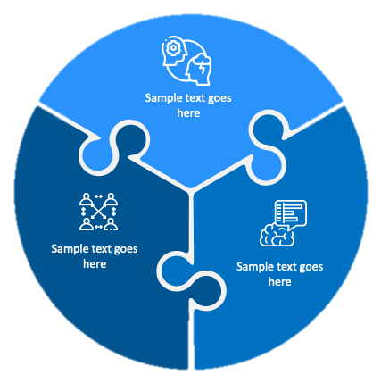


Acting on the user needs for Disaster Risk Management
Proof of Concept on Emergency Preparedness and Early warning of Floods
Copernicus
Demonstrators
Kick-off this year
Horizon
Europe
calls
Project
portfolio
GOVSATCOM topics
Internationalizing Copernicus solutions
Further develop the downstream
Past portfolio: e.g.
Current projects: e.g.,

Slide 11
EUSPA Horizon Europe – next call
Opening: October 2023
Type of Action | Topic | Indicative budget (EUR mln)
IA | EGNSS - Transition towards a green, smart and more secure post-pandemic society | 3.5
IA | EGNSS - Closing the gaps in mature, regulated and long lead markets | 8
RIA | Copernicus-based applications for businesses and policy-making | 7
RIA | Designing space-based downstream applications with international partners | 6
IA | EU GOVSATCOM for a safer and more secure EU | 10
Total budget: |  | 34,5

