Slide 1


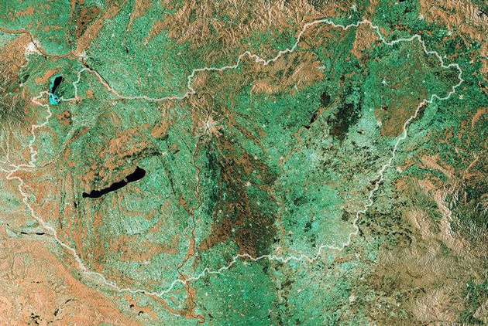





Satellite-based Services for Disaster Risk Management
18th July 2023
14:00 - 18:00 CET
National University of Public Service
Budapest, Hungary
Hungarian Ministry of Foreign Affairs
and Trade
Department for Space Policy and Space Activities

Slide 2
GOVSATCOM and disaster management
Georgios Synnefakis
GOVSATCOM Programme Manager, EUSPA

Slide 3
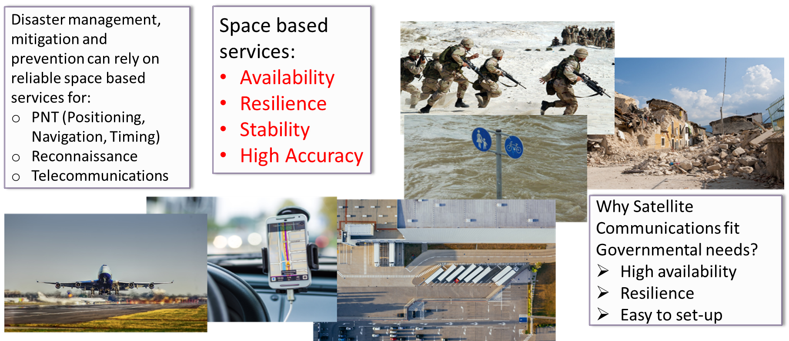
Space based solutions for disaster management

Slide 4
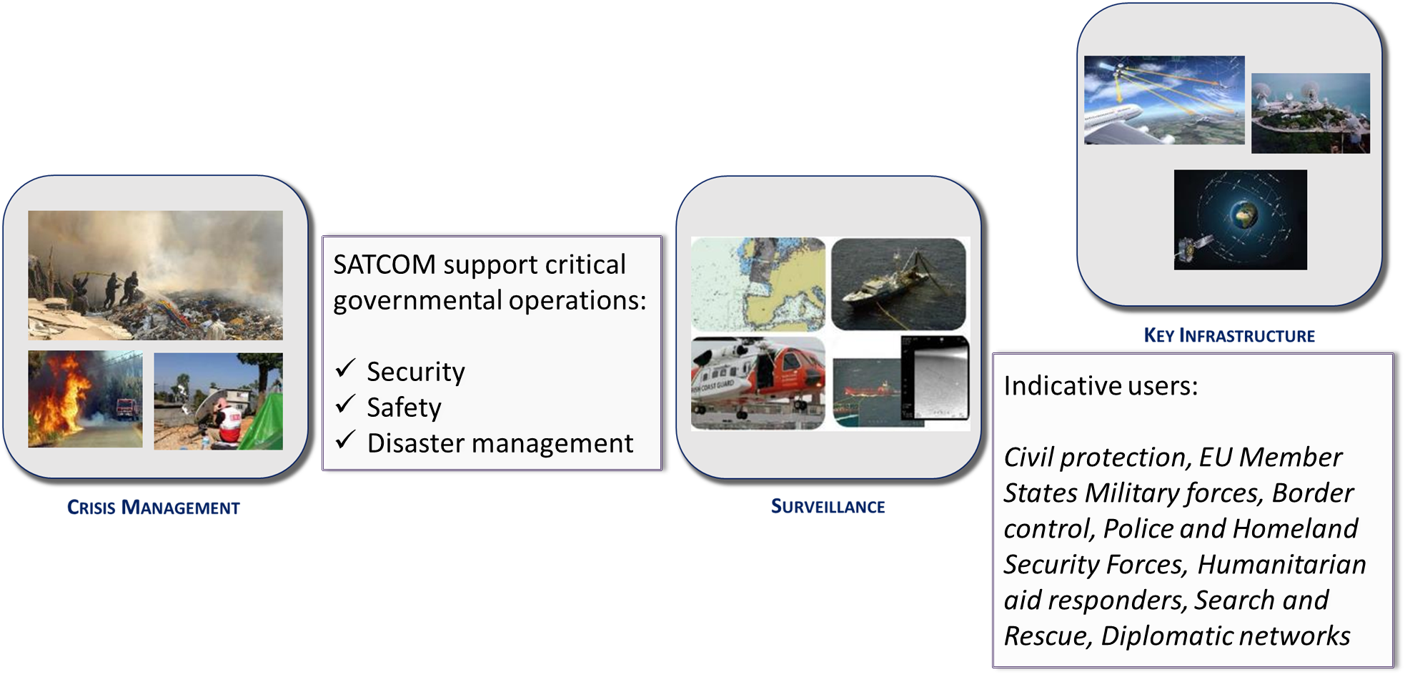
Satellite Communications and GOVSATCOM use case families

Slide 5
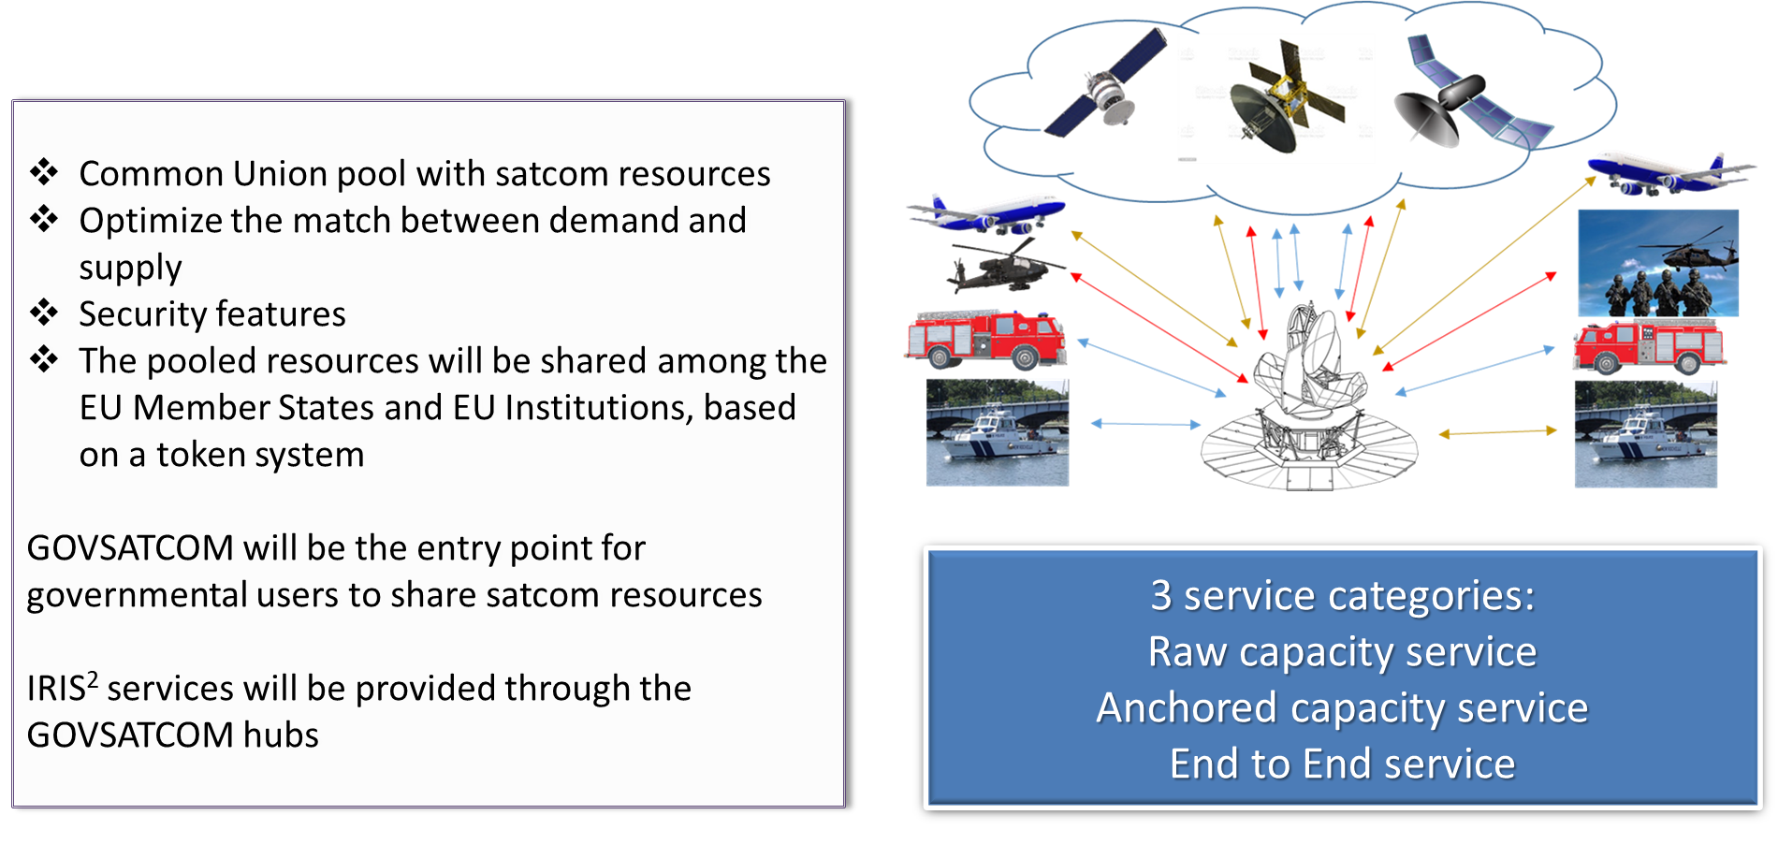
GOVSATCOM

Slide 6
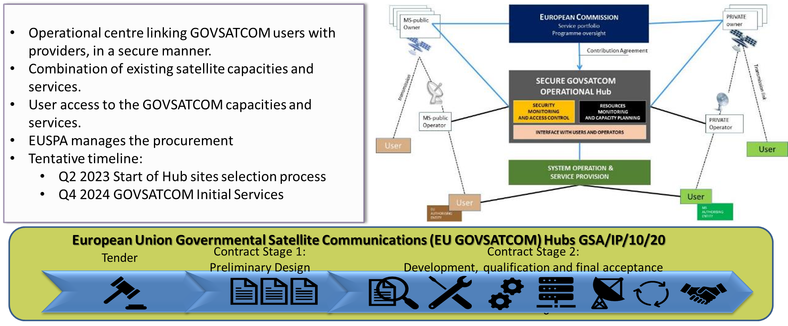
GOVSATCOM Hubs

Slide 7
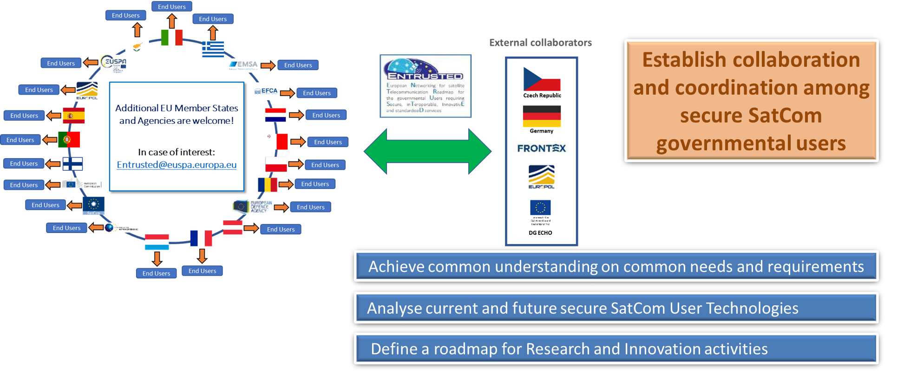
ENTRUSTED: The user network

Slide 8
Thank you!

