Slide 1
Galileo High Accuracy Service (HAS)
F. Javier de Blas – Commercial & High Accuracy Service Manager – EUSPA
EUSPA-EURISY Workshop Hungary | 18 July

Slide 2
Table of contents
What is the Galileo HAS
Galileo HAS users and applications
Galileo HAS: What comes next

Slide 3
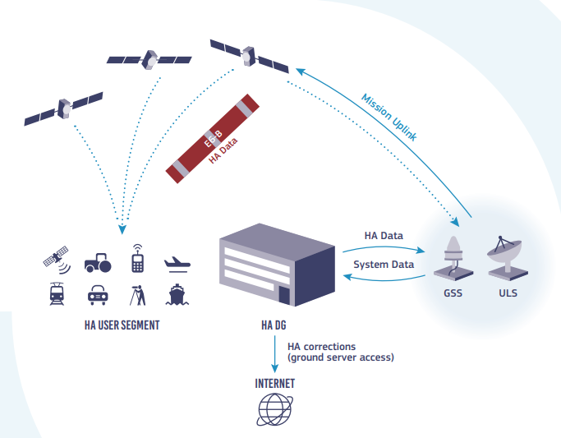
What is the Galileo HAS
Galileo HAS provides precise corrections for satellite orbit, clock and signal biases
Galileo HAS corrections distributed via
  Galileo satellites, E6-B signal (1278.75 MHz)
  Internet
Typical accuracy in the decimetre level (after convergence), with Precise Point Positioning (PPP) receivers
(Almost*) global coverage and free
*global coverage of corrections but no global performance commitment yet

Slide 4
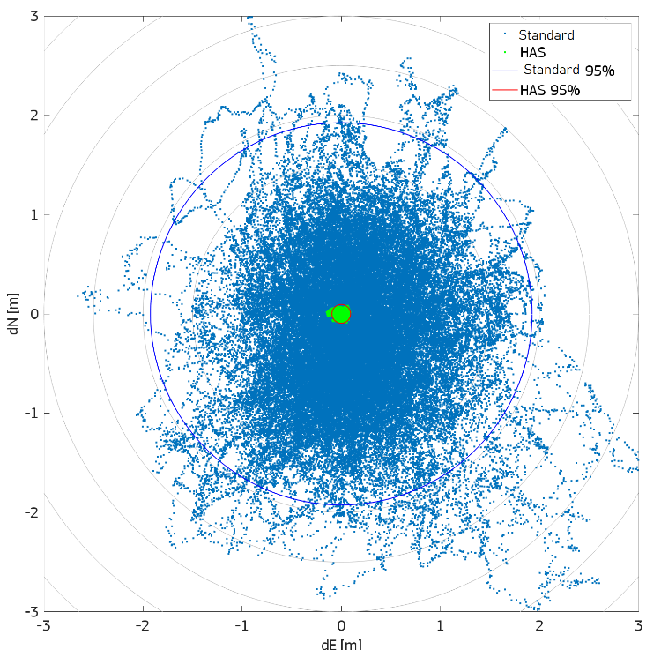
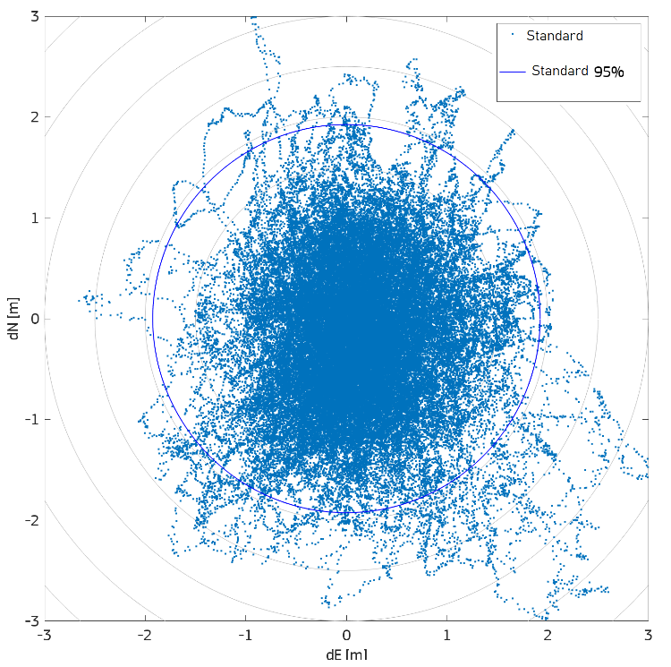
What is the Galileo HAS
Galileo HAS provides precise corrections for satellite orbit, clock and signal biases
Galileo HAS corrections distributed via
  Galileo satellites, E6-B signal (1278.75 MHz)
  Internet
Typical accuracy in the decimetre level (after convergence), with Precise Point Positioning (PPP) receivers
(Almost*) global coverage and free
Galileo/GPS single epoch standard positioning vs. HAS positioning
Horizonal position error, JRC, Ispra (IT), 7/Sept/2022
(Gal E1-E5b/GPS L1CA-L2C single epoch solution vs.HAS float solution)
Standard horizontal accuracy 95%: 1.925 m
HAS horizontal accuracy 95%: 0.094 m

Slide 5









What is the HAS – Ground Infrastructure
GNSS Service Center
/ HA data generator
Service development and validation
Operations and Maintenance
Security Accreditation
Service Provision – user’s interface
14+1 Galileo sensor stations
Ground Control Centers
Up-Link Stations
Space segment
Support to experimentation and Validation

Slide 6
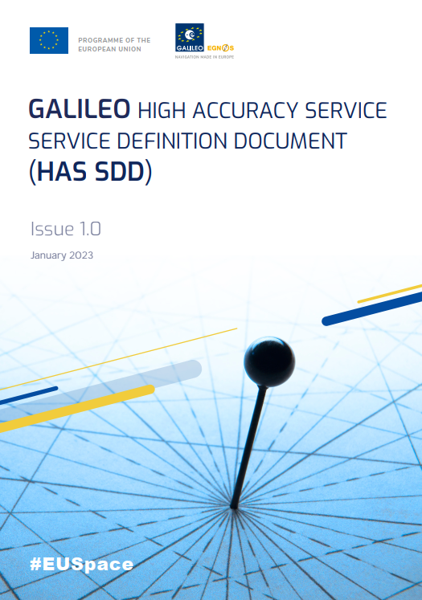
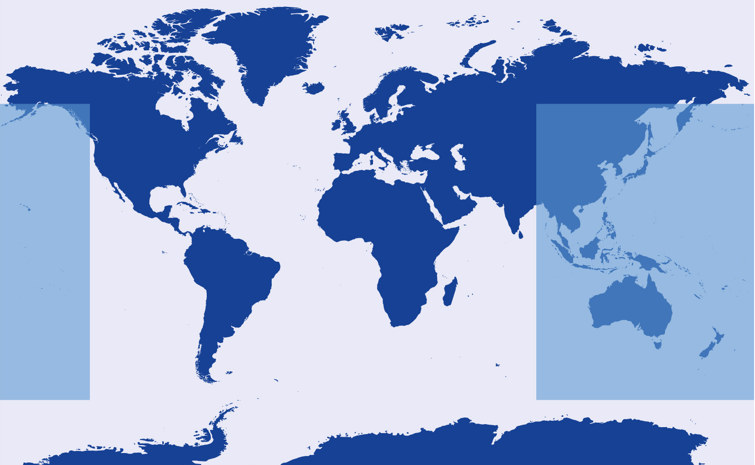
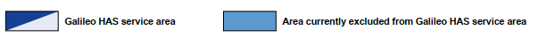
What is the HAS – Initial Service Area
European Union Agency for the Space Programme (EUSPA), HAS SDD [Online]:
https://www.gsc-europa.eu/sites/default/files/sites/all/files/Galileo-HAS-SDD_v1.0.pdf

Slide 7
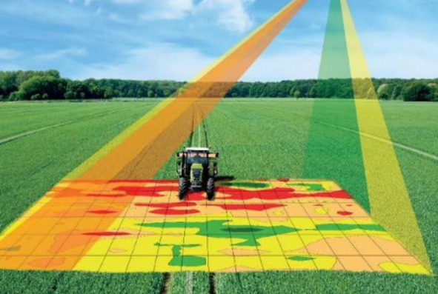
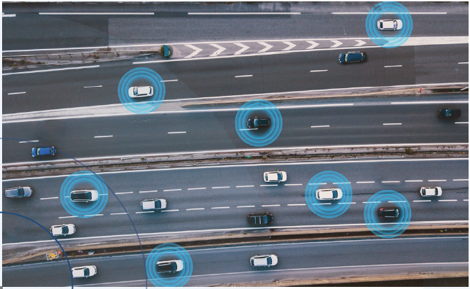


Galileo HAS Users and Applications
HAS serves a wide range of applications in different market segments, feeding innovation in transport, agriculture, geodesy, entertainment and many other sectors
Market Segment | Applications
 | GIS/Mapping. Cadastre in rural areas, hydrographic survey. Offshore exploration.
Agriculture | Guidance, VRA-low applications, farm machinery positioning, site-specific data analysis applications.
Aviation and Drones | Airport integrated surface management systems. Flight validation. Drones positioning and navigation system (urban), and geo-awareness system.
Consumer Solutions, Tourism and Health | LBS, gaming, health, AR for leisure/professional, geo-marketing, robotics.
Maritime and Inland Waterways | Merchant navigation and pilotage operations in ports. Pilotage in IWW. Port bathymetries and riverbed and coastal seabed surveys. Offshore supply vessels with dynamic positioning. Port terminal cranes and straddle carriers navigation. Autonomous surface vessels.
Rail | Cold movement detection. Odometer calibration. Door control supervision. Infrastructure and gauging surveying.
Road and Automotive | Autonomous driving, infrastructure survey.
Space and New Space | Precise orbit determination (incl. autonomous formation flying and in-orbit rendezvous and docking). Attitude determination. Civilian launchers (e.g. for precise orbit injection).

Slide 8





Galileo HAS Users and Applications
What does a user need to benefit from HAS?
GNSS data & measurements
(E1, E5…)
HAS corrections
GNSS measurements
(E1, E5…)
E6 (1278.75MHz)
Internet (3/4/5G, WiFi…)
HAS corrections (NTRIP)
PPP algorithm
PPP algorithm
Standalone mode
(Sat Signals in Space)
Assisted mode (HAS via internet)
Users will need a GNSS (Gal/GPS) E6 capable or connected RX with a PPP algorithm

Slide 9



Galileo HAS Users and Applications
EU is supporting the early development of HAS prototype RXs since years:
  F.E projects: Fantastic, eMAPs, ERASMO, ACCURATE… 9 projects
  H2020 projects: GISCAD-OV, PrepareShips, ESRIUM… 5 projects
  HAUT: HAS reference algorithm and user terminal used for the HAS Service Validation.
HAS early testing with dedicated test infrastructure enabling the development of HAS prototypes by key stakeholders in 2021/22:
AALECS: HAS demo and receiver prototypes. Transmitting SIS HAS corrections since 2021.
PAULA: HASlib, a public python library to decode the HAS SIS message: (https://github.com/nlsfi/HASlib)
GNSS E1/E5/E6 Signal or Internet connected receivers are already available

Slide 10

Commercial receivers hit the market following the Service Declaration
As per information managed by EUSPA on 20th June 2023
We would be delighted to consolidate the list. Contact us!
Manufacturer | Model | Segment or applications | Status
ANAVS | Multi-Sensor RTK/PPP Module | Autonomous Vehicles, Robots, UAVs and Vessels | Available
BeyondGravity | PODRIX | Space, LEO POD | Available (TRL 7)
BeyondGravity | NavRIX PinPoint | Space, LEO POD | Available (TRL 7)
EOS | Arrow Gold+™ | GIS, mapping, maritime pilotage | Available
Rokubun | SPEAR (SW engine) | Road, robotics, LBS, agriculture or IoT | Available
SpaceOpal | HAUT | HAS validation: surveying, maritime, machine control, aviation | Available (licensing process from EC underway)
ComNav |  | Maritime, int. driving, agriculture, GIS | Under development
Unicore Comm. |  | Surveying and mapping, agriculture, UAVs, and autonomous robots | Under development
Hemisphere |  | GIS, agriculture, and machine control | Under development
Hemisphere |  | Agriculture, machine control, marine, OEM | Under development
Bad Elf |  | Mapping and surveying | Under development
Deimos | G3STAR | Space, POD | Under development
Note: readiness of Receivers as stated by manufacturers (i.e. not tested by EUSPA)

Slide 11
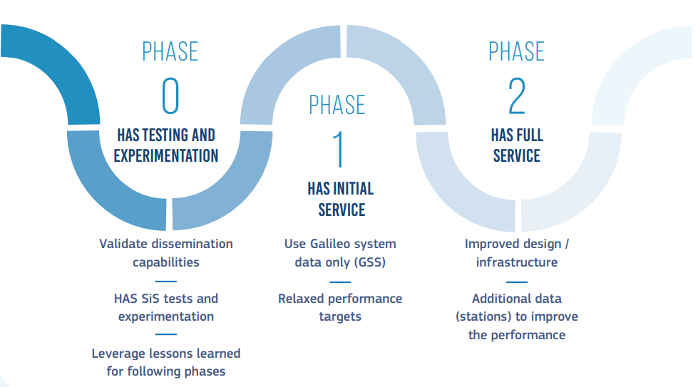
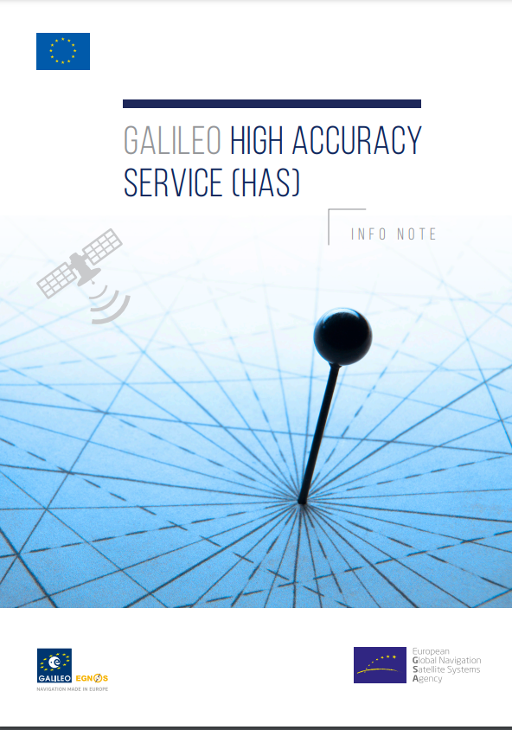
Galileo HAS
What comes next?
    Short-term: use it!
      User segment development
        More HAS-enabled receivers
        HAS R&D actions
        HAS Reference Algorithm publication
      HAS based applications development
    Mid / long-term: HAS Full Service
      Increased global performance (e.g. better accuracy)
      Faster positioning in EU (atmospheric corrections)
      HAS authentication and error characterization
https://www.gsc-europa.eu/electronic-library/programme-reference-documents

