Slide 1
e-shape – Reusable knowledge and EO applications contributed by EuroGEO

Slide 2








e-shape - EuroGEO Showcases Applications Powered by Europe
European Commission H2020 contribution to EuroGEO
15M€, 68 partners, 37 pilots in 7 showcases
4 years grant (2019-2023)
ARMINES (France) coordinator – e-shape.eu
Promoting users’ uptake of European Earth Observation (EO) resources
Building on Copernicus and GEOSS through the development of co-design pilots
Built on a user-centric approach to deliver economic, social and policy value to European citizens

Slide 3
e-shape in numbers – Towards reusable knowledge
68 partners / 37 Pilots / EUR 15 million / 4years
2 on-boarding phases (10 pilots)
26 user uptake workshops
15 Executive Board meetings
165 PMT meetings held (3.2/month)
16,000 emails exchanged in 17 mailing-lists
85 deliverables reviewed
111 articles in media and magazines
37 Data Management Plan (x 2)
4 General Assembly (2 virtual) (100-200 pp. each)
8 public outreach platforms:
Web site (27,000 unique visitors)
Helpdesk
Sustainability Booster
Eowiki
EOMall
Webservice-energy catalogue
GEO Portal
GEO Knowledge Hub
Private Jira ticketing system (443 tickets)
Confluence workspace (250 users / 1,200 pages)
Social media presence
Facebook/Twitter/LinkedIn: 2400 posts
YouTube: 59 videos

Slide 4
Reusable knowledge on the shelf for the EO sector
GENERIC
THEMATIC
Data Management Plan (DMP) self-assessment tool
Co-design methodology and self-diagnosis tool
Best practice guide for EO developers,
Sustainability Booster for EO application
EuroGEO position paper
37 pilot applications in 7 showcases

Slide 5
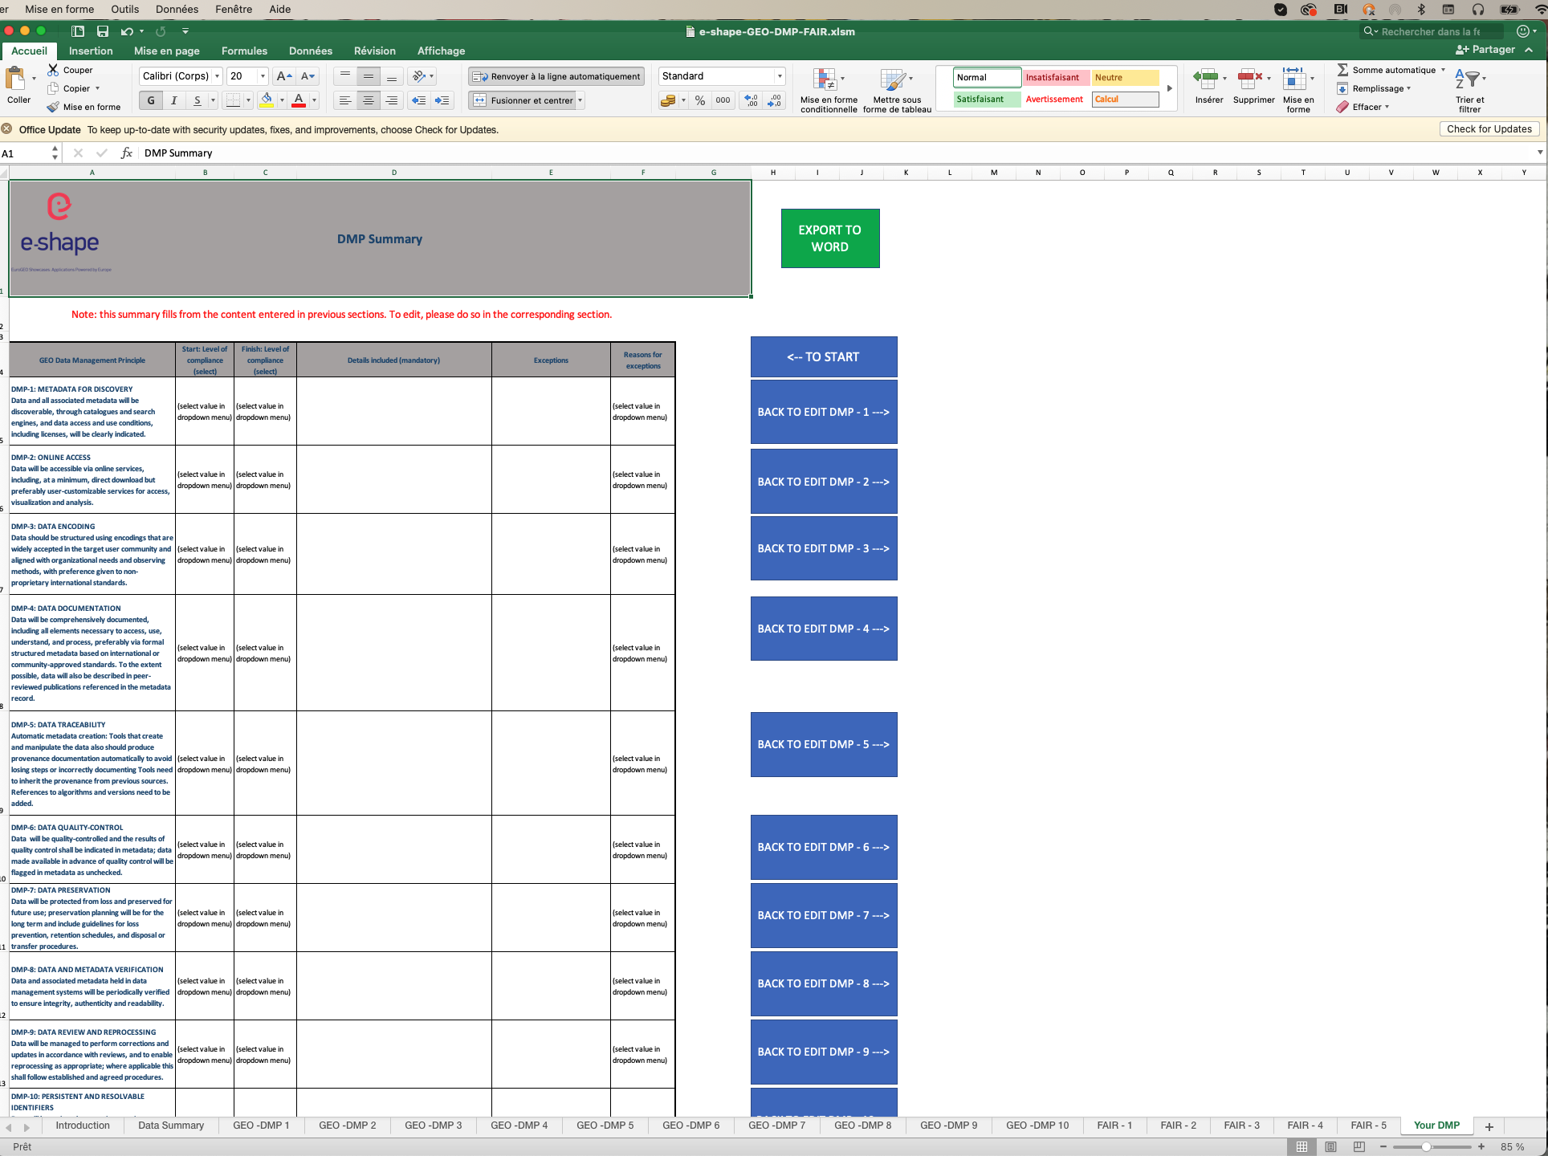
Reusable knowledge - Generic #1 - DMP self-assessment tool
Create a DMP for GEO and FAIR Principles
Tool - Excel package (Macro)
Free, open, simple and easy to navigate
10 GEO DMPs
5 FAIR Principles
Based on self-assessment (Pilot or project)
Provide recommendations and guidance’s
Allow templating (Look & feel)
Tested and validated on 37 pilots (X2)
Available as a package on the GKH
Next: Machine-actionable DMP
Open position for 6 month training period

Slide 6
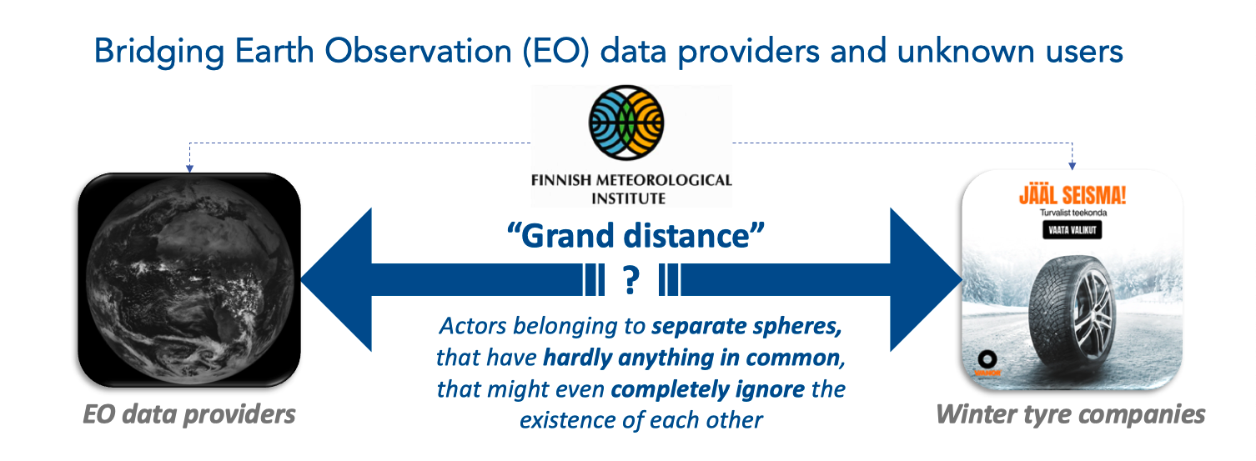
Reusable knowledge - Generic #2 – Co-design
Methodology and self-diagnosis tool
Dedicated to the EO sector
Bridge “grand distance” EO actors
Short-term seasonal forecast product
Supply chain management planning driven by temperature (0°)
How to create collective action in ‘’grand-distance’’ situations ?

Slide 7
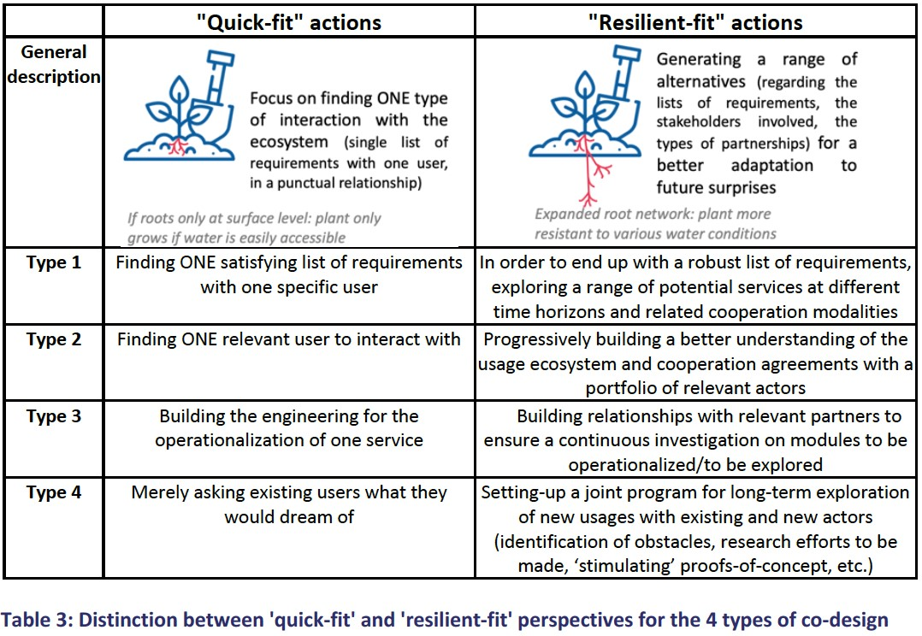
Reusable knowledge - Generic #2 – Co-design
4 types of co-designs methodology
Defined user and requirements
Unknown users to interact with
Uncertainties in operationalization
Extend the scope of usage of service
“Resilient fit” actions for long term sustainability
Diagnosis via interviews
Cycles of Workshop
Formalization of outcomes
Tool enable a self-diagnosis
Template and examples
Tested and validated on 27 pilots
3 academic papers - 1 PhD Thesis*
Part of GEO Post 2025 Strategy WG
Release as a GKH package: https://gkhub.earthobservations.org/packages/mbktp-rdv39
* Barbier, R., 2023. Collective action for bridging digital and sustainability transitions: modelling and experimenting a new form of co-design between Earth-observation data providers and unknown users. (Doctoral thesis). Mines Paris, PSL University. https://www.theses.fr/s210910 [soon to be released]

Slide 8
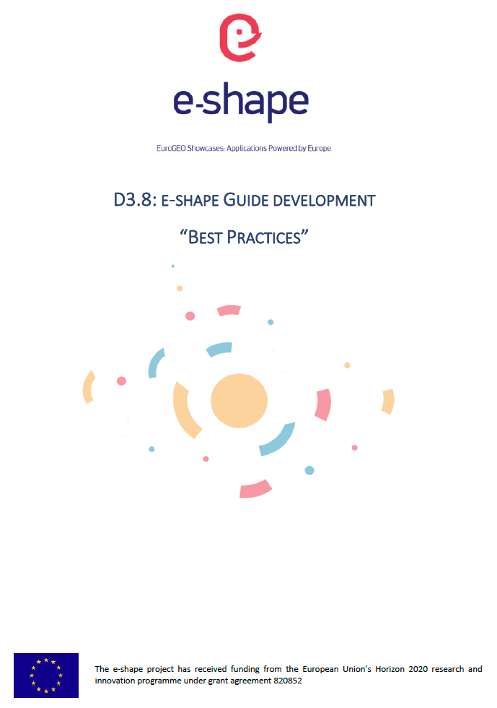
Reusable knowledge - Generic #3 – Handbook
Handbook – Best Practice Development Guide (Under final review)
Captures requirements and lessons learned
Implementation of the 37 pilots
Conducted under
1 year pilot’s initial assessment period
Monitored
2 Sprint periods (430 challenges tickets)

Slide 9
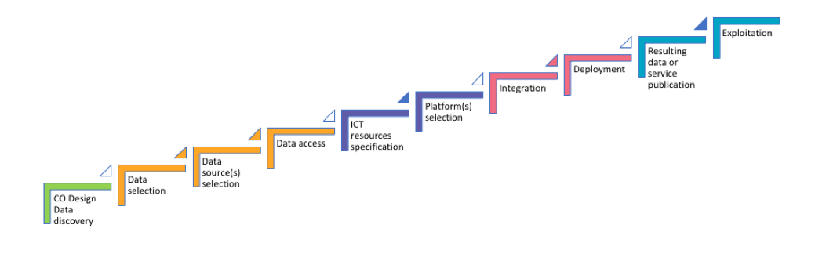
Reusable knowledge - Generic #3 – Reproducible development workflow
Based on a reproducible Pilot development workflow
Based on wealth of knowledge collected from the 37 pilots in e-shape:
Speed up the development process from the concept to a prototype and up to operations
Provides generic and reproducible workflow from data discovery to results publication

Slide 10
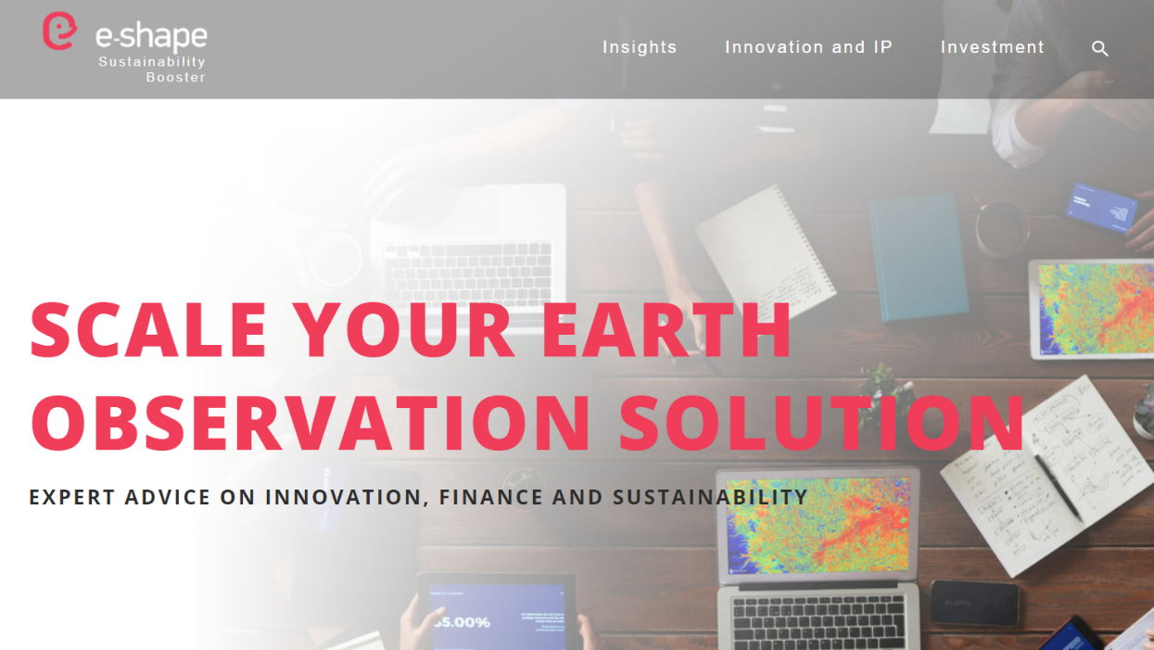
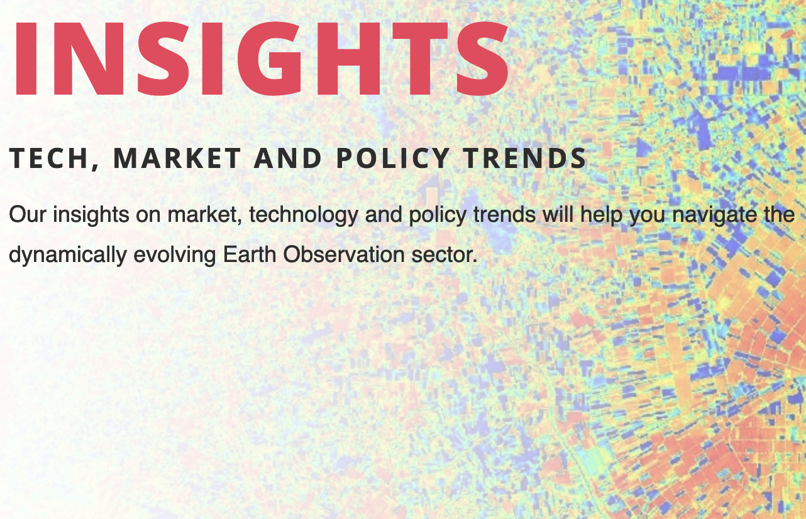


Reusable knowledge - Generic #4 – Sustainability Booster
“Enables the long-term sustainability of e-shape pilots, their penetration in public and private markets and support their upscaling”
Sustainability Booster give access to documents, videos, notices…:
Insights on market, technology and policy trends of EO sector
Agriculture, water, climate, energy, ecosystem…
IP and Innovation Office:
Guidance through the complexities of the innovation process
IP and innovation stories
FAQ on best practices, common mistakes and smart solutions
Tailored innovation support (On request)
Investment Readiness Support
Guidance to raising additional funds to grow your business
sustainability.e-shape.eu

Slide 11
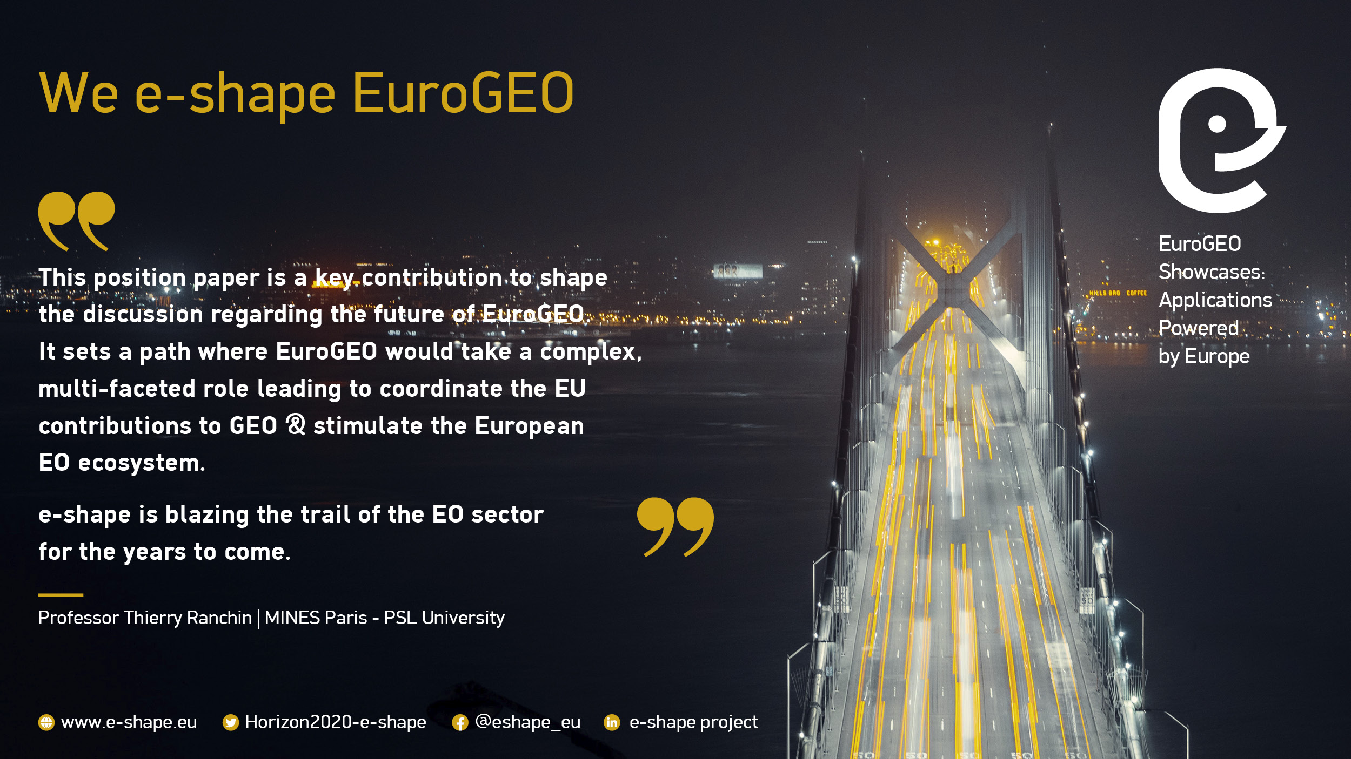
Reusable knowledge #5 – Contribution to EuroGEO
e-shape task 5.4 Governance: (2 deliverables)
Explored different options for the future governance of EuroGEO based on the e-shape experience
EuroGEO position paper (Nov. 2022):
https://e-shape.eu/images/news-events/Shaping_EuroGEO_Position_Paper.pdf
EuroGEO should endorse a multi faced role to:
Support the coordination of EU contributions to GEO
Foster partnerships between public, academic and private actors
Promote the FAIR and GEO principles
Create of an innovation pipeline in Europe
Apply to the HORIZON-CL6-2023 CSA EC call:
« Support to EuroGEO initiative coordination/establishing a EuroGEO secretariat »

Slide 12

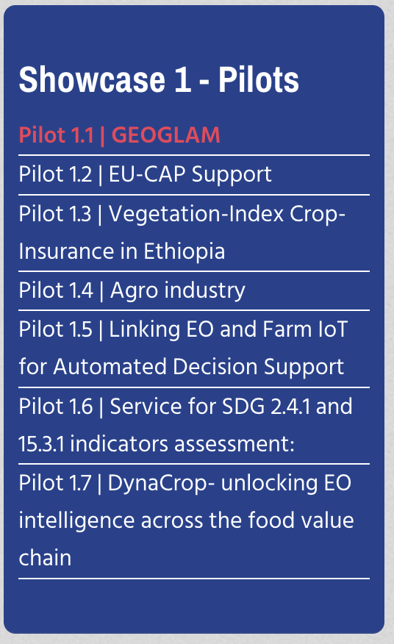
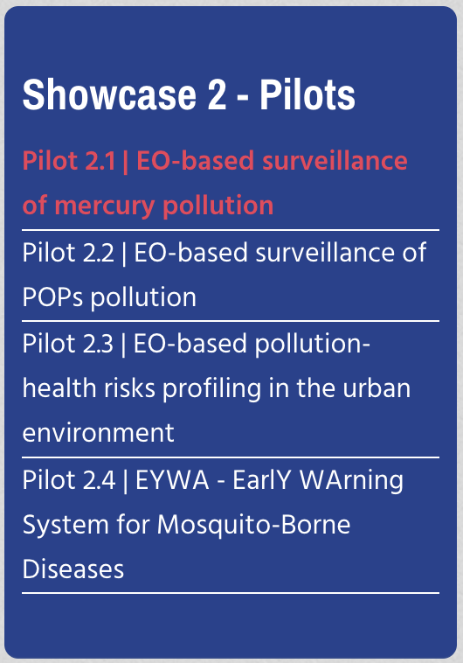
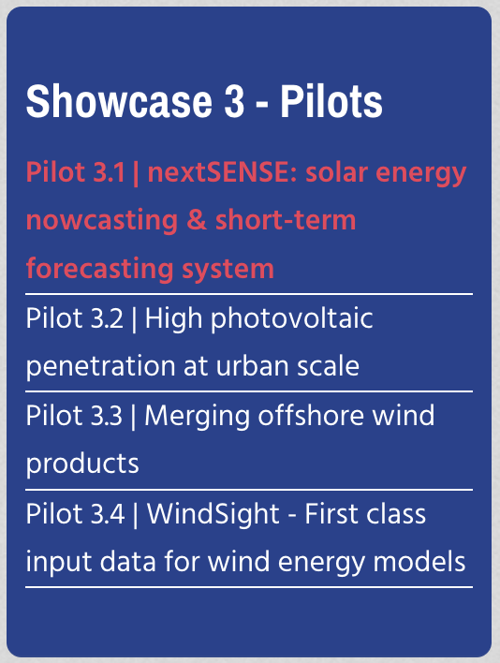
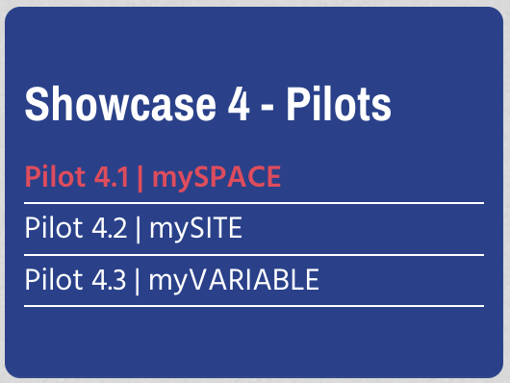
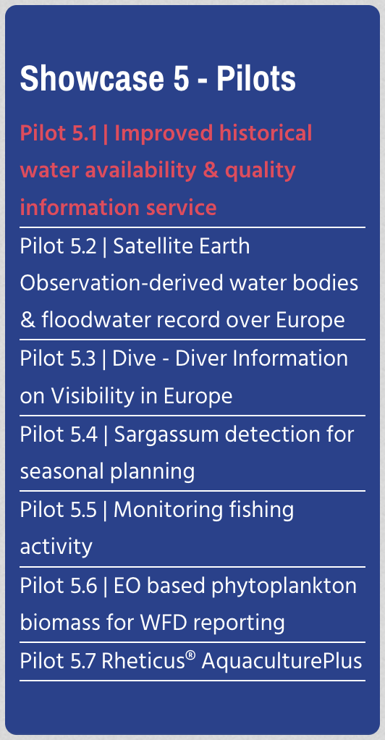
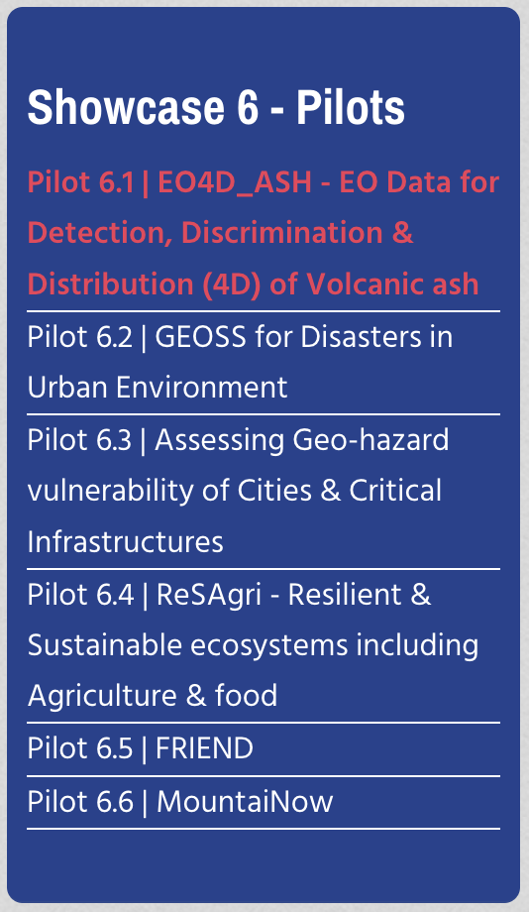
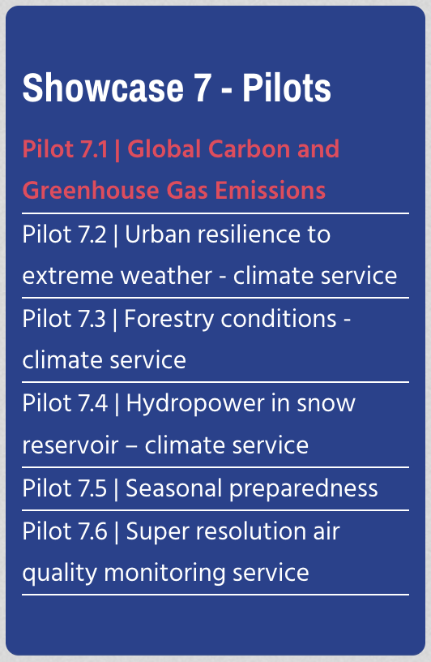
Reusable knowledge - Thematic

Slide 13
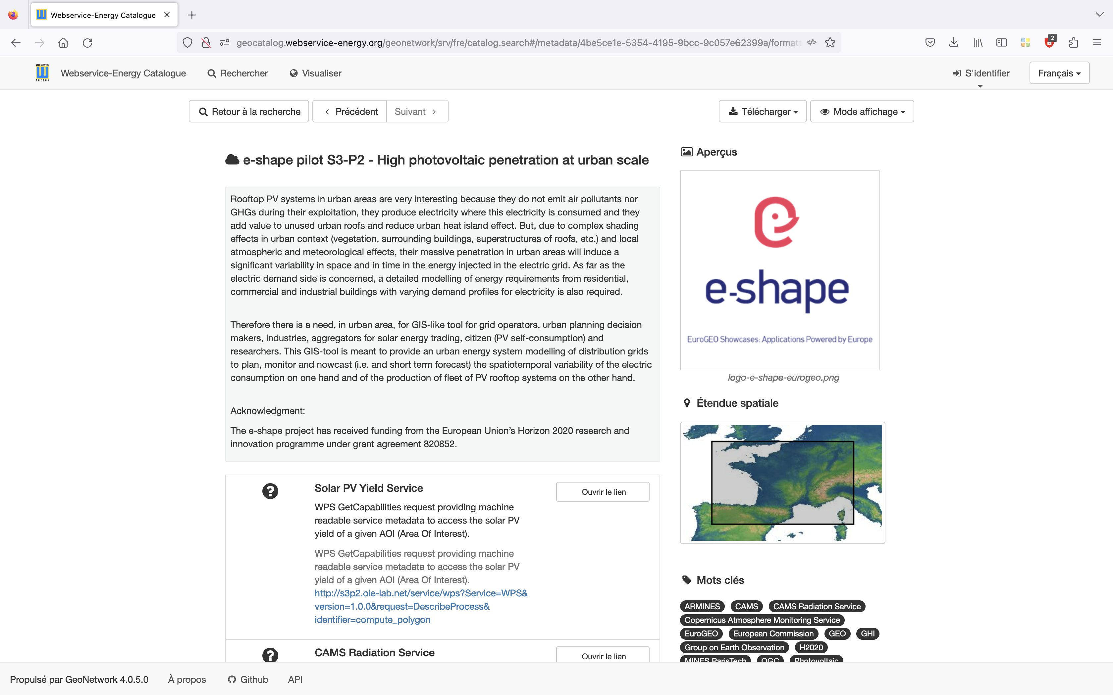
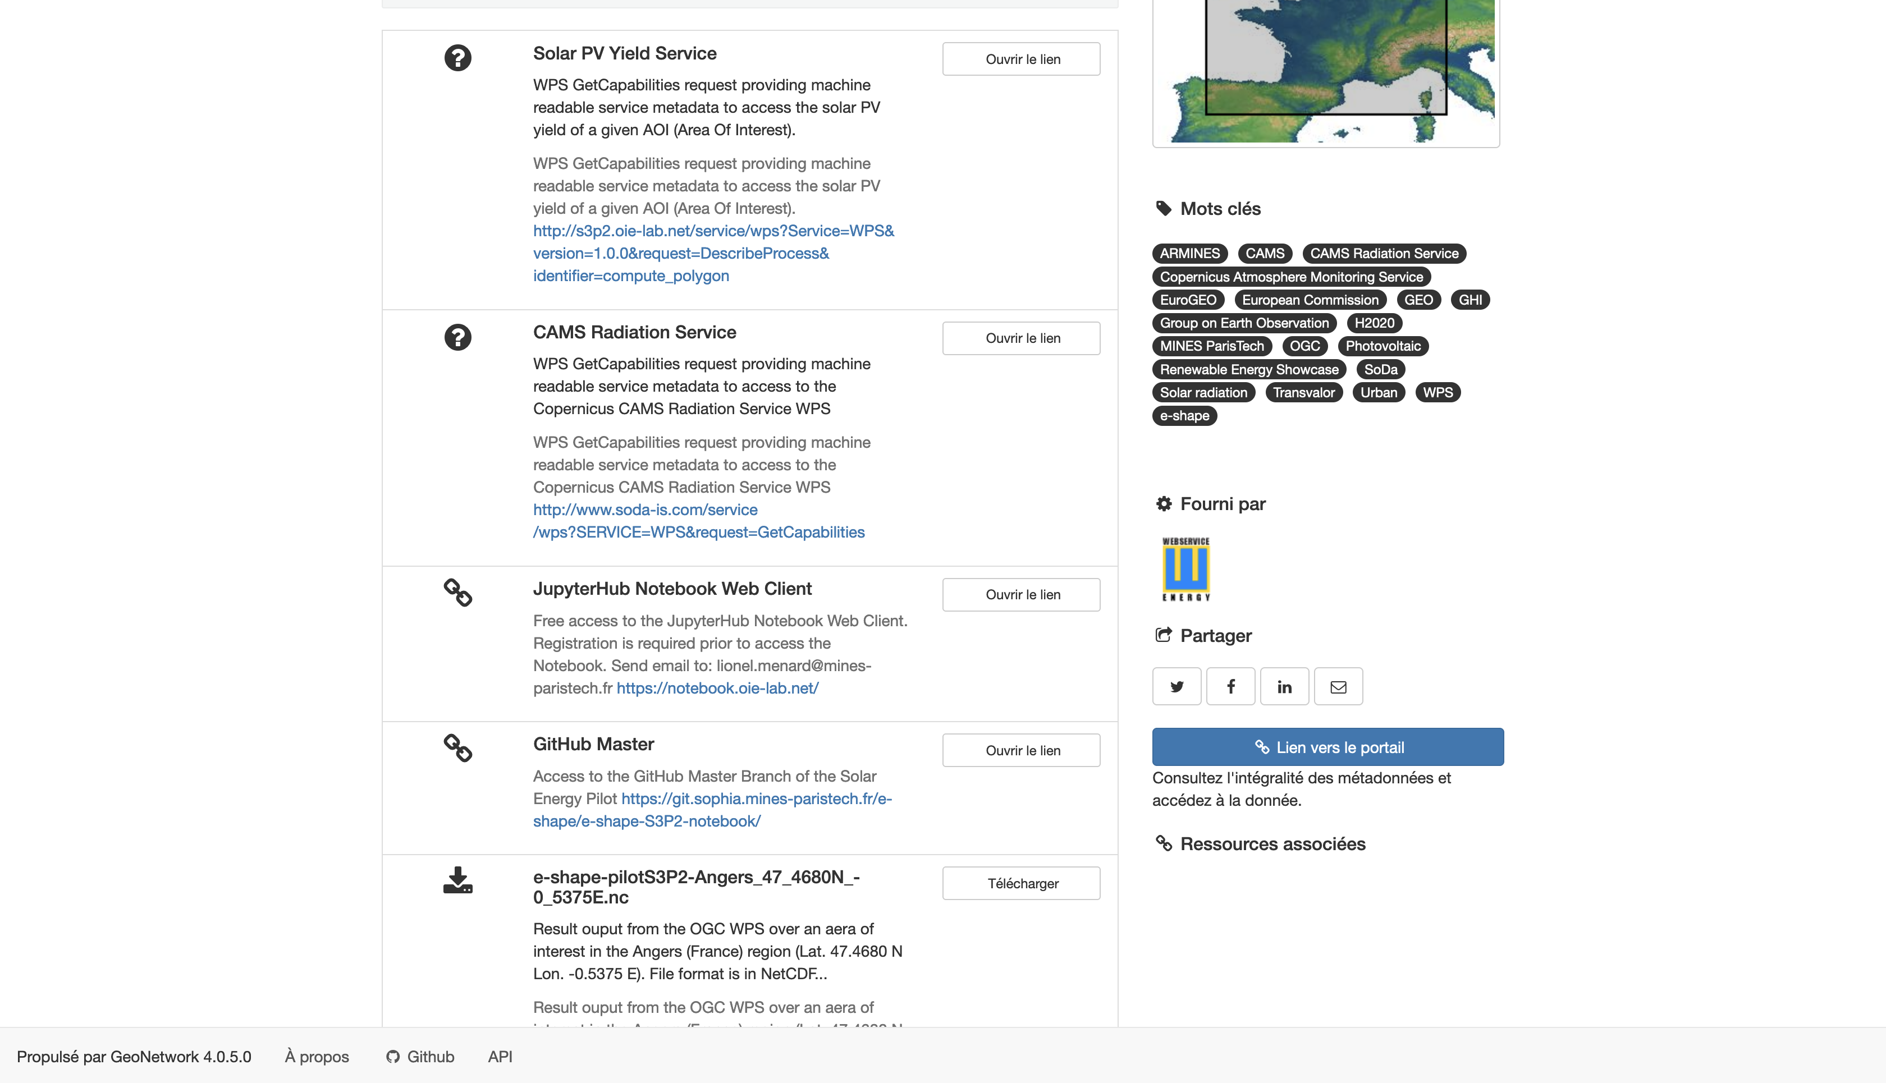
Reusable knowledge - Thematic
ISO and INSPIRE Metadata in webservice-energy catalogue
Aligned with “GKH Packages spirit”
Minimum metadata requirements
Link to the application
Link to video support
Link to e-shape web site
Additional information
Link to publication
Link to Notebook
Link to GitHub
Link to Web Service (WPS)
Harvested and visible on
GEO Portal
GEO Knowledge Hub
https://tinyurl.com/5dk34cks

Slide 14
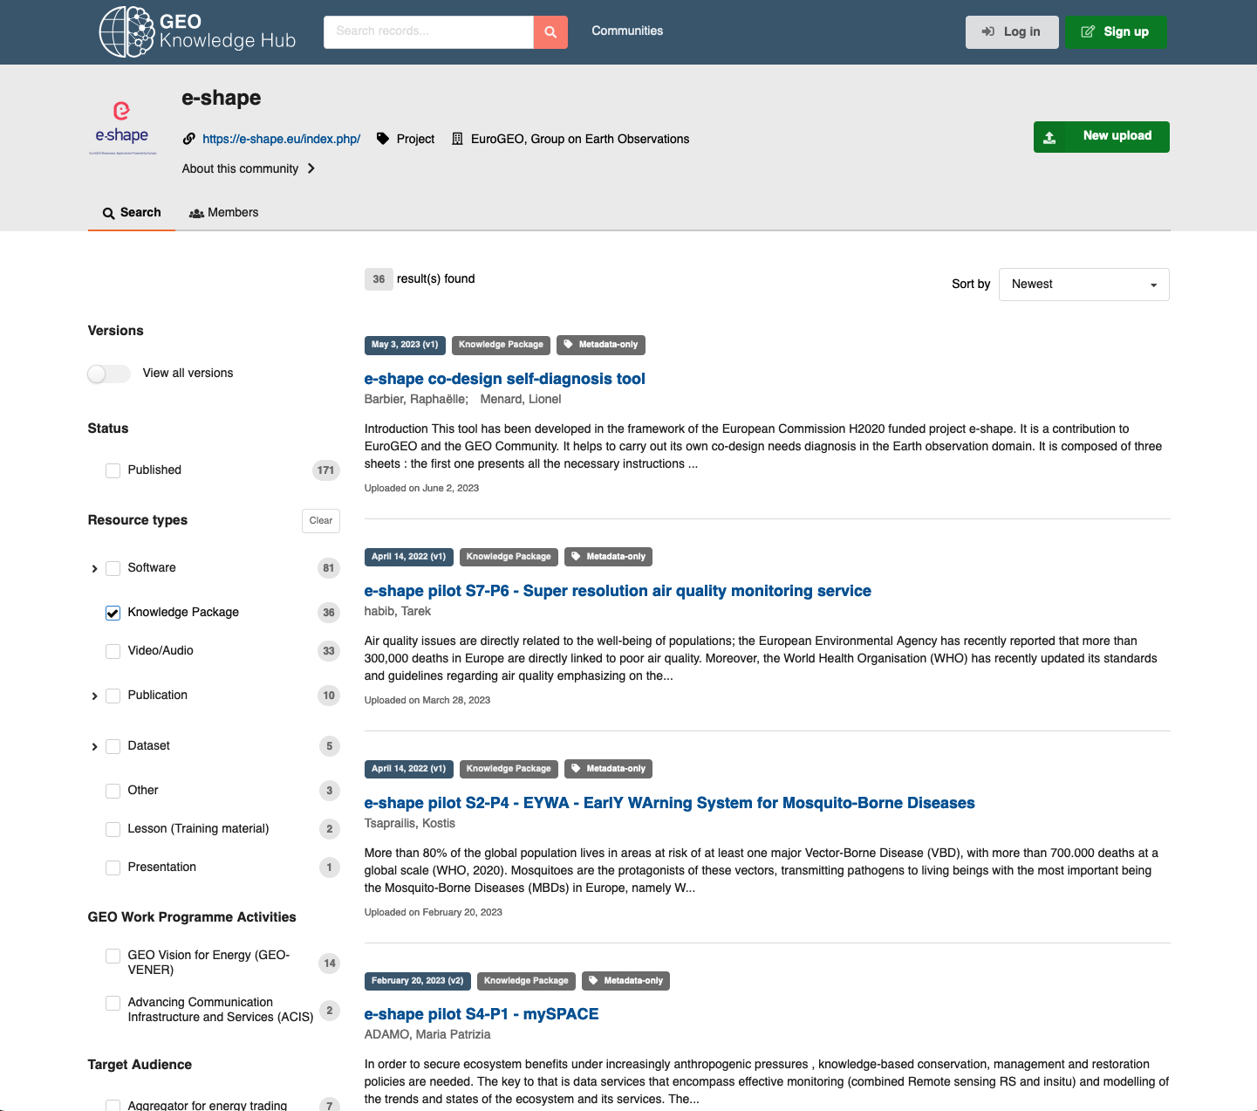
Reusable knowledge - Thematic
ISO and INSPIRE Metadata in webservice-energy catalogue
Aligned with “GKH Packages spirit”
Minimum metadata requirements
Link to the application
Link to video support
Link to e-shape web site
Additional information
Link to publication
Link to Notebook
Link to GitHub
Link to Web Service (WPS)
Harvested and visible on
GEO Portal
GEO Knowledge Hub
https://gkhub.earthobservations.org/communities/e-shape

Slide 15
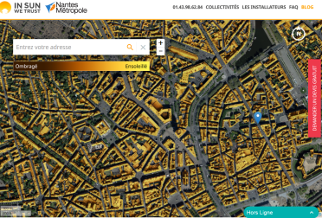

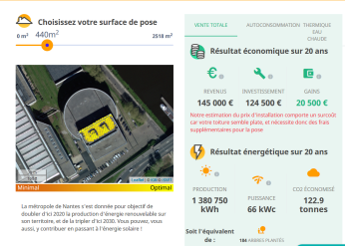



Reusable knowledge – Thematic – Copernicus Services
Pilot Solar Energy - High PV penetration at urban scale
Transition from static Solar Cadaster….
Providing free and easy-to-use tool for the general public to assess solar potential of rooftop PV systems !
Pre-computed solar map providing multi-year average yearly or monthly PV yields

Slide 16
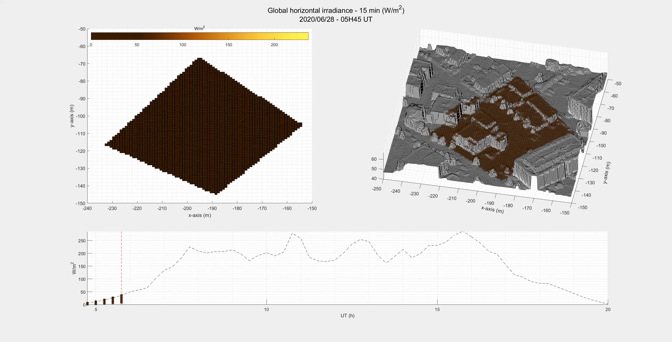
Reusable knowledge – Thematic – Copernicus
To dynamic Solar Assessment and Forecasting as a Service - (SAF-aaS)
Downscaling at urban scale solar irradiance and PV power output
Computed “on-the-fly”
Over any area of interest (User selection)
Temporally resolved (15 min)
Spatially resolved (1m)
Taking into account shadow’s effects, tilt and azimuth !

Slide 17



Reusable knowledge – Thematic – Copernicus
SAF-aaS - Infrastructure and service characteristics
Input data and access agnostic:
Solar data, weather data, DSM*, DEM*
Copernicus CAMS, IGN (French Mapping Agency), SRTM
Local, remote (WPS/WMS) access
Accessible via WPS (Interoperable OGC Service)
Output results as NetCDF file + CF Conventions
Deployed on scalable, parallel WEkEO DIAS cloud infrastructure
Elastic resources management (shelve un-shelve on-the-fly)
Variety of access from Web, Notebook, Desktop Apps, M2M
*DSM : digital surface model (< 1m)
*DEM : digital elevation model (30 m)

Slide 18
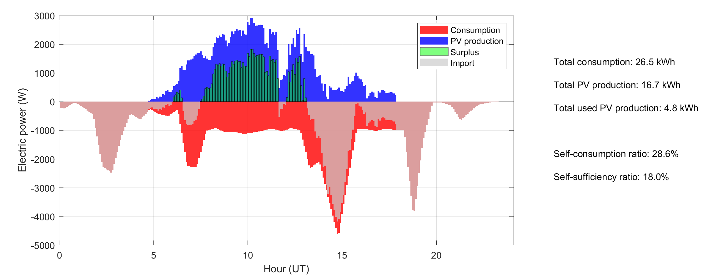
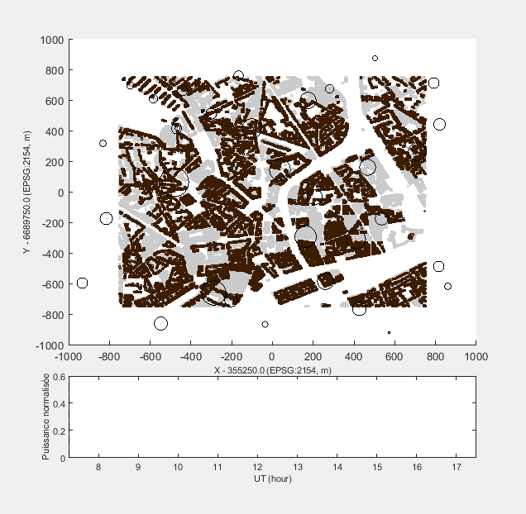
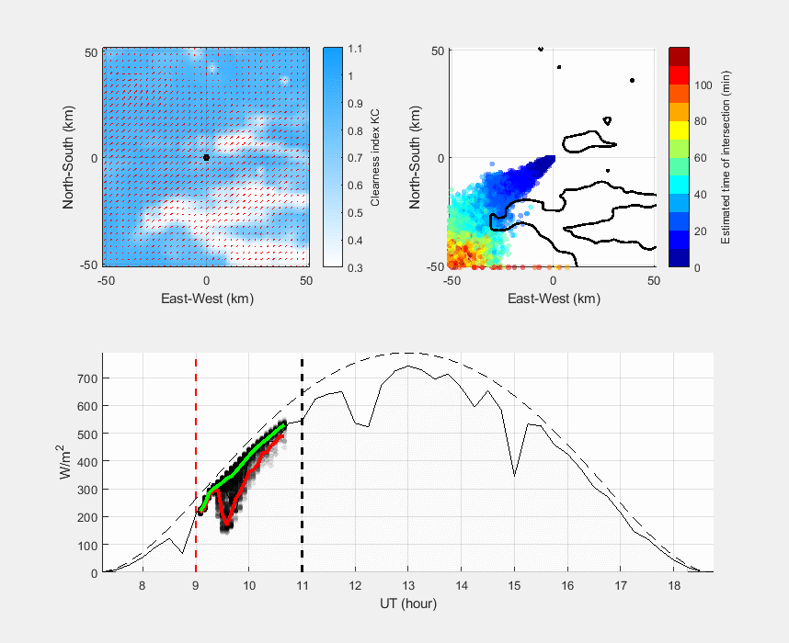
Reusable knowledge – Thematic – Copernicus
Co-designed several use cases for high PV penetration in cities
PV self-consumption: sizing PV systems when compared to concomitant electric consumption
PV integration in the grid: Simulated PV injection in different source points of the electric grid for different scenarios of PV penetration (for Distribution System Operator)
Energy trading: SPOT market with portfolio of PV rooftop systems

Slide 19

Reusable knowledge – Thematic – Copernicus
Benefit from Sustainability Booster to investigate sustainable alternatives
For pay
Creation of a spin-off for commercial applications
Urban planners, Distribution System Operator (DSO), Transmission System Operator (TSO)
Community based
Collaboration with JRC/Knowledge Centre on Earth Operation (KCEO)
Covenant of mayors initiative for climate and energy policies actions in cities
PV-GIS team to enhance spatial resolution (90m DEM -> sub-metric DSM)

Slide 20
Lionel.menard@minesparis.psl.eu
+33(0)4 93 95 74 23

