Slide 1

SPACE4GEO LSP
on Space Data, Services and Applications

Slide 2

From EO4GEO Alliance to SPACE4GEO LSP: the evolution
Leveraging on the results of the EO4GEO Blueprint project on Space Geoinformation (first wave project) the EO4GEO Alliance was established (www.eo4geo.eu), with its own governance based on a Network Agreement.
The Alliance implements the Strategic Objectives of the Sector Skills Strategy and evolved towards the new Large Scale Partnership on Space Data, Services and Applications – SPACE4GEO, with official launch on April 25th.
The new LSP is complementary and wish to collaborate with the existing LSP on Aerospace and Defence and with those LSPs representing the other vertical sectors, which could benefit from the provision of space-related data and services, i.e. agriculture, natural disaster management, infrastructure planning and monitoring, tourism, health, forestry, insurance and finance, urban development, cultural heritage, road and automotive, maritime and inland waterways, energy, security and defence

Slide 3
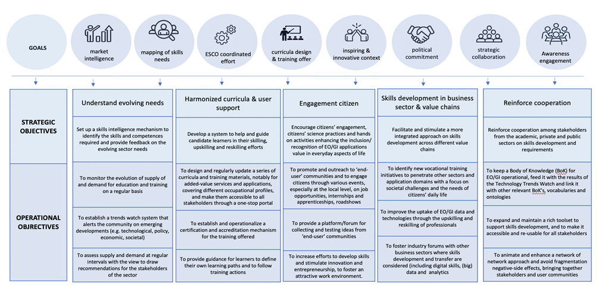
Objectives of the Partnership
According to the Sectoral Skills Strategy

Slide 4
SPACE4GEO LSP
Objectives and most of KPIs are already drafted in the Sector Skills Strategy and Long-term Action Plan released within EO4GEO project (see "Public deliverables" on the web site), focusing not only on Earth Observation and GeoInformation, but embracing the full downstream ecosystem, including Positioning, Navigation & Timing, satellite communications and, in general, all skills needed to implement current and future policies, i.e. EC Communication on Space Security and Defence.
The expectation from the LSP is to raise awareness and attract talent to apply for jobs on a segment of the space economy which is recognised to have a strong growth potential for next decade(s).
The LSP counts already around 49 members from 14 EU countries (PA, Academia, VET providers, companies, sectoral associations) and is open to all key stakeholders in the sector (and beyond).

Slide 5

















































PARTNERS
coordinator

Slide 6
High Commitments
The Partnership is committed to:
Ensure continuous exchange and cooperation among stakeholders from the academic, private and public sectors on skills development and requirements
Establish and deliver a shared understanding of the volume of skills needs and capacity requirements needed (in the short, medium and long term) to achieve the high level vision of a successful space downstream and geoinformation sector
Bridge the skills gaps and mismatches and an improved user uptake of space data, services and applications

Slide 7
Specific commitments
To monitor the occupational supply and demand to identify the skills and competences required and provide feedback on the evolving sector needs.
To help and guide candidate learners in their skilling, upskilling and reskilling efforts, supporting them to access quality training.
To facilitate and stimulate a more integrated and inclusive approach on skills development across different value chains (vertical sectors) and at different levels, including local and regional level.
To encourage citizens’ engagement, citizens’ science practices and hands-on activities enhancing the inclusion/recognition of space downstream and geoinformation applications' value in everyday aspects of life, also attracting new talents to the present and emerging space geospatial professions

Slide 8

Benefits of joining SPACE4GEO
In general, members of the Pact have access to knowledge on upskilling and reskilling needs, advice on relevant funding instruments to boost the skills of adults in their regions and countries, and partnership opportunities within a growing community.
By joining SPACE4GEO a member can also:
Participate in key discussion panels at the EC level regarding skills development in the Space downstream and Geoinformation sector.
Be part of a dynamic international partnership allowing you to access and bundle the knowledge and expertise needed to:
Set-up strong transnational consortia to submit proposals for funding, ensuring that efforts are not duplicated or weakened.
Participate to tenders and procurements with the right partners.
Submit offers for commercial exploitation of added value services and training initiatives.
Propose and develop initiatives to mainstream the results at national and regional level.
Be part of a recognised brand acting collectively towards relevant institutions and reaching out to key stakeholders with a stronger impact.
Have visibility on the Partnership website and promote its activities via the channels operated by the Partnership, including social media, newsletters, sectoral events of interest.

Slide 9
SpaceSUITE proposal
The constitution of the Large Scale Partnership allowed GISIG to promote, coordinate and submit the new Blueprint project "SpaceSUITE - SPACE downstream Skills development and User uptake through Innovative curricula in Training and Education" under the ERASMUS+ Programme.
The Call for Blueprint projects was restricted to LSP members and must be coordinated by the LSP Coordinator (GISIG in this case). Only one project per LSP will be funded.
SpaceSUITE will leverage on the results of EO4GEO, expanding them and making them evolve to cover new functionalities and areas related not only to Earth Observation and Geo-information, but also to Positioning Navigation and Timing and Satellite Communication.
The partnership is composed by 25 partners from 12 EU countries, plus 3 affiliated entities and 7 associated partners. It includes universities, VET providers, companies, sectoral associations, public bodies and regional authorities. All of them had to join the LSP before submission.
The funding schema is "lump sum budget based", meaning that a budget for the project has been estimated, amounting to approx. 5M€ and, if approved, the UE will recognise the 80% of the budget, in form of lump-sum of approx. 4M€ to be released upon completion of work (no cost statements).
If approved, the project will start in January 2024, with a duration of 4 years.

Slide 10
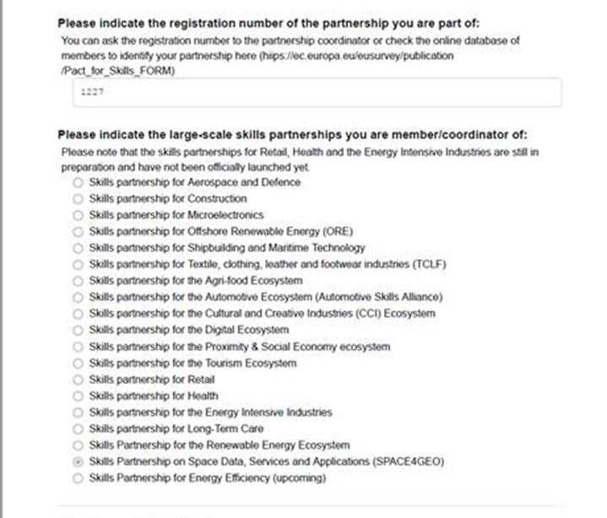
How to join
Connect to Pact for Skills Application Form
Answer question1
Answer question 2
Step 5, indicate partnership N. 1227 and click on “SPACE4GEO”
For any questions, please contact the Support Services at PactforSkillsMembers@ecorys.com

Slide 11
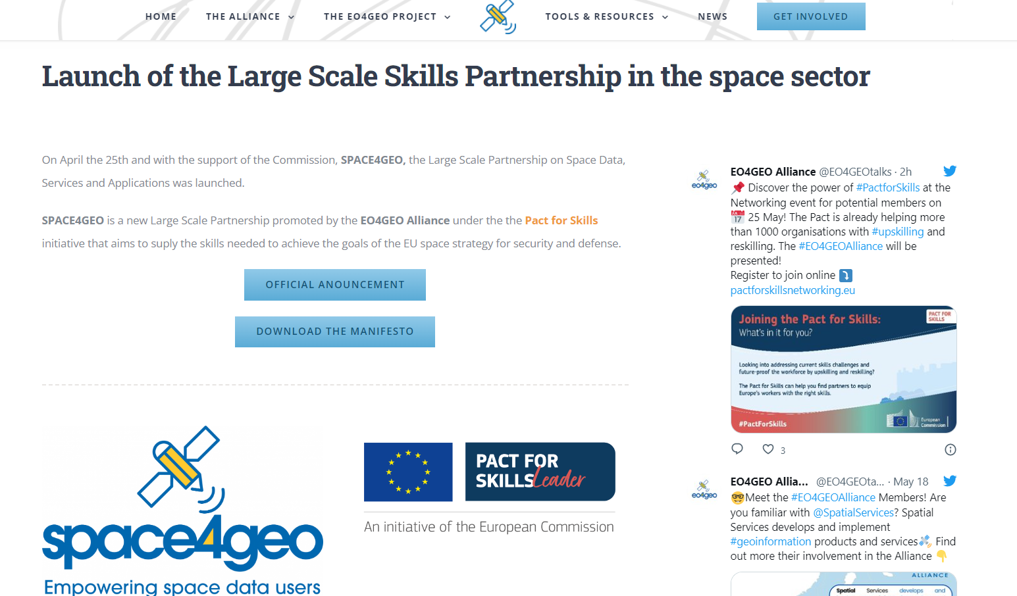
More info (re-branding in progress)

