Slide 1
Copernicus and disaster management
Bratislava, 30 November 2023
Marie Ménard

Slide 2




EUSPA – Linking Space to user needs
With the new regulation, space data is at the heart of a technological revolution
EU space activities under one umbrella:
New EU Space Regulation
((EU) 2021/696)
To acknowledge the growing role of space in supporting EU priorities in terms of growth, competitiveness, sustainability, and security
Setting the ground for the creation of EUSPA, officially launched on 12 May 2021
Galileo
EGNOS
Copernicus
GOVSATCOM / IRIS2
SSA
Global satellite navigation and positioning system (GNSS)
10% of the EU GDP enabled by satellite navigation
Makes navigation signals more accurate and reliable
Operational in 360+ airports & helipads in 23 countries
Earth Observation (EO) and monitoring based on satellite and non-space data
Nr.1 world provider of space data and information (>20TB/day)
Secures satellite communications for EU governmental actors
Delivering rapid support over crisis areas
Space Situational Awareness monitors and protects space assets.
Market Uptake

Slide 3
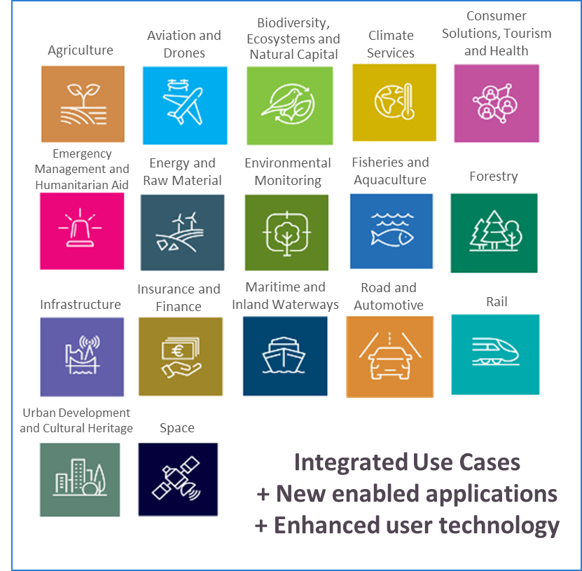
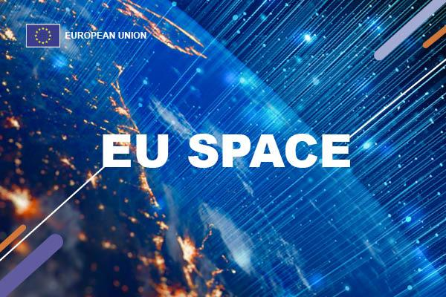
Integrating the EU Space Programme with a synergetic approach

Slide 4
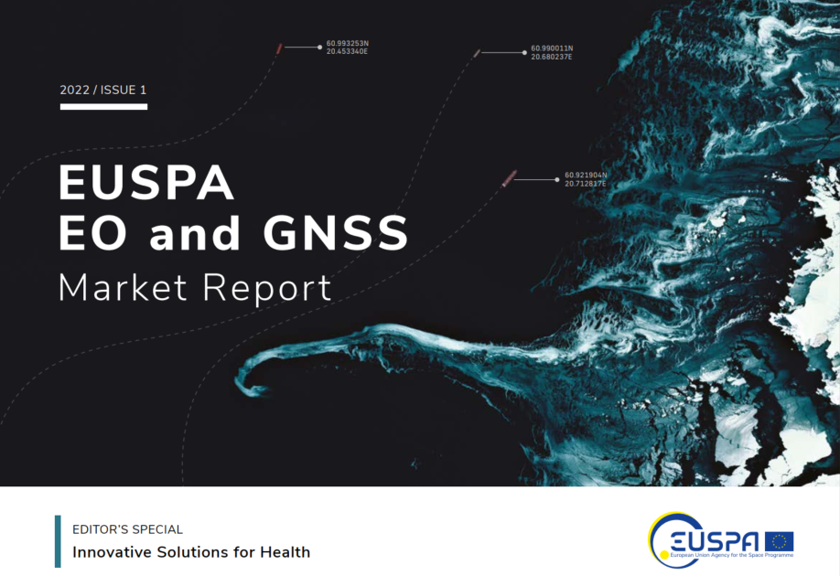
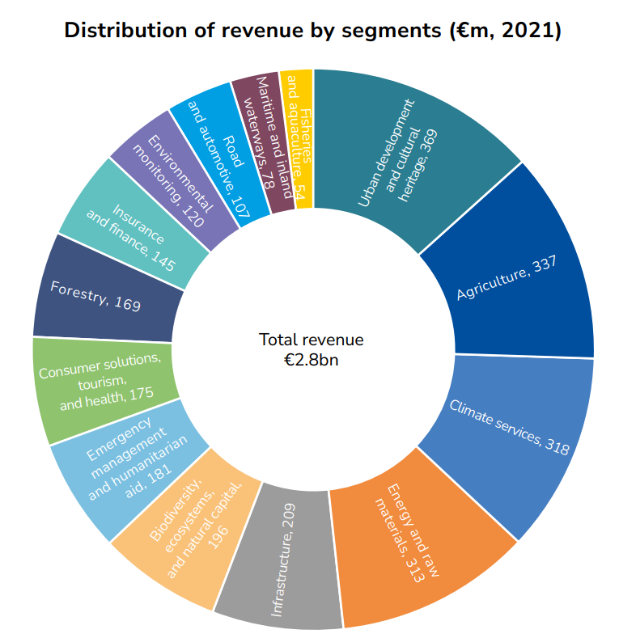
The Market for Space Data has a huge economic potential
The EO and GNSS Market Report combines the market and application insights into a single report that provides global coverage of the EO and GNSS applications across multiple market segments
New Edition coming soon !

Slide 5

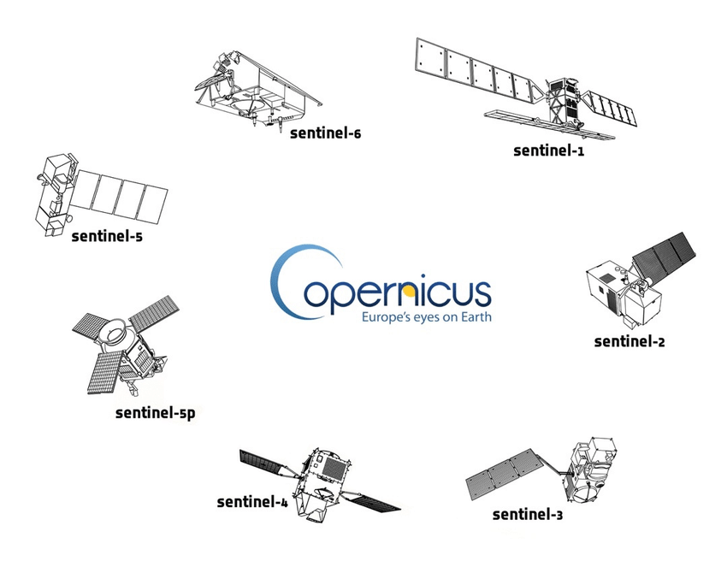






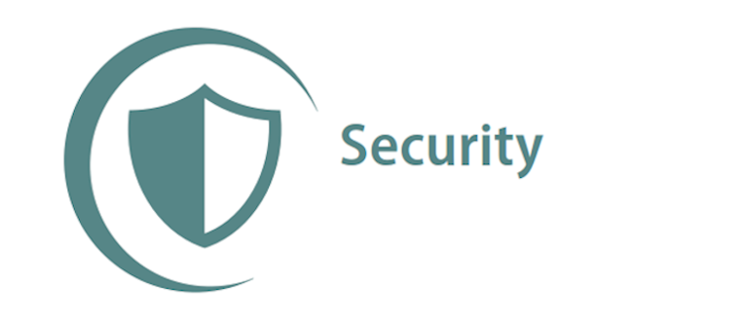


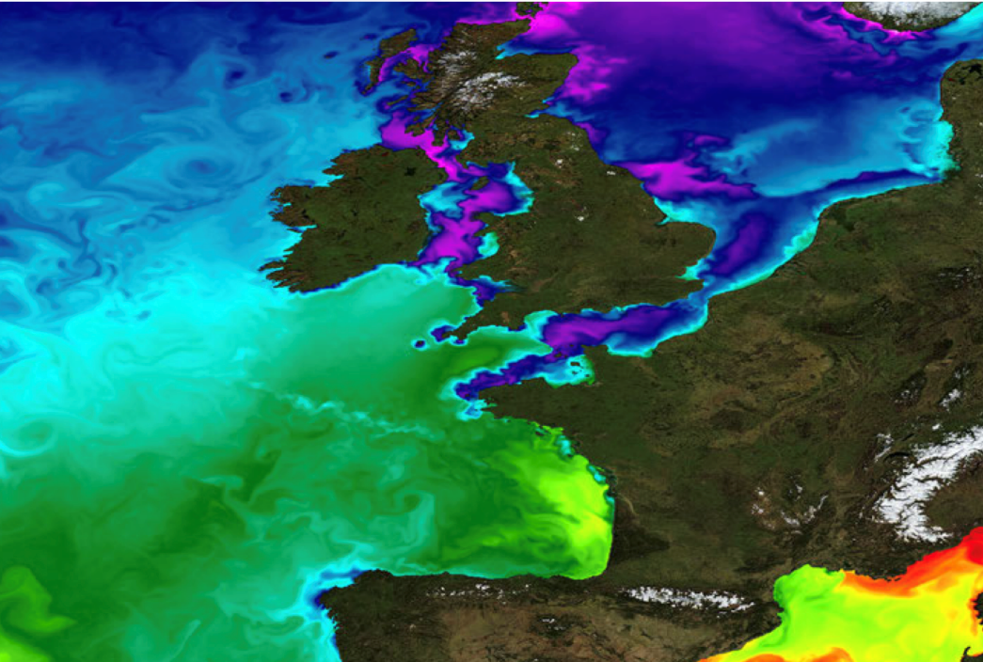
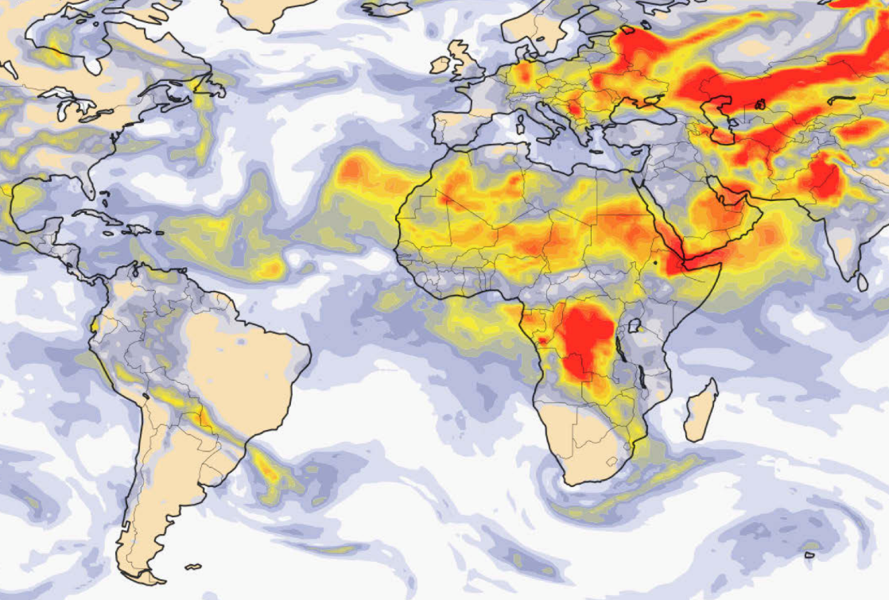
Copernicus delivers unique Earth Observation data
European Union's Earth observation programme, looking at our planet and its environment to benefit all European citizens Copernicus provides free and openly accessible data to all users around the world
SPACE
IN SITU
SERVICES
Nr.1 world provider of space data and information
Notes:
- On the other hand, we have Copernicus, the well known EU Earth Observation programme, providing free and open global data about the earth and its environment.
- What is important to mention is that Copernicus is not only about satellite images. A part from the sentinel missions, existing and future ones, Copernicus has two other components, that are the In Situ component and the Copernicus services.
The In situ component is composed of myriads of sensors distributed across the world providing complementary data to those captured by the satellites.
Whereas the Copernicus services offer processed and analysis ready data for different thematic areas, which are atmosphere monitoring, marine services, land monitoring, climate change, security and emergency management.

Slide 6

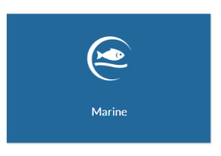
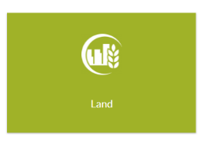




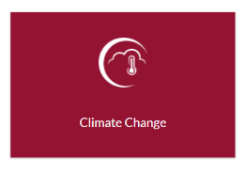
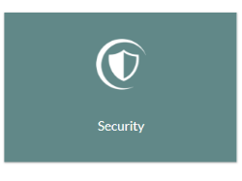
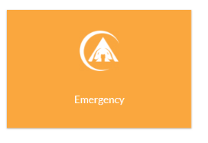




Copernicus services
https://atmosphere.copernicus.eu/
https://marine.copernicus.eu/
https://land.copernicus.eu/en
https://climate.copernicus.eu/
https://www.copernicus.eu/en/copernicus-services/security
https://emergency.copernicus.eu/

Slide 7
Copernicus services for disaster management

Slide 8
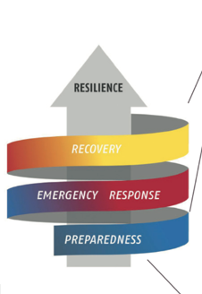
Emergency management service
Benefit areas:
  Disaster Emergency situation
  Humanitarian crisis

Slide 9
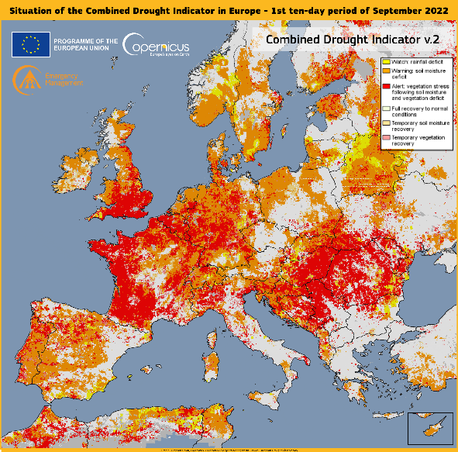
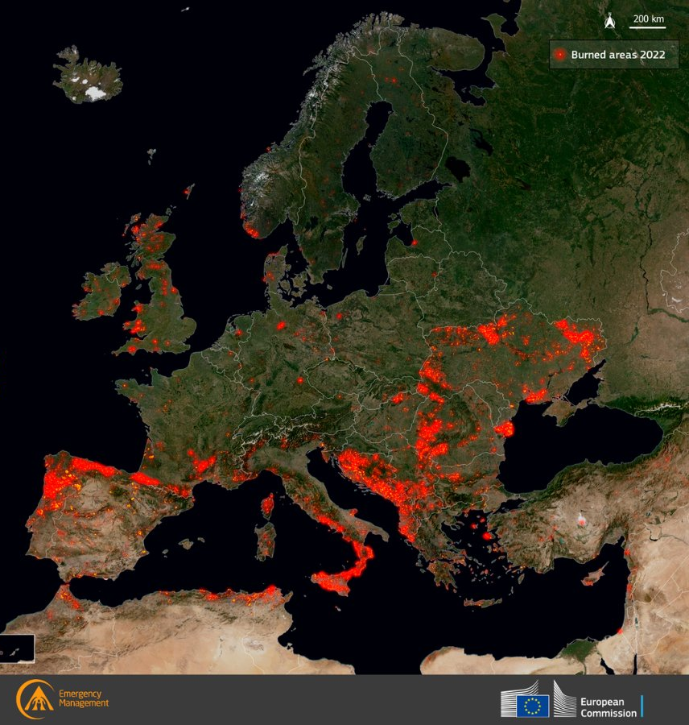
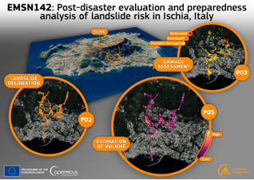
Emergency management service
  Early Warning for i.e floods, forest fires, drought
  Rapid Mapping with
    Reference Maps
    Delineation Maps
    Grading Maps
  Risk and recovery mapping,
    Reference Maps
    Pre-disaster Situation Maps
    Post-disaster Situation Maps

Slide 10
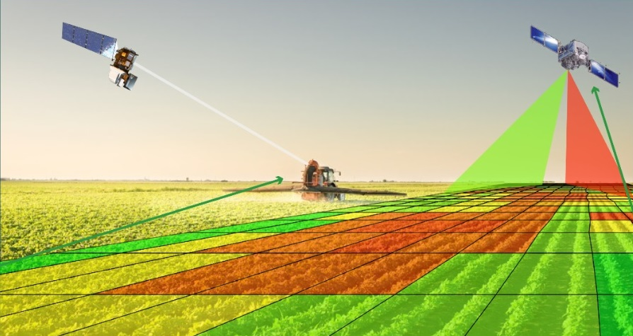
Land monitoring service
Ecosystems
Biodiversity
Agriculture
Forestry
Drought monitoring

Slide 11

Climate change monitoring service for mitigation, adaptation and preparedness
Seasonal Forecasts and Climate Projections therefore support the mitigation and adaptation Strategies
  Accurate evaluation of the Essential Climate Variables (ECV) such temperature increase, sea level rise, or other climate indices (precipitation, drought event, …).
  Modelling scenarios based on climate projections
Notes:
The Climate Change Service will provide information aimed at providing:
The Copernicus Climate Change service responds to environmental and societal challenges associated with human-induced climate changes.
The service will give access to information for monitoring and predicting climate change and will, therefore, help to support adaptation and mitigation. It benefits from a sustained network of in situ and satellite-based observations, re-analysis of the Earth climate and modelling scenarios, based on a variety of climate projections.
The service will provide access to several climate indicators (e.g. temperature increase, sea level rise, ice sheet melting, warming up of the ocean) and climate indices (e.g. based on records of temperature, precipitation, drought event) for both the identified climate drivers and the expected climate impacts.
The Copernicus Climate Change service is under implementation
The service will provide information for monitoring and predicting climate change and help to support adaptation and mitigation
It will give access to several Essential Climate Variables e.g. :
temperature increase, sea level rise, ice sheet melting, warming up of the ocean and several climate indices
The Service is currently under implementation

Slide 12
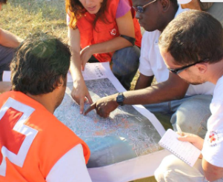
Security service and the
Support to EU External Action
Road network status assessment
Conflict damage assessment
Critical infrastructure analysis
Reference map
Support to evacuation plans
Crisis situation map
Border map
Camp analysis

Slide 13
More information on Copernicus
Copernicus academy has several relays that you could reach if you want details on the products provided by Copernicus Entrusted Entities.
  i.e: The Plant science and biodiversity center, Bratislava
  The faculty of Natural sciencesof Matej bel University, Banska Bystrica

Slide 14
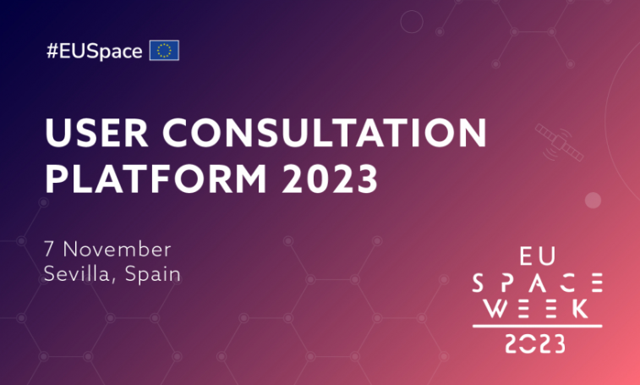


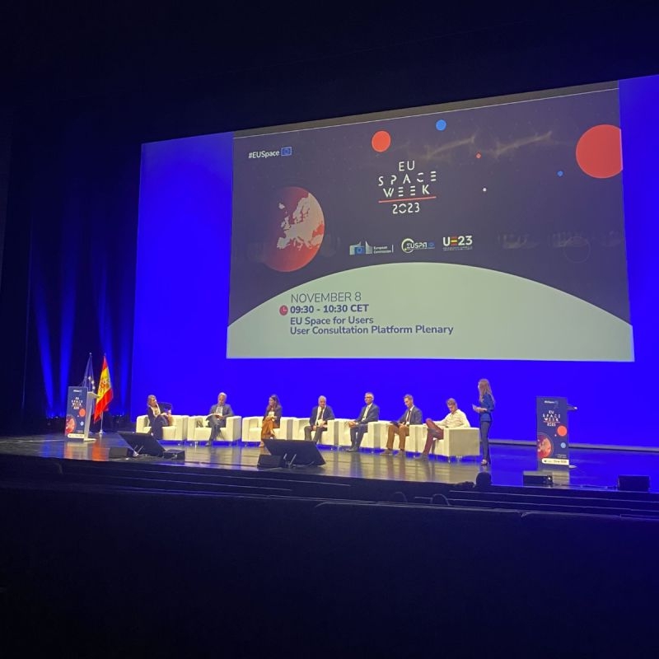
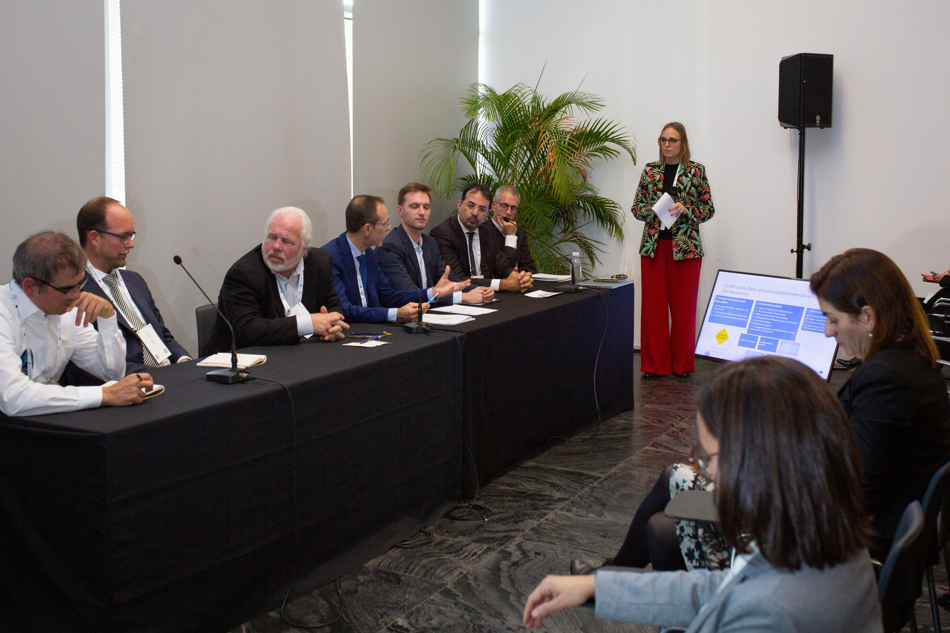




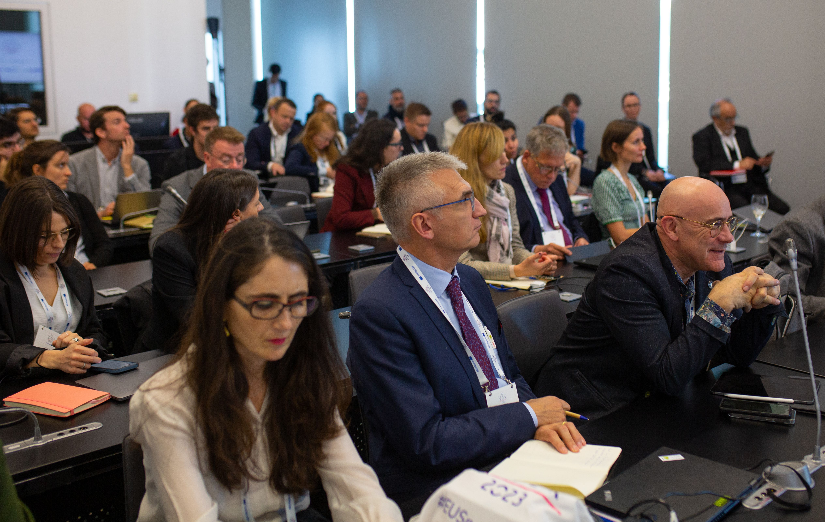
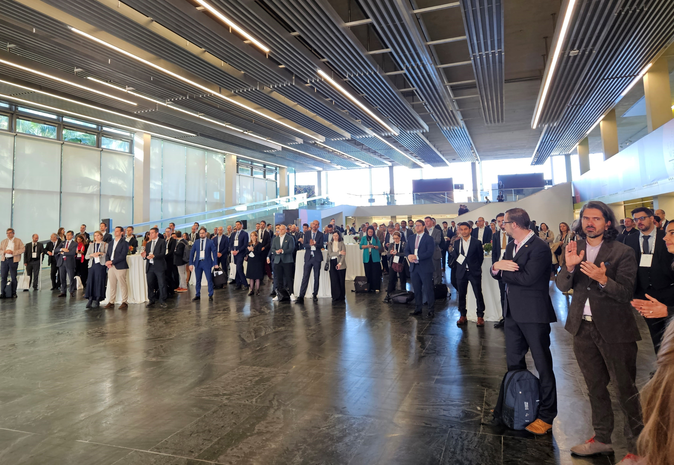


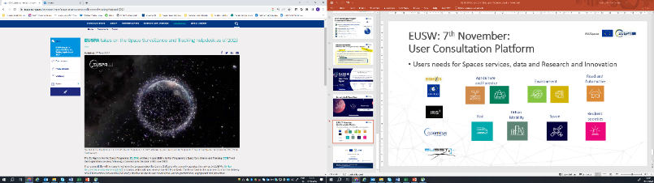


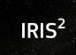


You can contribute to the evaluation of the services in participating in the next User Consultation Platform.
Over 500 EU Space users
The platform for business leaders, entrepreneurs, service providers, innovators and space user communities to express their needs, share best practices, discuss market & technology trends, R&D&I priorities, and present case studies

Slide 15
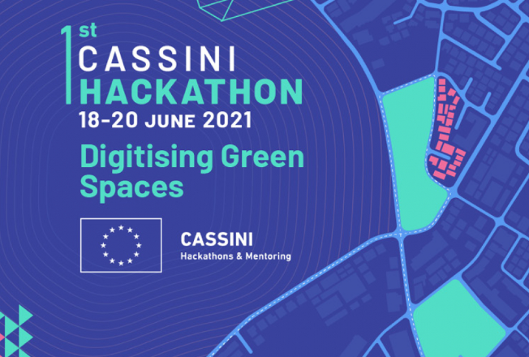
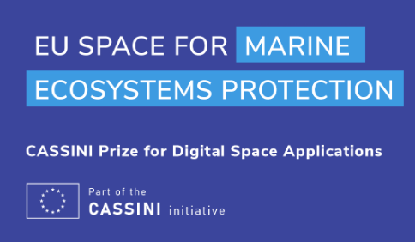

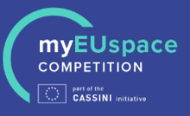

EUSPA funding tools stimulating innovation and fostering EU Space ecosystem, incl. start-ups & SMEs
  CASSINI initiative
  Horizon Europe
Foster EU’s innovative spirit to deliver applications and services
Stimulate innovation and entrepreneurship in the space ecosystem
Foster adoption of Galileo, EGNOS and Copernicus via downstream application development and commercialisation
Support the development of fundamental technologies for enabling integration of space services in downstream applications

Slide 16
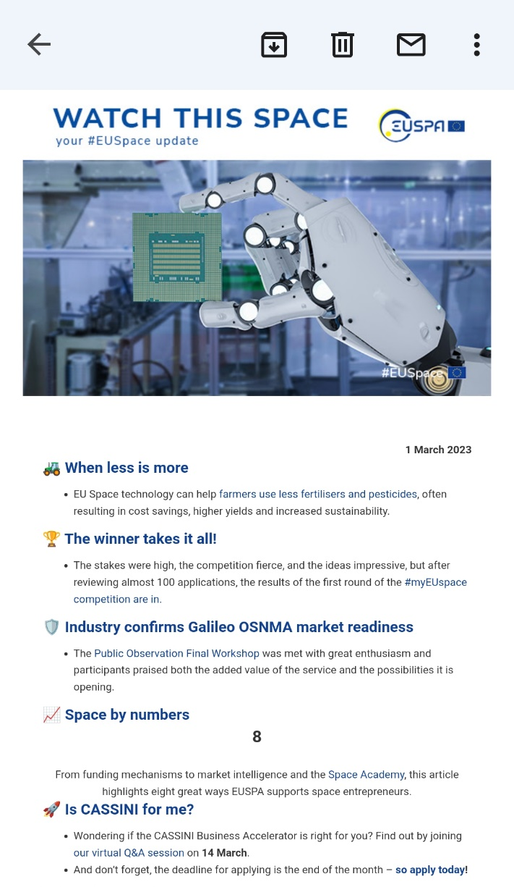

Subscribe to our newsletter Watch This Space
… and receive the latest #EUSpace news every week in your mailbox.
To subscribe, scan the QR code below:

