Slide 1

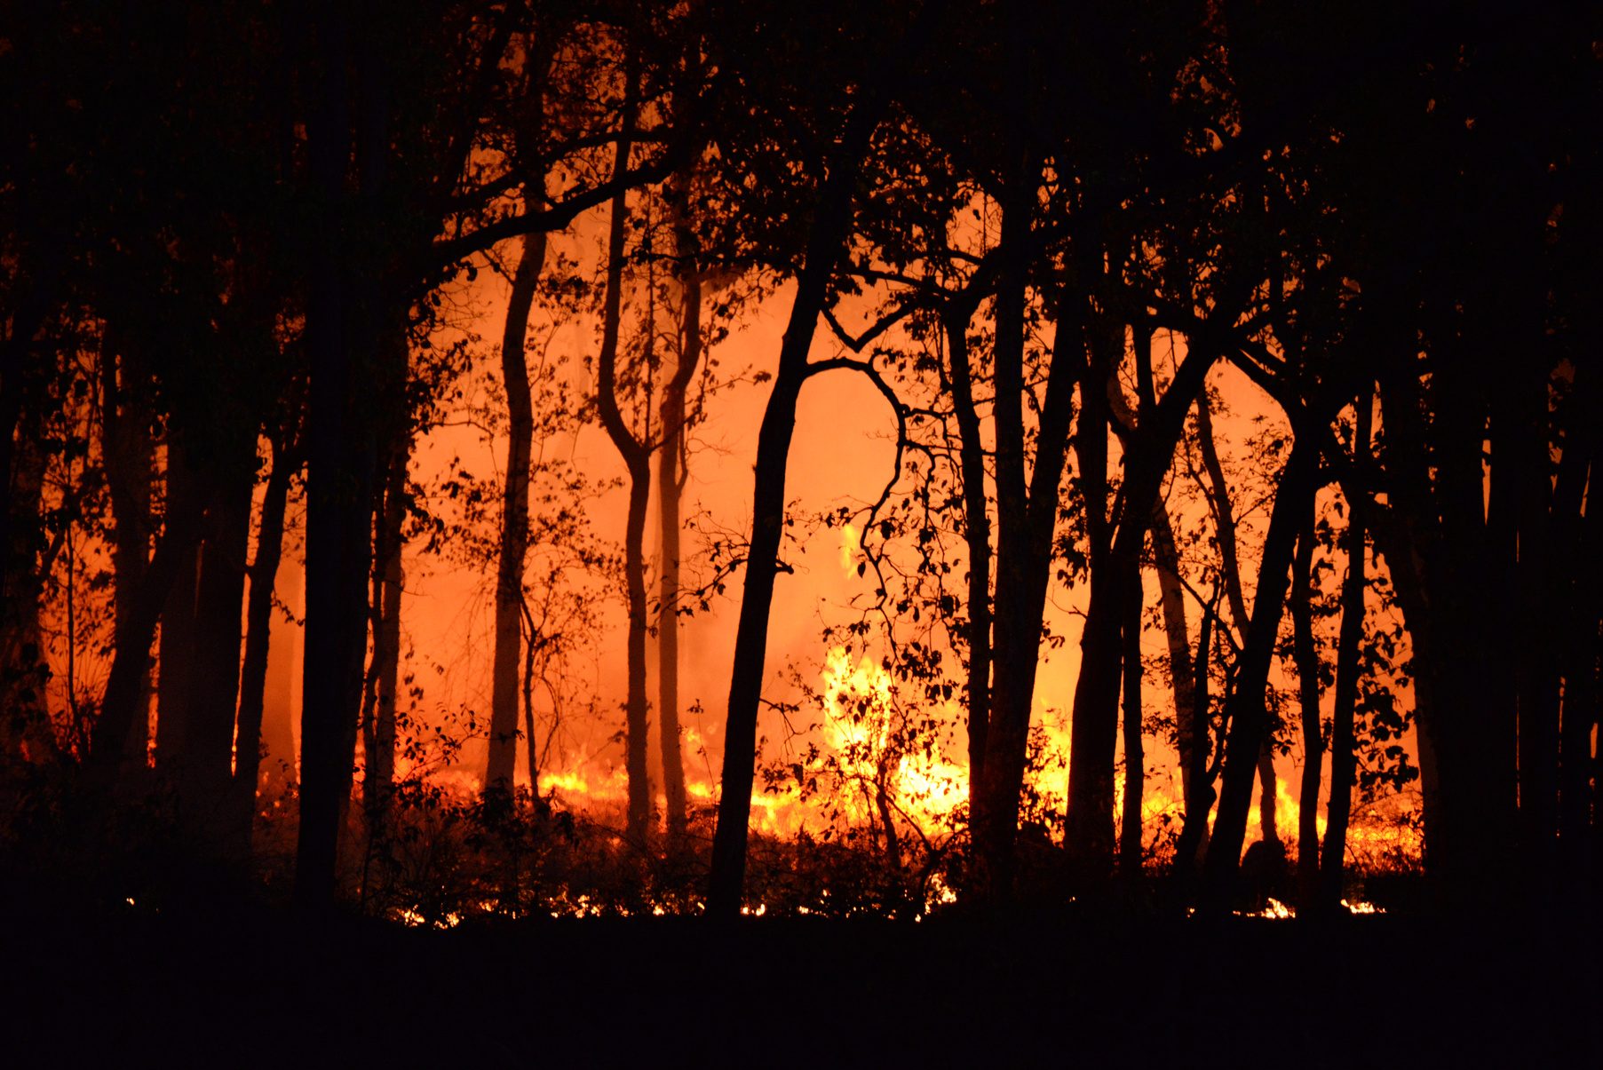
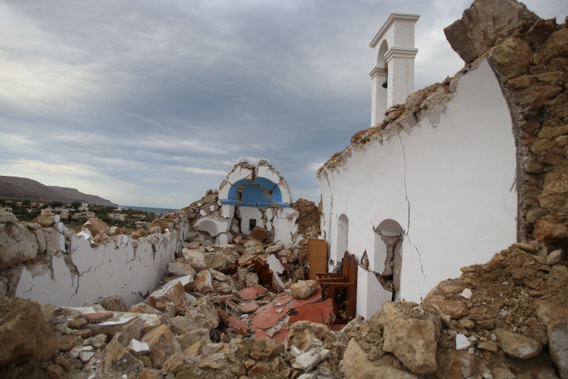
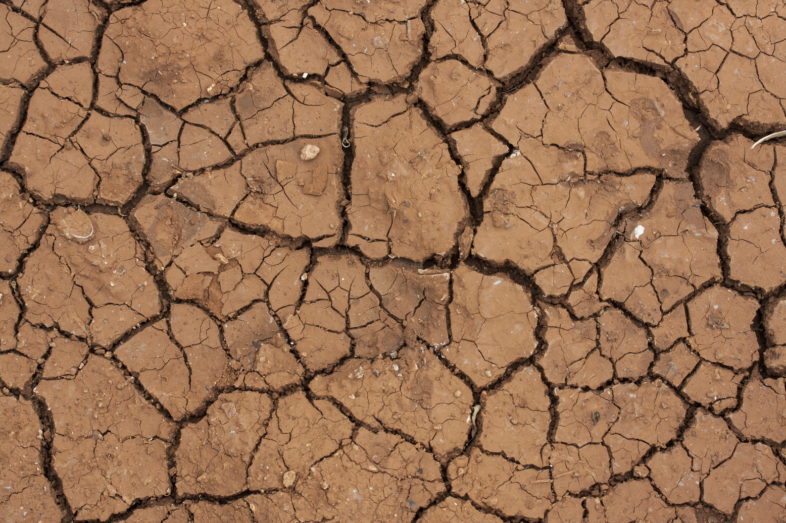
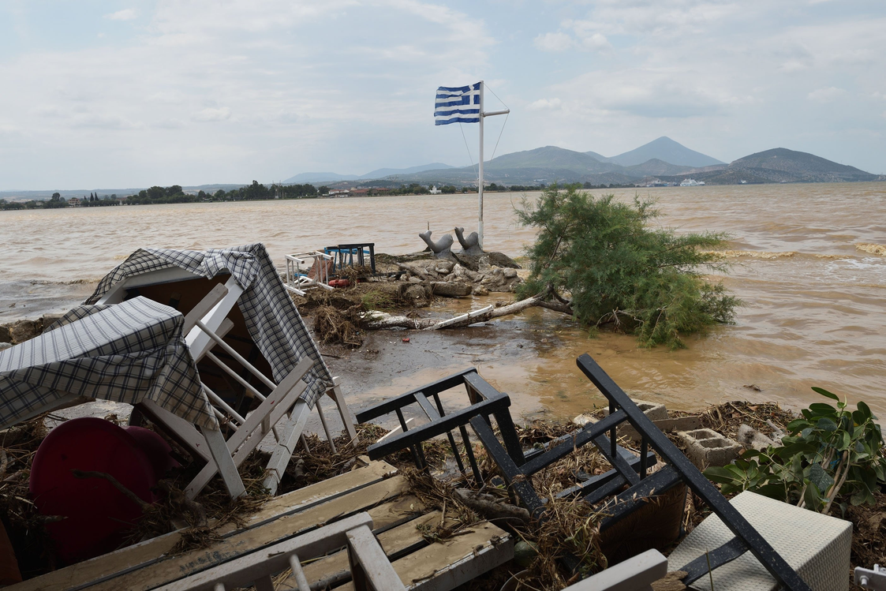
Assessing EO Capacity Needs in Europe – User Needs Assessment for Enhanced Disaster Risk Reduction
Annalisa Donati
Secretary General
Satellite based applications for disaster risk management
30/11/2023

Slide 2
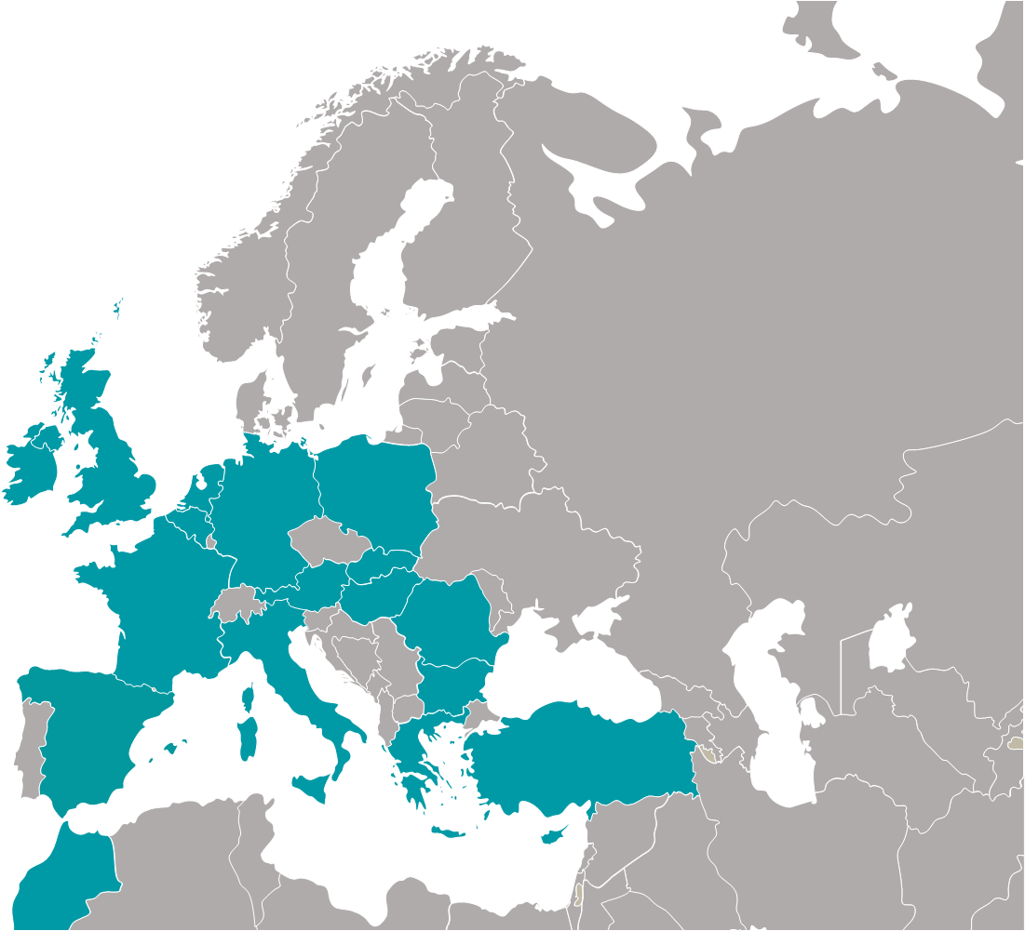























Members

Slide 3

Mission
Eurisy has been mandated by its Members to create networks to bridge space and society.

Slide 4
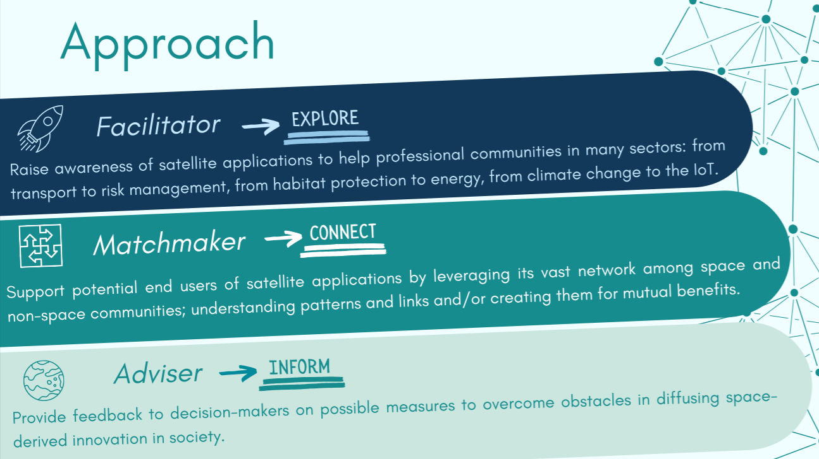

Agenda

Slide 5
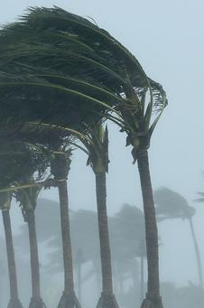






Human cost of disasters: an overview of the last 20 years – UNDRR Report
Climate challenges
145
1389
44
263
1980
1999
1.63
trillion
163
2043
3254
552
338
238
2000
2019
2.97
trillion
47%
$1.39 trillion
22%
$651 billion
21%
$636 billion
4%
3%
$636 billion
$93 billion

Slide 6
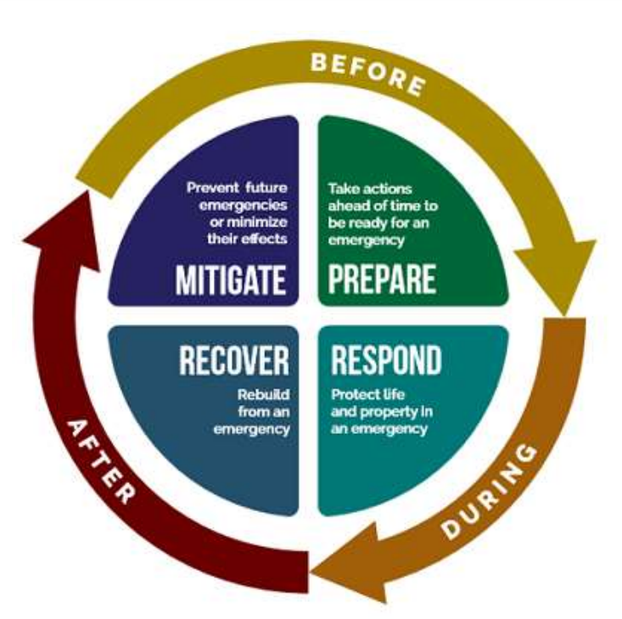
Disaster risk management
Key information & observation needs:
Hazards: Past events; adverse phenomena; geographic settings
Vulnerability: physical and socio-economic vulnerability assessment
Exposure: inventory of assets
Key information & observation needs:
Forecasts & early warnings: pre-disaster information
Need for assistance: post-disaster maps; human displacement
Prevent future emergencies or minimising the effects
PREVENTION
Take action ahead
of time to effectively manage a crisis
PREPARADNESS
RECOVERY
Restoring human activities and services
RESPONSE
Saving lives and minimizing losses
Key information & observation needs:
Losses and damages: post-disaster maps
Recovery and risk: changes of risks and hazards
Key information & observation needs:
→ Disaster scenarios: pre-disaster information

Slide 7







Disaster risk management

Slide 8
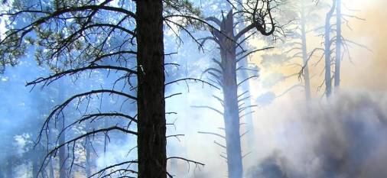

FireHUB: early-warning service relying on meteorological and EO data
The user:
GREEK MINISTRY OF ENVIRONMENT
The challenge:
Droughts, high winds, and the sprawl of land development in the proximity of forests cause several wildfires every year. Monitoring these large areas can be very costly and time-consuming.
The solution:
Through a dedicated web-GIS application operators monitor wildfires and forecast smoke dispersion. The service also generates burnt scar maps during and after wildfires during the last 30 years
The benefit:
Provides timely fire detection data, enabling authorities to get a Situation Awareness Picture and to effectively deploy available resources. Maps of the burnt areas are also useful for damage and deforestation assessment

Slide 9
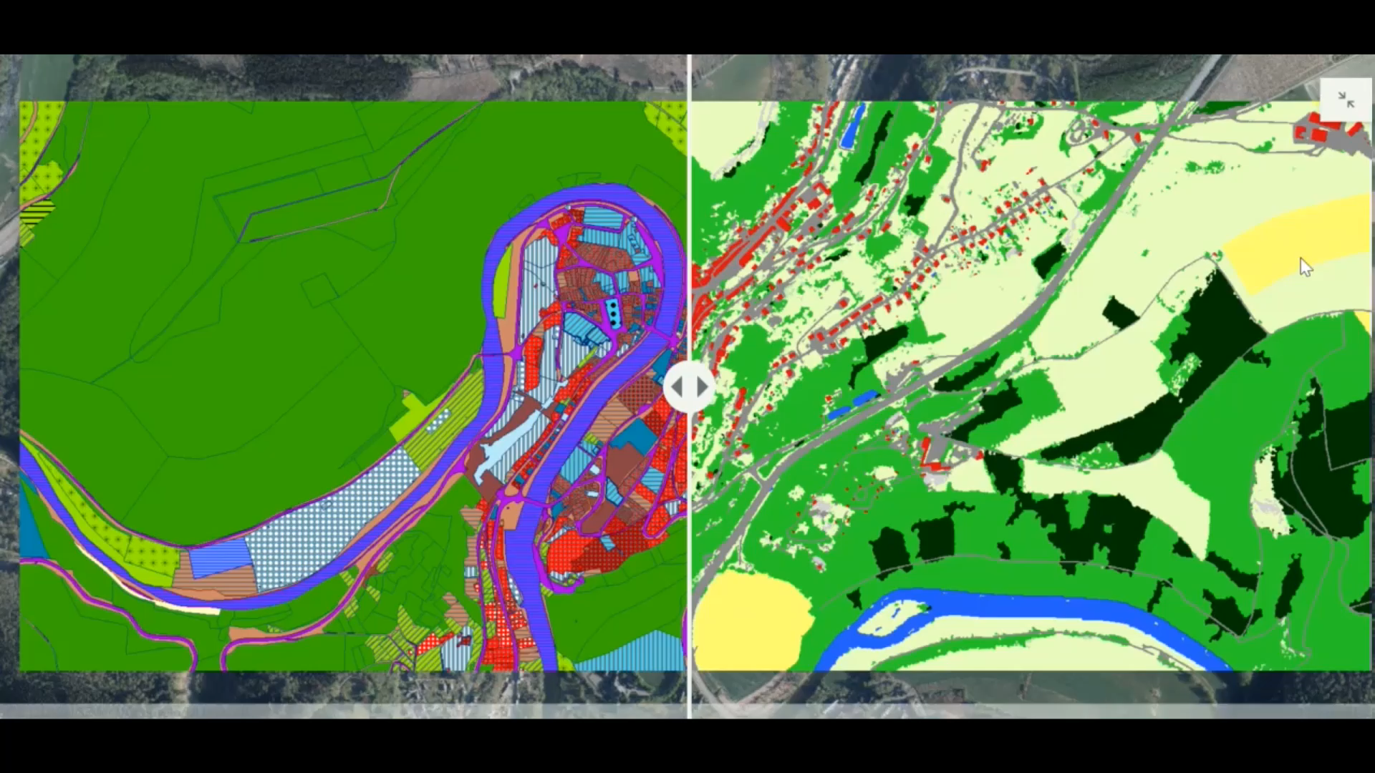

The Public Service of Wallonia (Belgium) relies on satellite imagery for a comprehensive view of land cover and use
The user:
The Public Service of Wallonia
The challenge:
Acquisition of precise, accurate and easily updatable information, on land cover (LC) and land use (LU) to comply with EU INSPIRE Legislation
The satellite solution:
WALOUS maps’ integrate the latest georeferenced data on the whole Walloon territory
The benefit:
the Department of Agriculture, Natural Resources and Environment of the PSW uses the map to support farmers in making their declarations

Slide 10
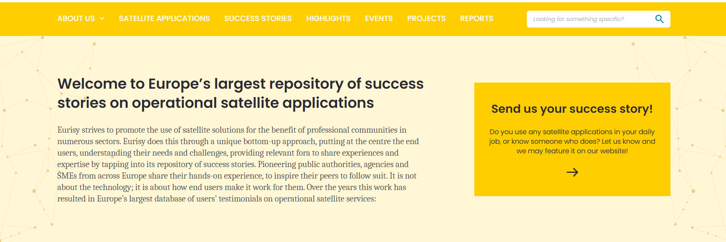
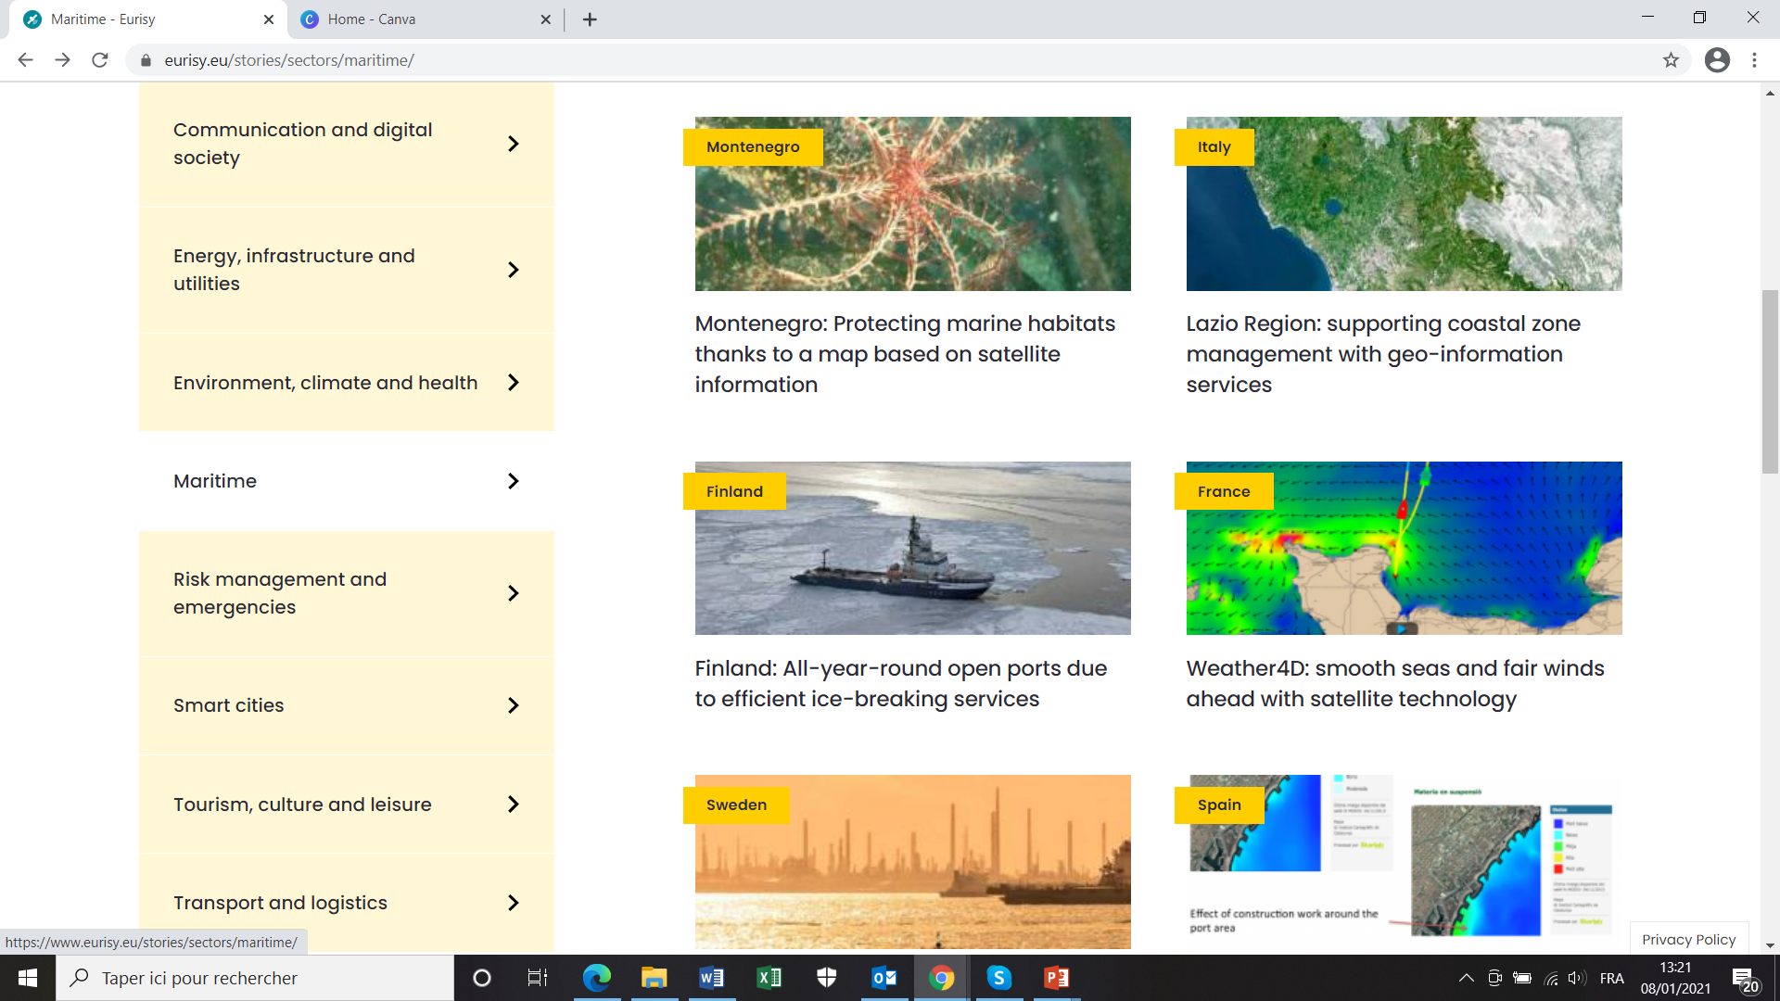
Success stories database
Success stories will favour the dissemination of case studies and help connecting service providers and end users.
The Success Stories aim at addressing communities outside the space sector to express their needs and to present their challenges.
Objective is to favour the integration of satellite-based solutions in their workflow.

Slide 11
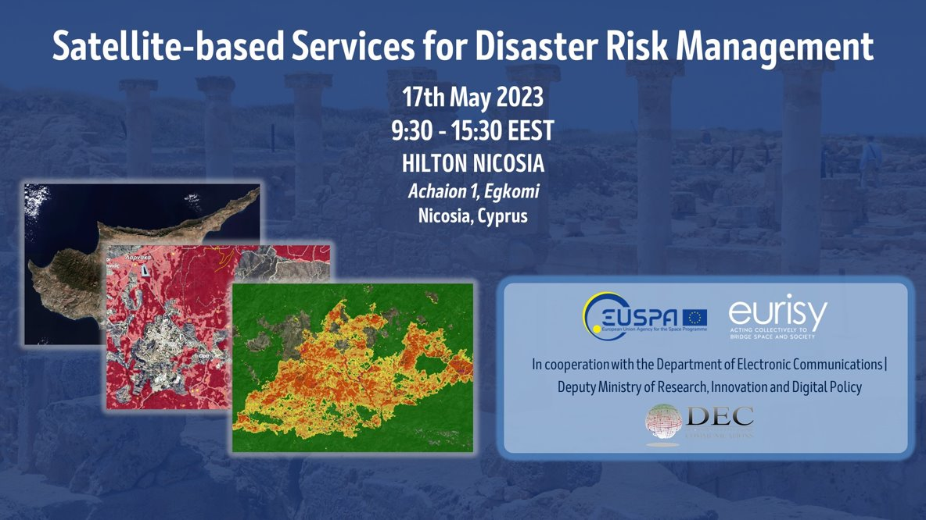
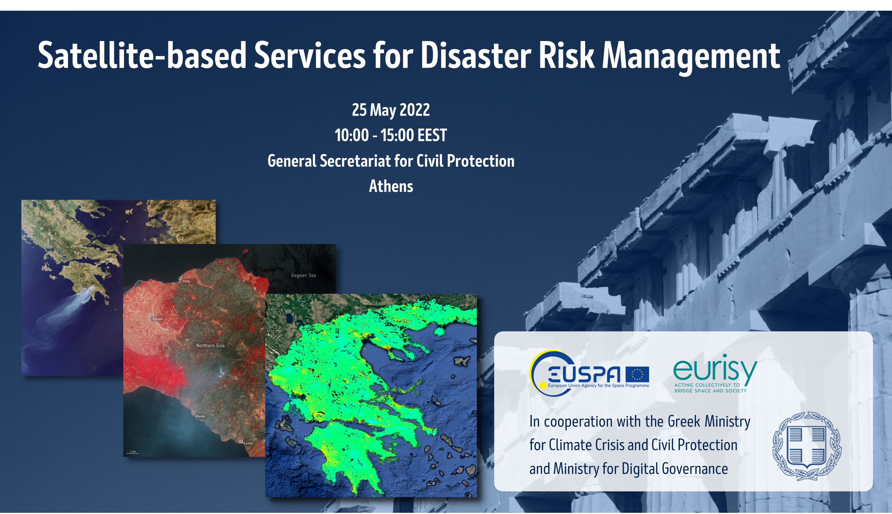
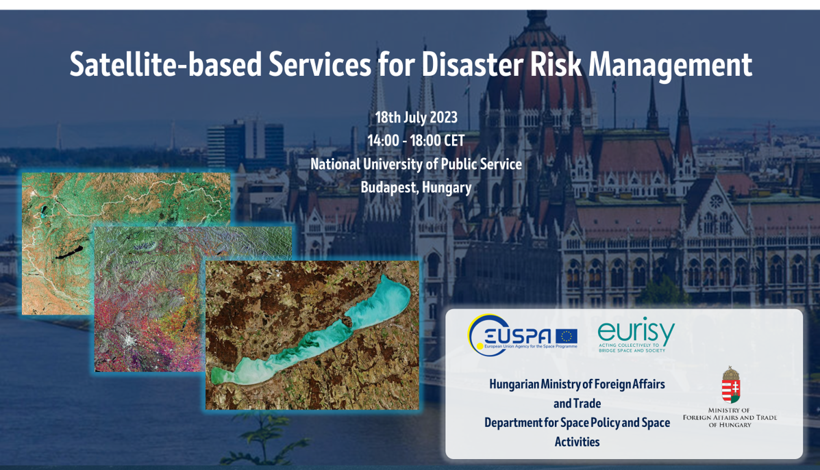
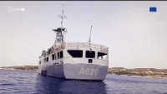
Satellite based services for DRM

Slide 12
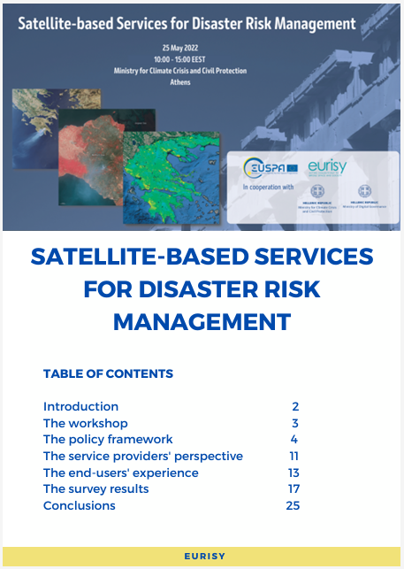
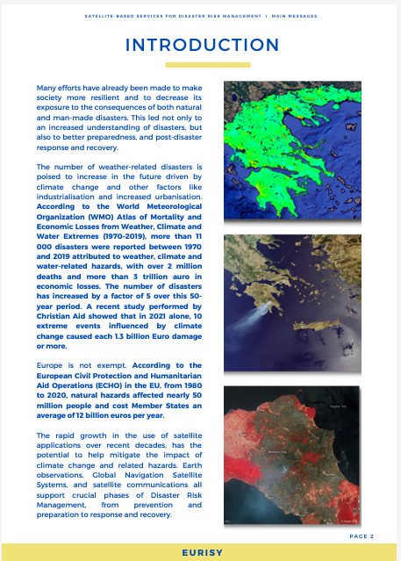
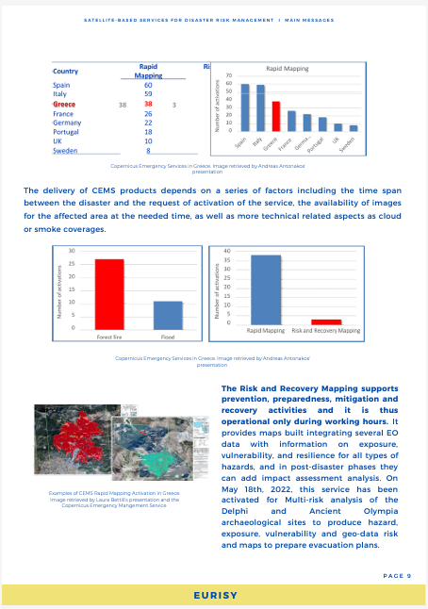
Methodology
Close cooperation with national authorities
Identification of current/interested/potential stakeholders
Questionnaire
Objectives
To get quantitative and comparable data
Allow for an easy sampling
In-depth interviews
Objectives
To get qualitative data from individual stakeholders/users
To specify the sampled categories

Slide 13
Local Users perspectives: sample
BENEFITS

Slide 14
Local Users perspectives: sample
CHALLENGES

Slide 15





For more visit our website
Follow us:
Thank you!
QUESTIONS?
eurisy1
@Eurisy1
Eurisy

