Slide 1
Satellite-based Services for Disaster Risk Management
Eurisy Workshop in Slovakia, 30 November 2023
Flavio SBARDELLATI, Market Downstream and Innovation

Slide 2
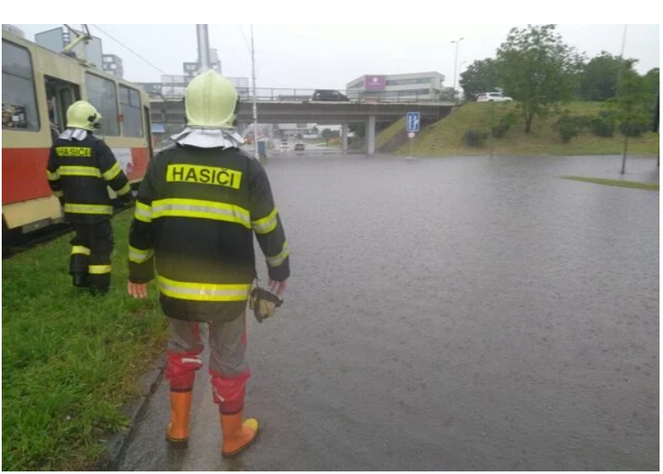
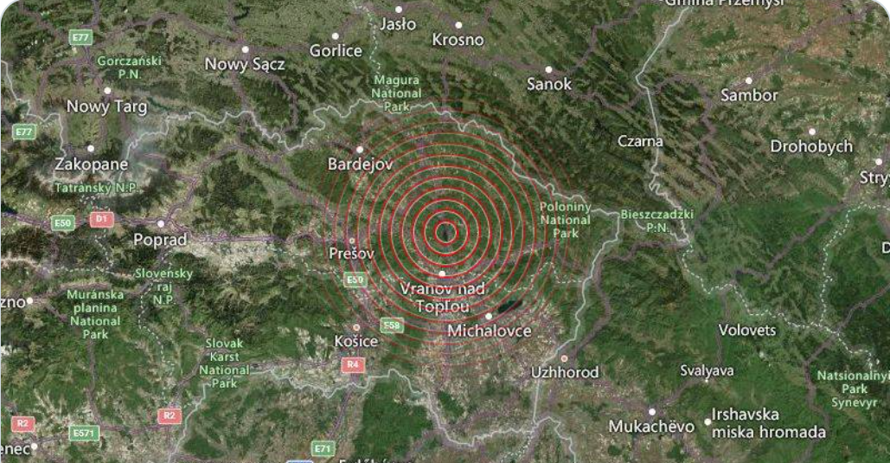
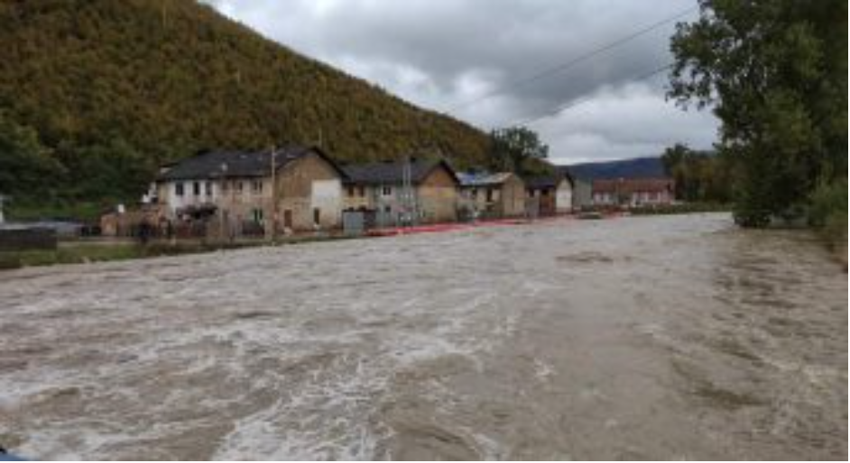
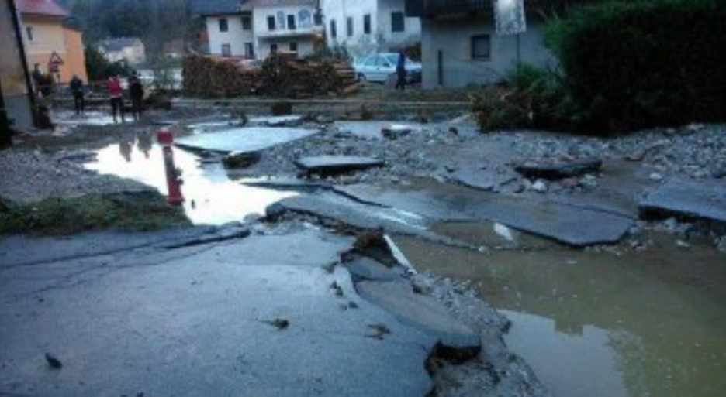
Earthquakes
June 2023
Oct 2023
Floods
Storms
2020
2014

Slide 3









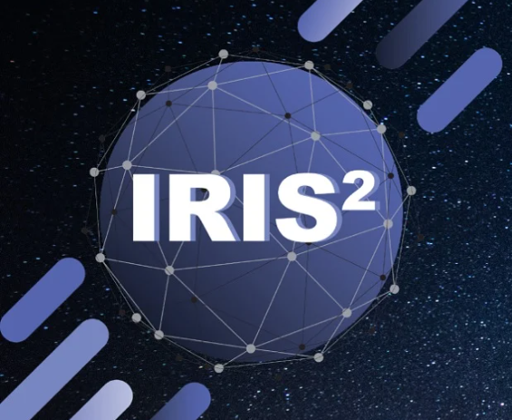
EU Space Programme for disaster management applications
Copernicus
Galileo/EGNOS
Galileo Emergency Warning Satellite Service (EWSS)
Asset/fleet tracking and management (vehicles/drones/equipment)
GOVSATCOM/IRIS²
Secure and resilient Connectivity to first responders in the aftermath of a crisis, in case the terrestrial network is compromised or absent (e.g. voice, data, images, IoT, ..).
Emergency Management Service
Navigation for responders on the field
Free, open and accessible Copernicus data to assess the risk, detect & monitor hazards
Climate Change Service
Land Monitoring Service (e.g. ground motion)
Receivers accurately detect earthquakes, landslides, land deformations etc.
Crowdsourcing applications (geo-tagged images)

Slide 4



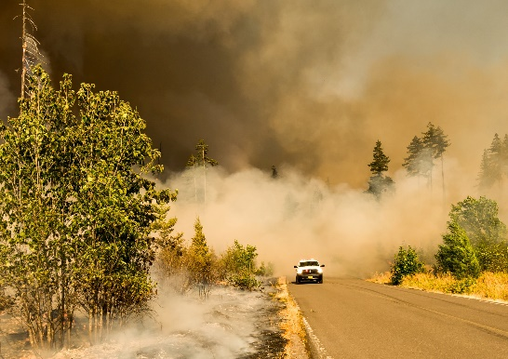


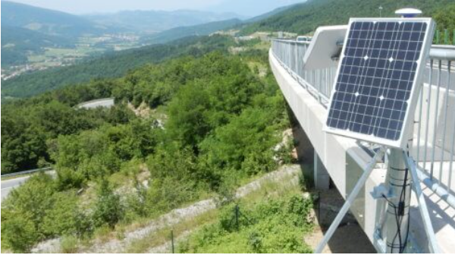
Examples of EUSPA projects addressing crisis management challenges
Integrated holographic management map for safety and crisis events
Copernicus & Galileo used to shorten the data acquisition / observation & decision-making loop with Augmented Reality Holographic interface for disaster response teams.
Satellites for Wilderness Inspection and Forest Threat Tracking
Protect forest health and production with an early warning system of forest threats, using space data and Artificial Intelligence.
Geodetic Integrated Monitoring System
GNSS and SAR interferometry applied on Copernicus data. The goal is monitor landslides and subsidence, Recover deformations with millimetric level accuracy and provide real-time alerts.

Slide 5
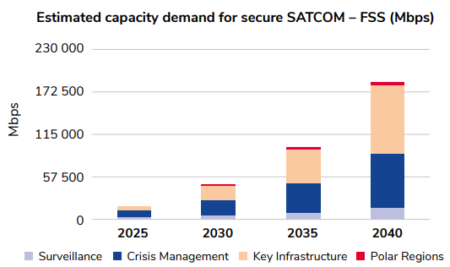
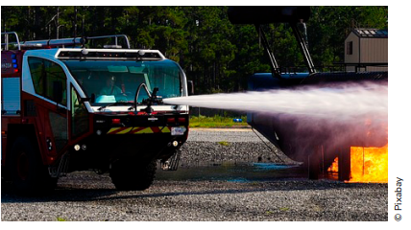
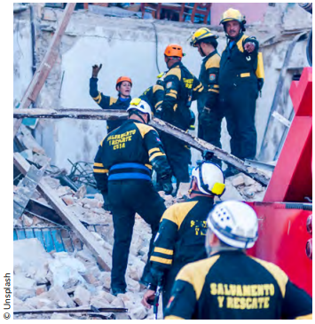
Crisis Management will account for almost half of the total SATCOM demand in 2025
Civil Protection is one of the main contributors
SATCOM is key when terrestrial networks are unavailable
Real-time monitoring of emergency operations, fostering effective communication among response teams and coordination centers
Higher number of expected natural disasters due to climate change
Increase of units equipped with a Communication on the Move capability and the spread of intelligent sensors transmitting valuable data.
Smart emergency response vehicles serve as a critical asset for first responders, such as civil protection, ambulance services, and fire & rescue teams.

Slide 6
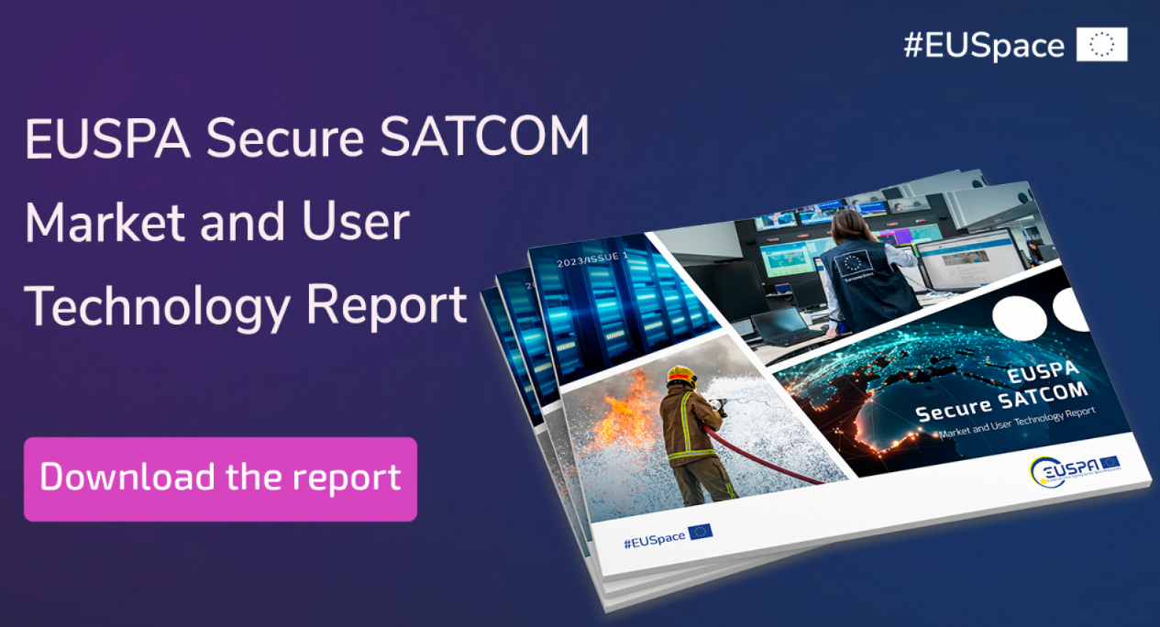
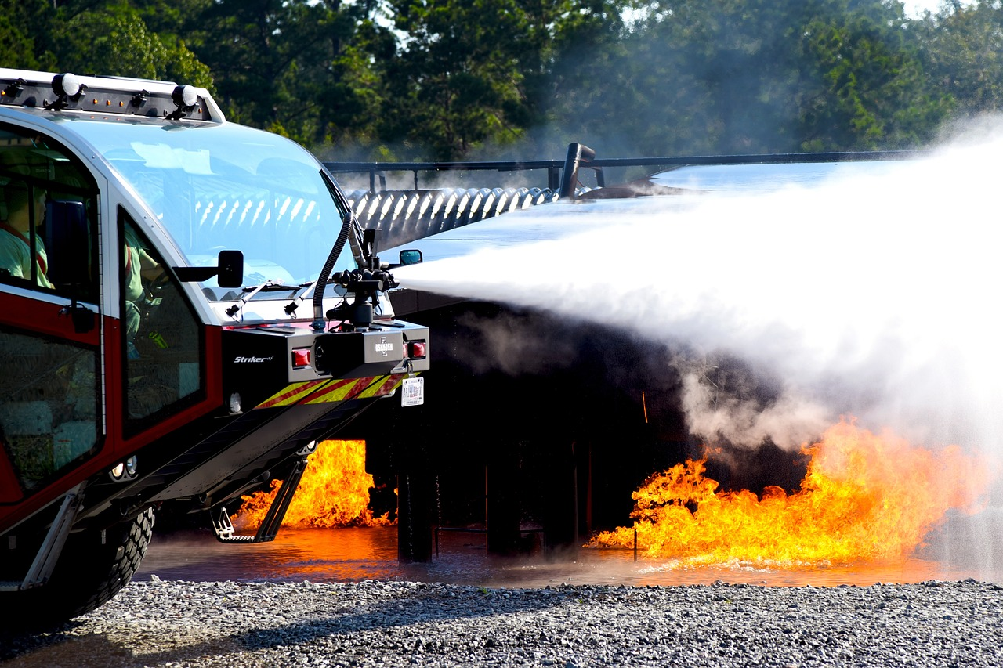
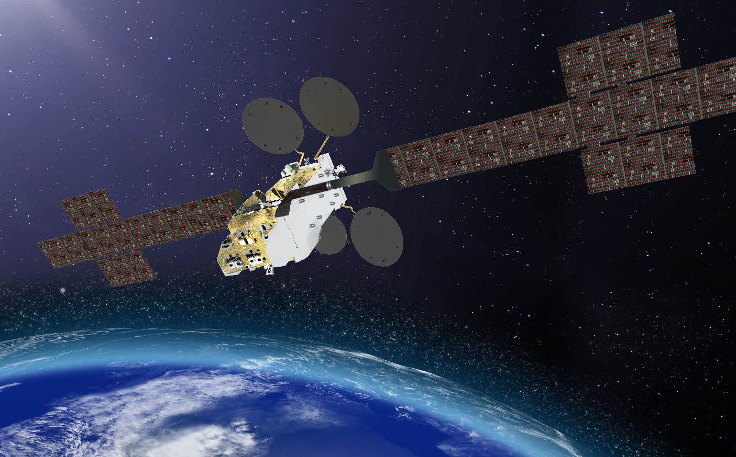


Secure SATCOM in the EU: A Comprehensive Overview
Secure SATCOM
Market
Secure SATCOM
Supply
Secure SATCOM User Technology
Register
here!
Do you want to know more?
Join the online Webinar on 12th December at 10-12h

Slide 7
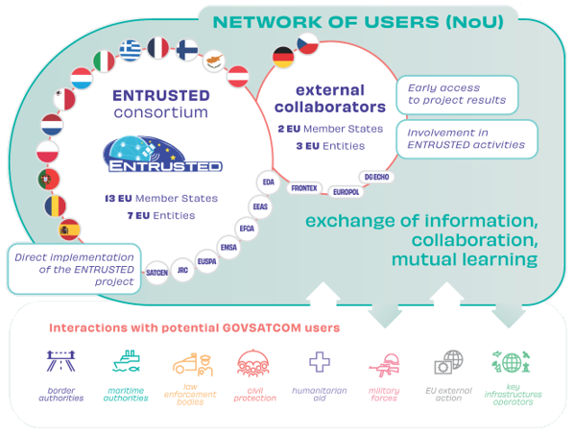
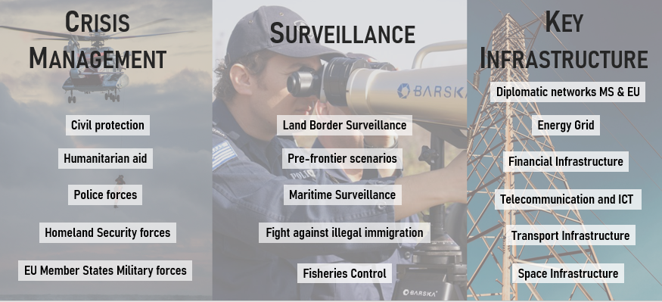
ENTRUSTED: The voice of EU and National secure SATCOM users
Interaction with Potential GOVSATCOM Users
3 months
Secure SatCom Requirements
192 use cases analyzed
Consultation
450 Users
154 responses

Slide 8
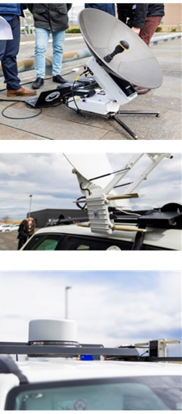
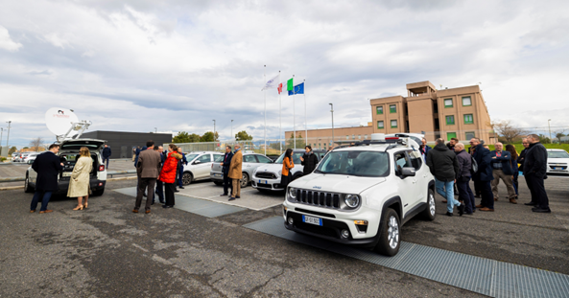
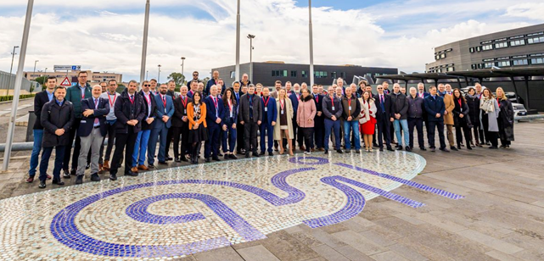
EUSPA is launching a new network of users
Interested to join?
Thematic groups (Emergency Management, Critical Infrastructure, Surveillance…)
Gain access to opportunities and promote share of experience across the communities
Identify, discuss and assess further use cases and requirements, challenges and opportunities for the use of secure SATCOM
Launch pilot activities
Discuss and prioritise technological gaps to be filled
Workshops, Demo events, Training needs …
… and much more..
ENTRUSTED@euspa.europa.eu

Slide 9
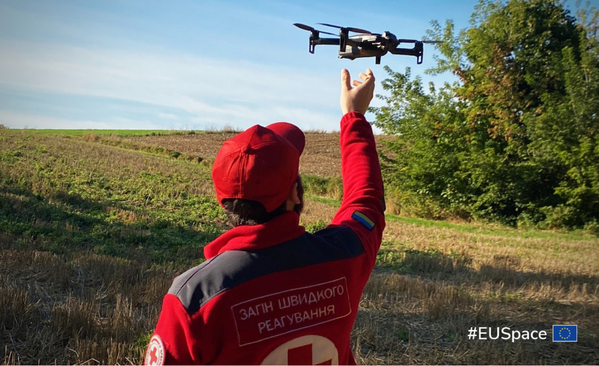






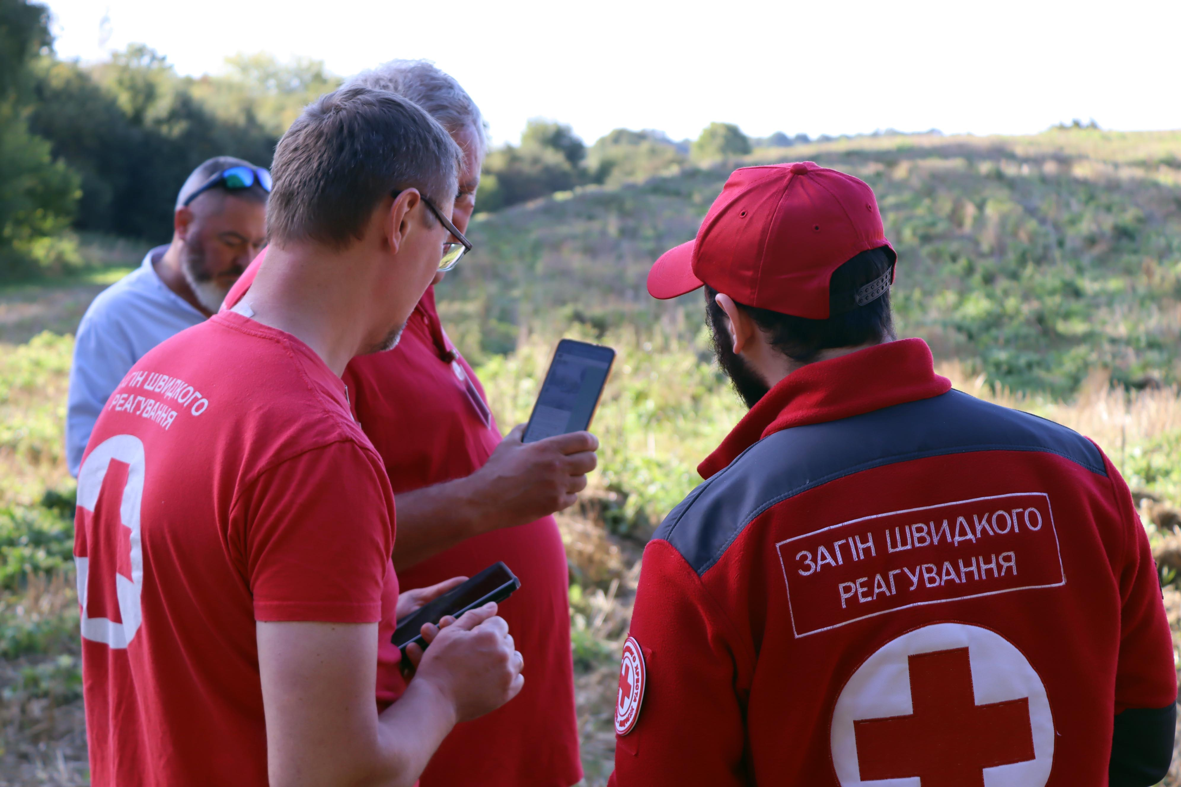

Pilot with the Ukrainian Red Cross: #EUSpace4Ukraine
3
Demonstrate
EU Space-enabled use cases
#1. Assessing conflict impacts in agricultural fields
#2. Up-to-date maps for fieldwork navigation
#3. Galileo-powered drones for search-and-rescue ops
Demo Day
20th Sep Lublin, Poland
Tailored operational solution, based on actual needs of Red Cross Ukraine
Validated and Demonstrated on the field, in Poland
Currently in-use by the Red Cross Ukraine in their operations

Slide 10
EUSPA Workshop on Emergency Management
Outcomes
Conclusions
Copernicus EMS service well-known and used, but users can exploit beyond Earth Observation (i.e. GNSS and SatCom)
Coordination and collaboration with the national authorities in MS is essential (favoring regional approach)
National initiatives and capabilities, as well as industry solutions need to be taken into account and leveraged
Consideration of existing best practices, guidelines & procedures
DG ECHO interested to follow up on how EU Space can support the Disaster Resilience Goals and their corresponding flagships
Exploit synergies
Engage MS practitioners
Involve EU Policy makers

Slide 11
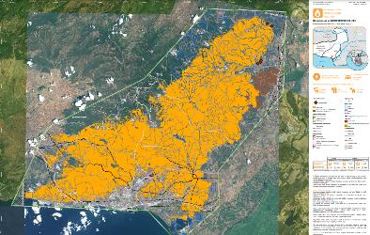





Involving Slovak end-users and industry
Interested?
emaid@euspa.europa.eu
End Users
Industry
Illustrative example
Identify/prioritise operational challenges that can be addressed by EU Space
Be the first to use and validate operational and tactical solutions and technologies
Be informed about industrial capabilities that can support your work
Raise awareness on your products or services in the domain of Emergency Management
Support EUSPA co-developing an operational Space-based Emergency Management platform
Be informed about relevant opportunities
Mitigation
& Prevention
Respond
Preparedness
Recover

Slide 12
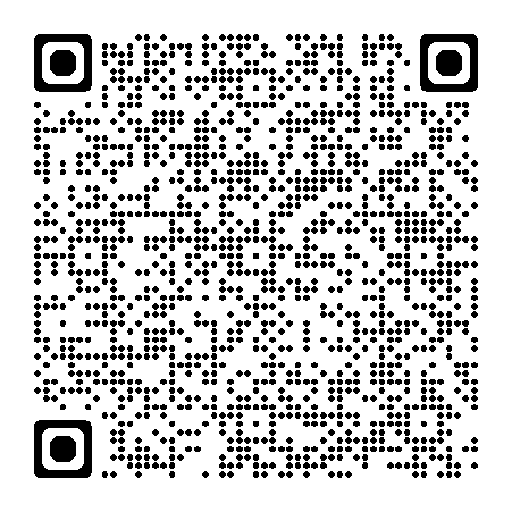
EUSPA Horizon Europe call of 2023 (HORIZON-EUSPA-2023-SPACE)
Type of Action | Topic | Indicative budget (EUR mln)
IA | EGNSS - Transition towards a green, smart and more secure post-pandemic society | 3.5
IA | EGNSS - Closing the gaps in mature, regulated and long lead markets | 8
RIA | Copernicus-based applications for businesses and policy-making | 7
RIA | Designing space-based downstream applications with international partners | 6
IA | EU GOVSATCOM for a safer and more secure EU | 10
Total budget: |  | 34,5
Deadline: 14 February 2024
Innovation action (IA)
Activities to produce plans and arrangements or designs for new, altered or improved products, processes or services.
Research and innovation action (RIA)
Activities to establish new knowledge or to explore the feasibility of a new or improved technology, product, process, service or solution.
The information presented is only indicative, for the full description of the call please see the Funding & Tenders portal.

Slide 13




In conclusion
EU Space is an enabler for Crisis management operations: from risk analysis to damage assessment
Secure SATCOM is key for effective and reliable communication among response teams and coordination centers, especially when terrestrial network is compromised
Join the EUSPA SATCOM webinar
Become a member of the new EUSPA network
Call for interest for First responders, Crisis Coordination office or Industry with relevant solutions, to co-develop, validate and demonstrate a Space-based operational platform
Funding opportunities: Horizon Europe 3rd Call is open!

Slide 15

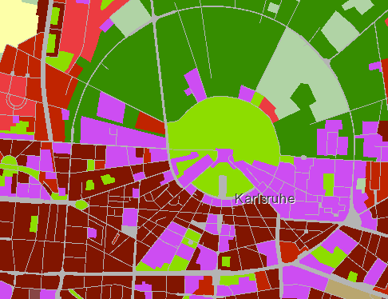
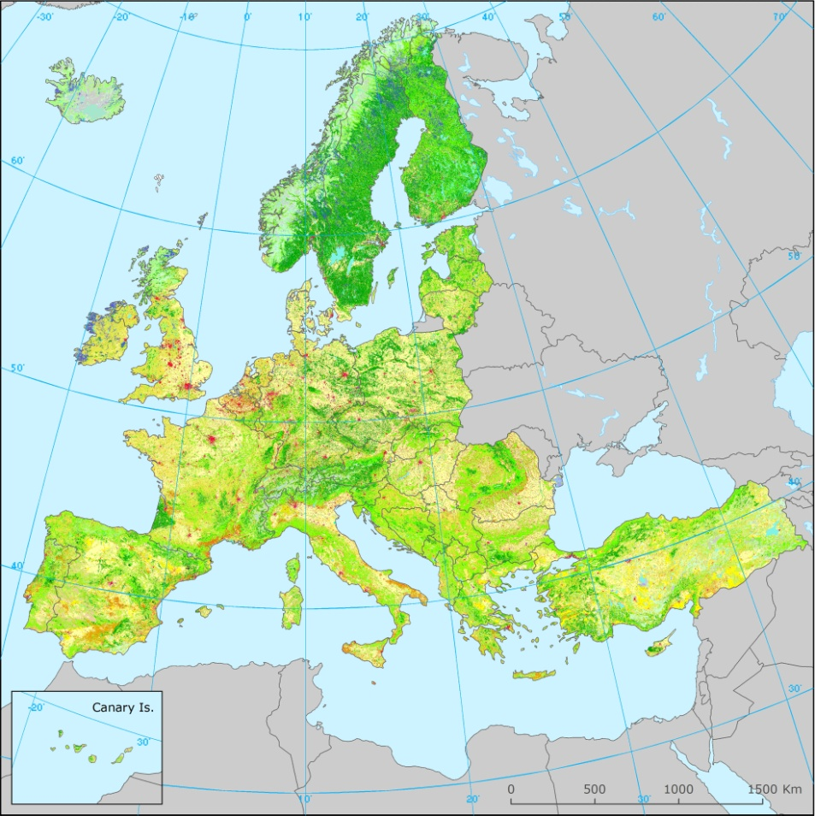
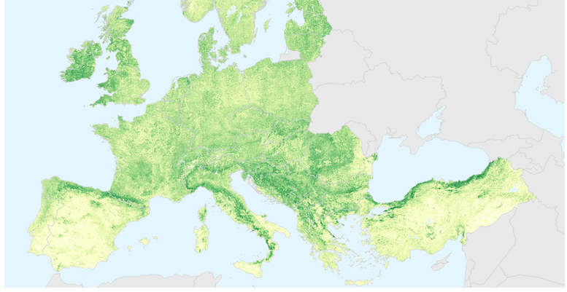
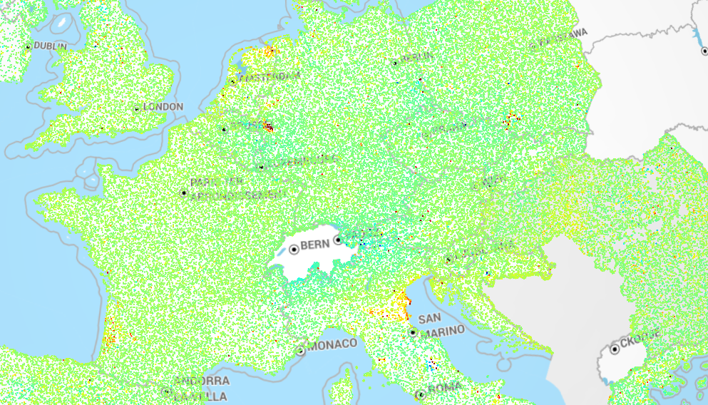

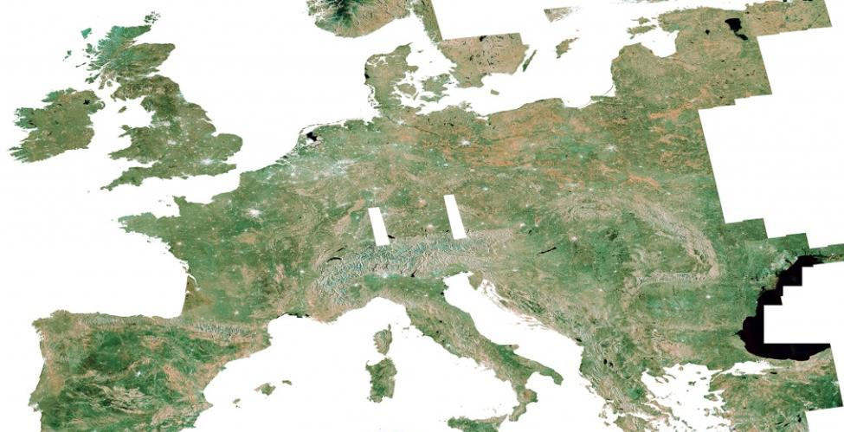
Copernicus for DRM
Emergency Management Service
Land Monitoring Service
Preparedness: forecasts
Response: rapid maps & monitoring of events
Recovery & prevention: risk assessment for specific hazards and post-disaster recovery maps
Priority Area Monitoring
Land Cover & Land Use mapping
For further information:
JRC-LIST-E1-MAPPING@ec.europa.eu
Biophysical Parameters
European Ground Motion Service
Climate Change Service
Image mosaics, In-situ, Ref.data
High-quality climate data through Climate Data Store (CDS)
Observations – forecasts - projections
For further information:
copernicus@eea.europa.eu
For further information:
climate.copernicus.eu

