Slide 1
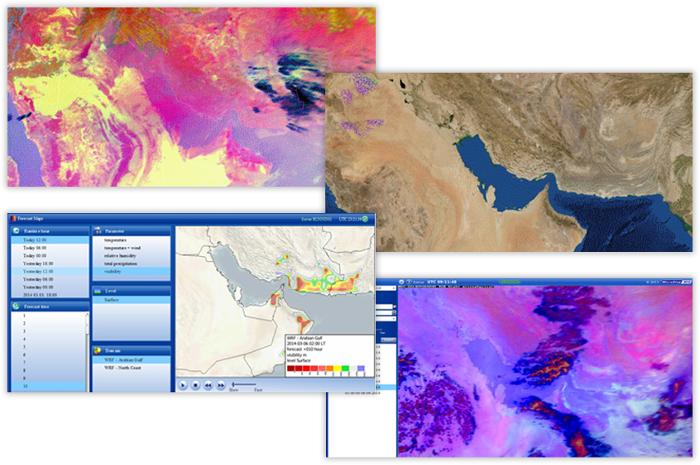
Role of satellite imagery in microstep-mis systems for Disaster risk management
Satellite-based Services for Disaster Risk Management
Presented by Lukáš Ivica (head of Data Science Department, MicroStep-MIS)

Slide 2
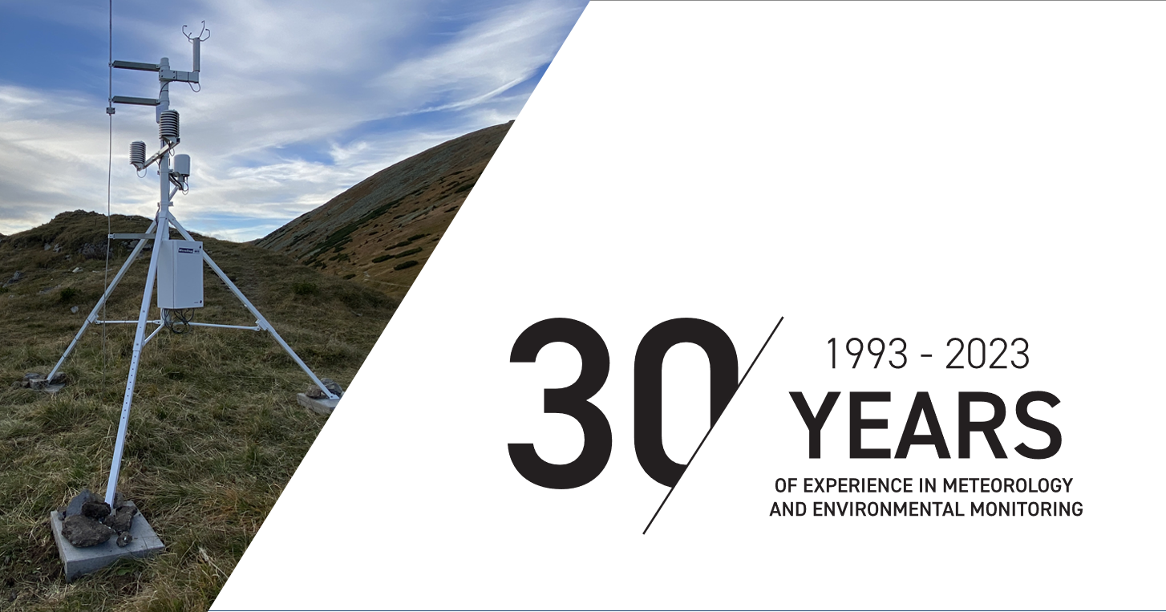
Webinar

Slide 3
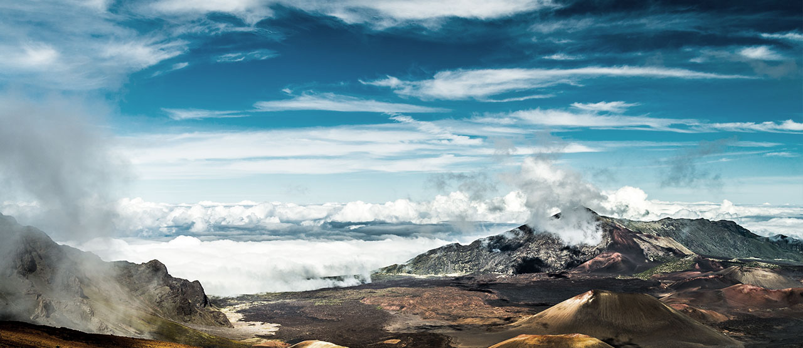
30 YEARS OF EXPERIENCE IN weather and environmental monitoring
4000+
. . .
professional met
stations
1000+
. . .
completed
projects
370+
. . .
aviation weather systems

Slide 4
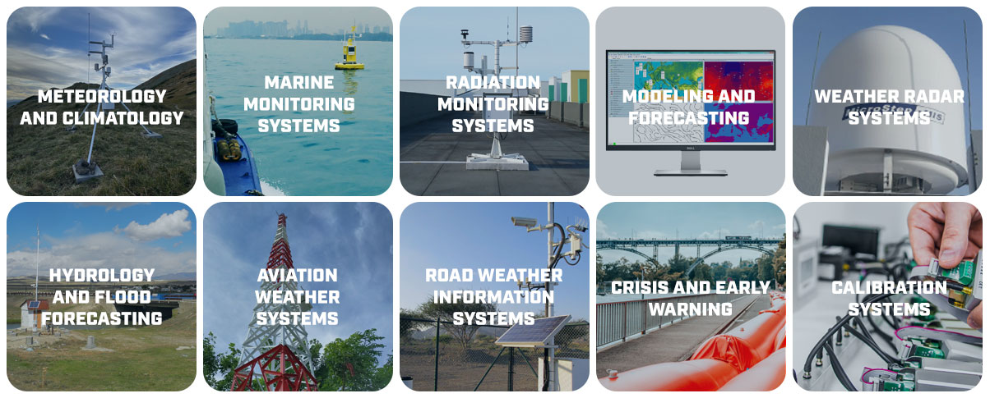
The company`s key Business fields
Webinar

Slide 5

OUR PROJECTS WORLDWIDE
80+
Supplied countries
worldwide
Webinar

Slide 6
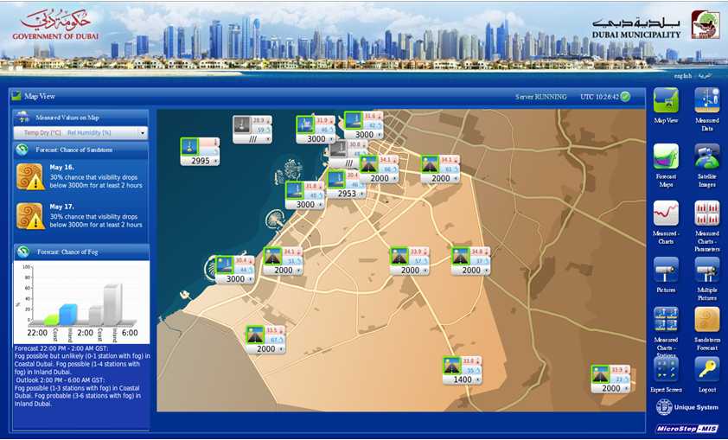
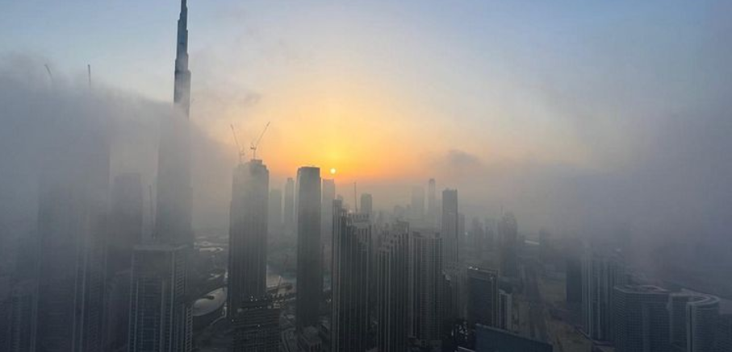
Role of satellite imagery in visibility monitoring and prediction in road weather monitoring system for municipalities
Road weather monitoring system: optimal management of traffic in all visibility conditions and prevention of mass car crashes by reduced visibility (e.g. Ghantoot incident 200 cars, 5 dead, 227 injuries)
Road weather monitoring system main parts: automated weather stations, cameras, meteorological models (3D WRF model, 1D PAFOG model, Datamining based fog prediction model, Model for reduced visibility by sand and dust…)
Webinar

Slide 7
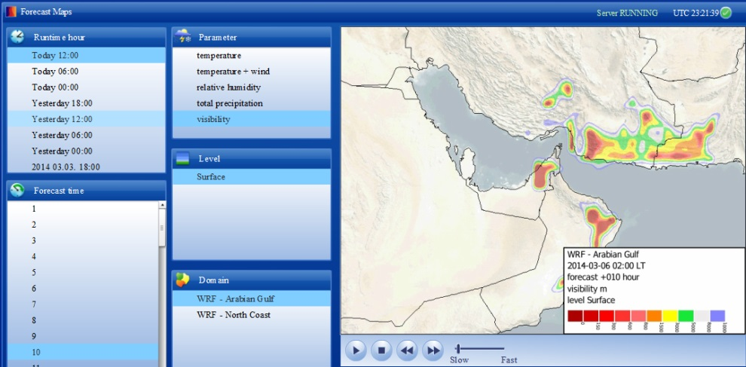
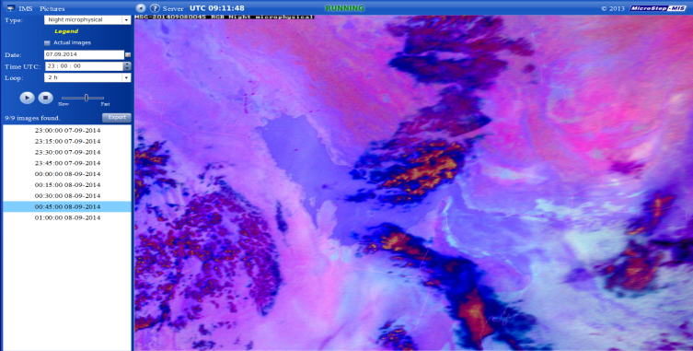
Satellite images role for fog prediction in road weather monitoring system
Groundwork for predictions comes from three sources:
Physical model outputs (3D model WRF, 1D model Pafog)
Outputs of the model based on data mining methods
Satellite images with high frequency (5 min, 15 min)
The final predictions based on these three sources are made by human forecaster.
Webinar

Slide 8
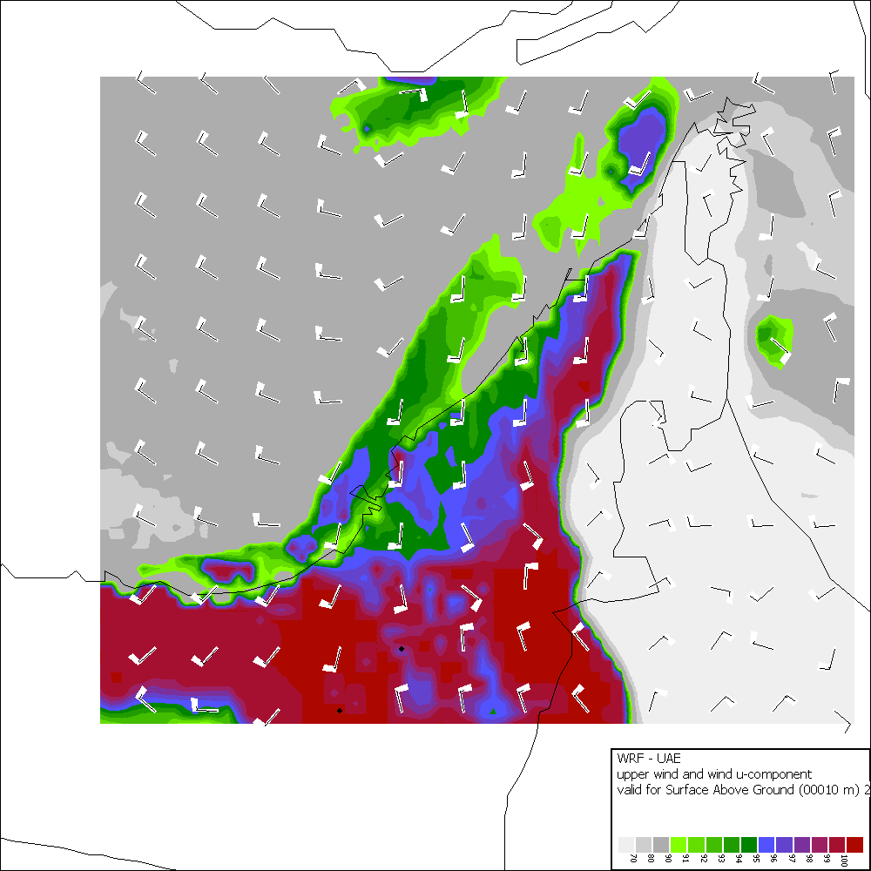
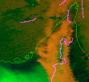
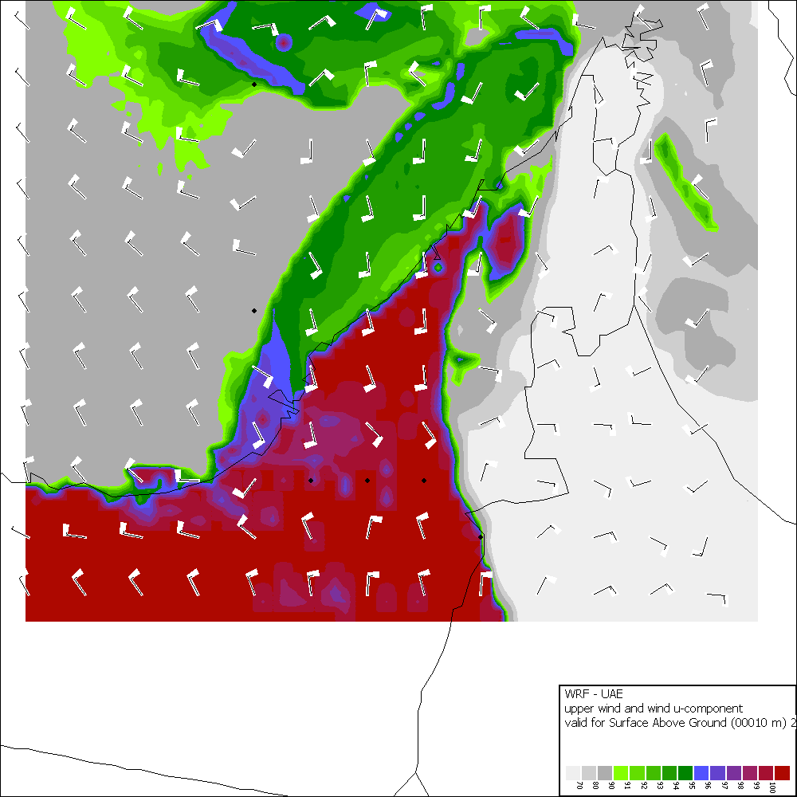
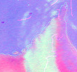
Satellite images role for fog prediction in road weather monitoring system
Satellite images are used also for tuning of fog prediction models
The first image of the following pairs of images shows the visualized prediction of the fog situation predicted by meteorological model (the dark red areas represent the densest fog)
The second image of the following pairs of images shows the situation as it was actually captured on the satellite image, the first satellite image is night low clouds composite (the orange areas represent the fog), the second satellite image is night microphysical composite (the blueish white areas represent the fog)
Webinar

Slide 9
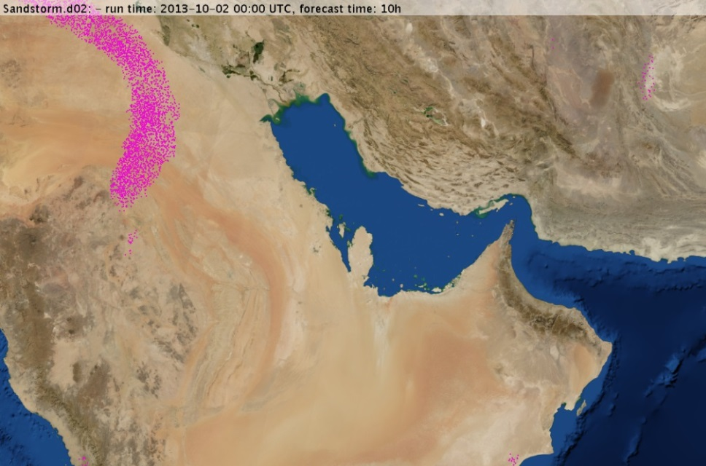
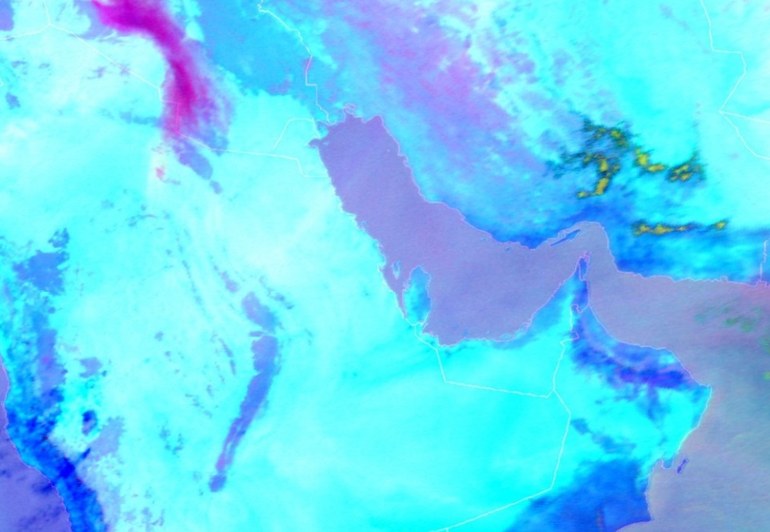
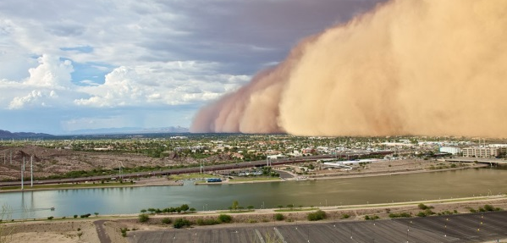
Satellite images role in prediction of reduced visibility by sand and dust in road weather monitoring system
Models
Meteorologists using satellite images in operational use
Satellite images used in tuning models and identifying sand sources and their intensities
Webinar

Slide 10
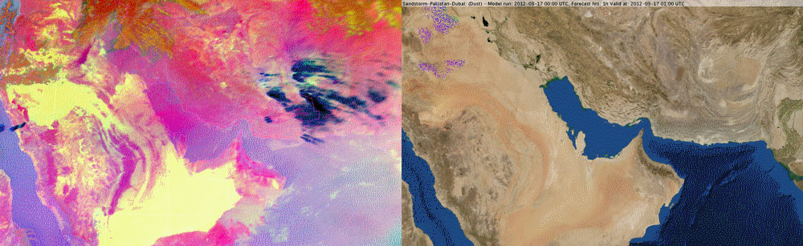
Satellite images role in prediction of reduced visibility by sand and dust in road weather monitoring system
The sandstorm evolution on satellite images (dust cloud appears pink/violet)
Evolution of the sandstorm predicted by model (different colors of sand particles displays their height above the surface)
Webinar

Slide 11
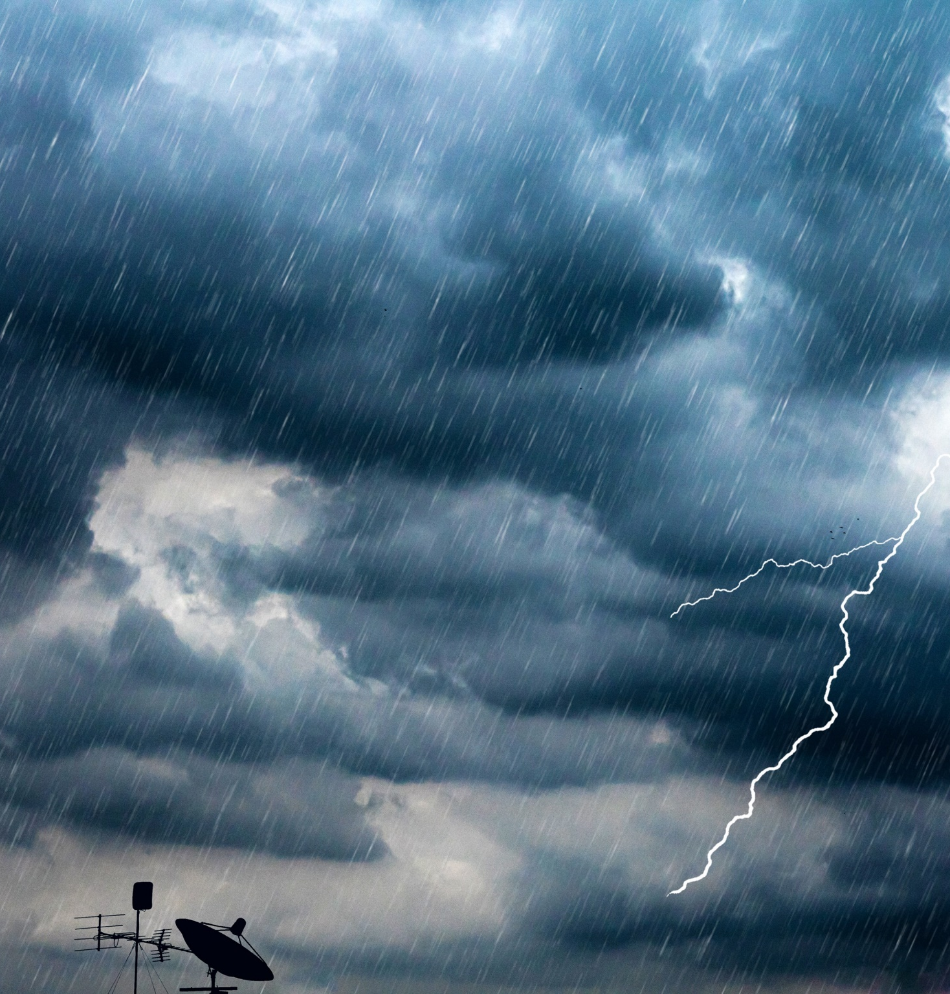
Role of satellite images in thunderstorm nowcasting
thunderstorms most dangerous meteorological phenomena
it is expected that climate change will bring even futher extremalization of thunderstorms
improved thunderstorm nowcasting= an early, accurate warning of a thunderstorm will enable people to take preventive measures to protect their property and health
AI4THOR – AI for Improved Thunderstorm Nowcasting from MSG and MTG (under ESA RPA )
Webinar

Slide 12
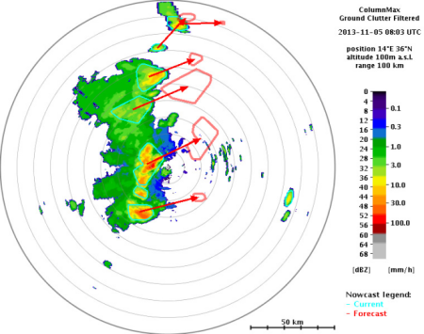
AI4THOR – AI for Improved Thunderstorm Nowcasting from MSG and MTG (under ESA RPA)
Most state-of-the-art thunderstorm nowcasting methods are based on extrapolation techniques
In order to increase the success of nowcasting, we have already started working within a recent research project (targeted on radar data,) on an innovation based on the AI method
We are going to use satellite data with AI methods to develop a new AI nowcasting model based only on satellite data, which will be of a great benefit for customers who do not have access to radar data
Research projects and activities

Slide 13
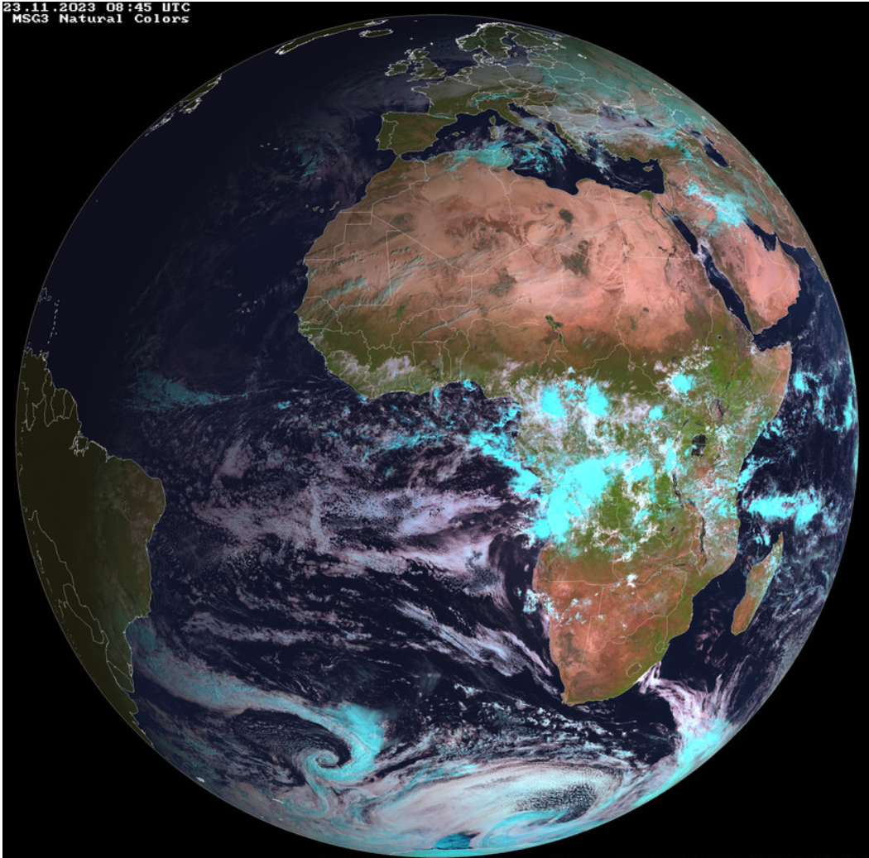
AI4THOR – AI for Improved Thunderstorm Nowcasting from MSG and MTG (under ESA RPA)
To accomplish mentioned objectives, MSG data are intended to be used
One of the benefits of the MSG data is the size of the database:
  more than 10 years of historical data is available for any location (which used to be problem with radar data) on which the AI models can be trained
In this project we would also like to perform a study for the simplest and the most effective way to convert the trained models to data from MTG, which will come with a better resolution and other benefits such as flash detection sensors
Research projects and activities

Slide 14

Thank you for your attention
Company profile

Slide 15

Contact US | offices worldwide
Bratislava | Head office
info@microstep-mis.com
Saint Petersburg
info.russia@microstep-mis.com
Beijing
info.china@microstep-mis.com
Ha Noi
info.vietnam@microstep-mis.com
Bangkok
info.thailand@microstep-mis.com
Dubai
info.uae@microstep-mis.com
Bangalore
info.india@microstep-mis.com
Brisbane
info.australia@microstep-mis.com
Company profile

