Slide 1


Satellite-based Services for Disaster Risk Management in Slovakia
30 November 2023 09:00 - 15:00 Bratislava, Slovakia
ISEMI and RDI projects
with focus to Satellite-based Services

Slide 2
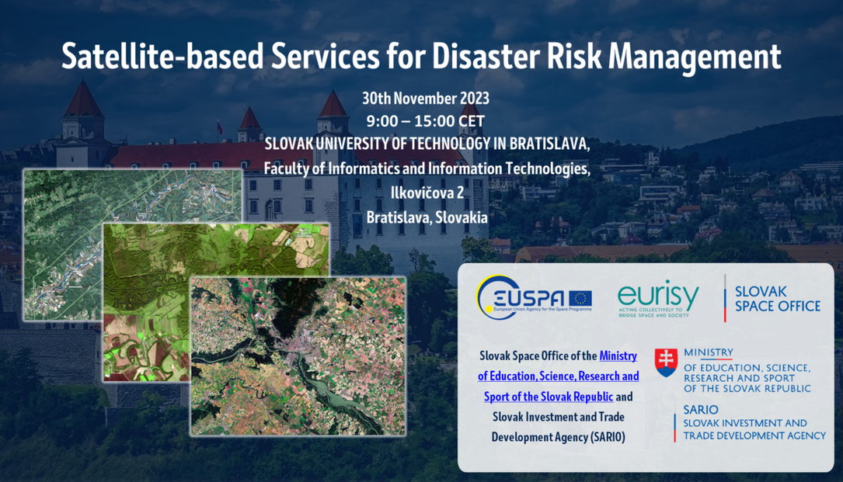

Slide 3

ISEM – International Security and Emergency Managemetn Institute, n.p.o. (ISEMI)
Non-profit organisation providing publicly beneficial services
Establishment: 07/2014
Main objectives:
Implementation of strategies and policies in the field of security and crisis management
Increasing the effectiveness of the fight against crime and organized crime
Support of emergency services and crisis management entities for managing crisis situations
Target group:
Public administration entities (police/LEAs, FRS, EMS, CP and crisis management)
European and International institutions (EC and its DG, JRC, Europol, Interpol, NATO, etc.)
Other affected public sector entities (healthcare, environment, defense, etc.)
Scientific research organizations, universities, non-governmental organizations as well as natural persons
Networks and groupings of relevant entities

Slide 4

ACTIVITIES
Satellite-based services
Training & Exercises
EU CBRN CoE
RDI
H2020
Networking
CBRN CoE
Other
HORIZON
UCPM
ISF-P
ISF-P
IFS
H2020
Specific training
Study visists
TTX, FX, FSX
Tests/pilots
Scenarios and planning
Demonstrations
HORIZON
UCPM
ISF
Platforms
Workshops and Conferences
Ad-hoc aktivity
Dissemination
ISF, IFS
H2020, HE
UCPM
iné
Specific (one-time) activities
Exploitation
CBRNe
Crime and terrorism
Civil security and crisis management
Rescue
Education activities
Procedures
Equipment
Methodologies

Slide 5












Research & Development & Innovations Projects
TARGET – Augmented Reality Training
TERRIFFIC – optimization of intervention activities in CBRNE incidents
SYSTEM – detection/monitoring of drug/explosive precursors
ILeaNet – innovations through networking of LEAs
DAREnet – networking and innovations for flood resilence
iProcureNet – networking and research for procurement innovation
RESCUER – technologies for rescuers in adverse conditions
VALKYRIES – standards and harmonization for MCI response
NOTIONES – networking and innovation for security and intelligence services
PANTHEON – Smart City Digital Twins for Disaster Resilient Communities
PROTECT – Procuring innovative climate change services
SHIELD4CROWD – PCP for Crowd Management Security
R-PLAN – Risk assessment methodology
CRISPRO – Security and protection networking for knowledge synergies

Slide 6

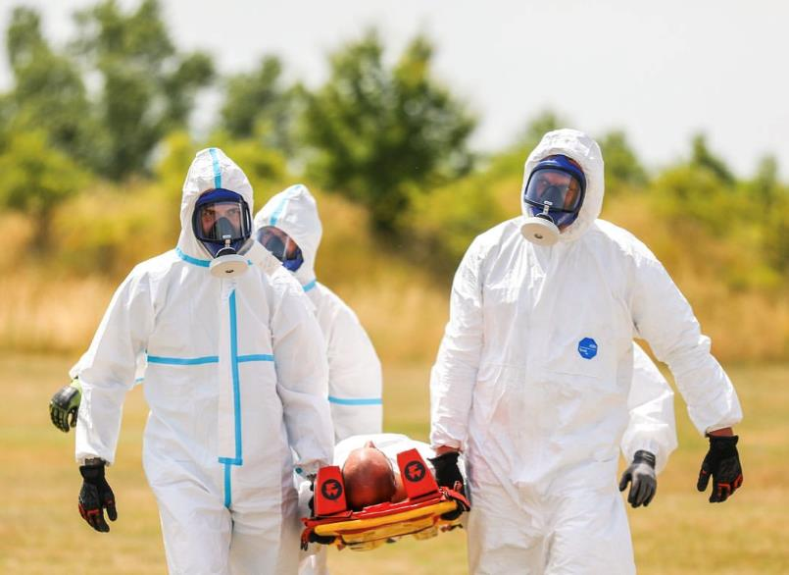

COMPLETED
Harmonization and Pre-Standardization of Equipment, Training and Procedures for FRs on MCI.
Project aimed at exploring the impact of the emerging technologies, procedures and collaboration tools for supporting the actuation of the first aid responders on cross-border disasters and major crisis situations.
Implementation of satellite pictures of affected area was examined with goal to improve common operational picture and for effective decision making on different levels.
Related partner: Aratos.Net Ltd
TITLE

Slide 7





ONGOING
Community-Based Smart City Digital Twin Platform for Optimised Disaster Risk Management operations and Enhanced Community Disaster Resilience
Satellite Services related objective:
Intelligence, CB-SCDT Processes and Optimal Disaster Risk Management Operations
Employ earth observation data, Smart City IoT, insitu, community-generated data and AI technologies.
Focus on Big Data processing for data cleaning, organising and restructuring; design appropriate and controlled data flow.
Improve the accuracy of the DT by adding AI/ML with a certain amount of data for training purposes.
Related partner: EPSILON Malta Ltd
(www.epsilonmalta.com)
Community-Based Smart City Digital Twin Platform for Optimised DRM operations and Enhanced Community Disaster Resilience
This project has received funding from the European Union’s Horizon Europe programme under grant agreement N°101074008.

Slide 8










ONGOING
First Responder-Centered support toolkit for operating in adverse and infrastructure-less Environments
Rirst Responder localization and visualization:
Visual based self-localization
Inertial based localization
Galileo based localization
Related partners: DLR
UOG
CERTH
UPM
101021836 — RESCUER — H2020-SU-SEC-2018-2019-2020 / H2020-SU-SEC-2020
Project funded by: EUROPEAN COMMISSION - Research Executive Agency (REA)

Slide 9
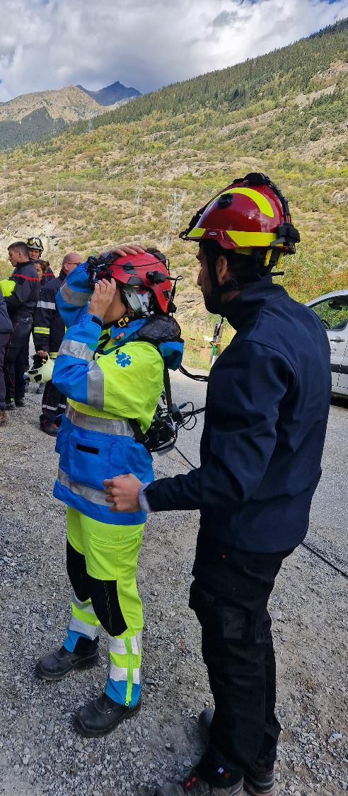
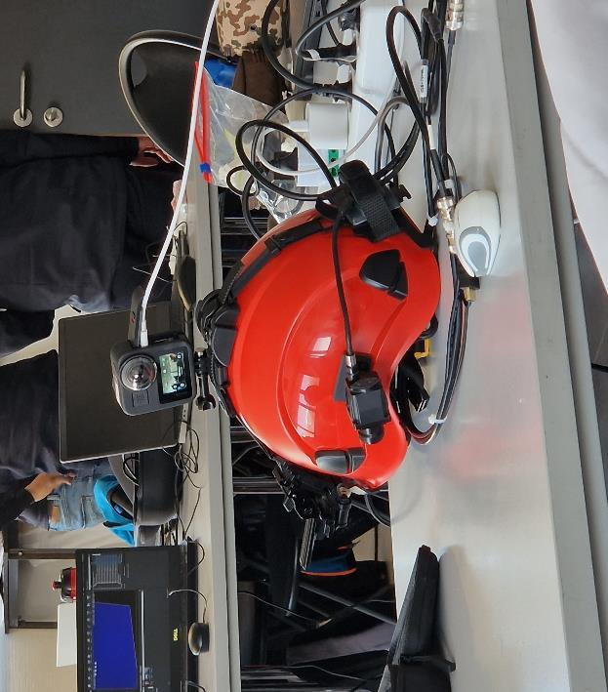
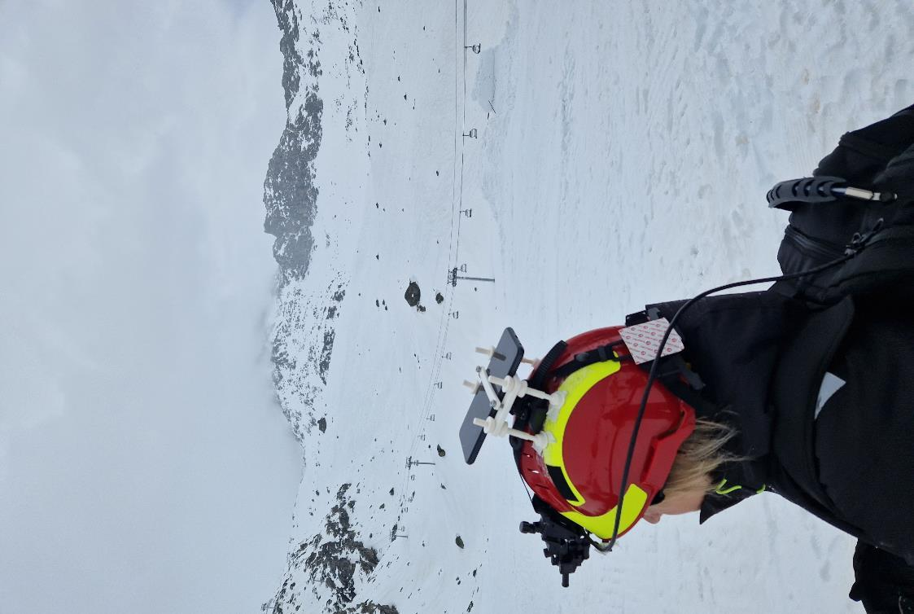
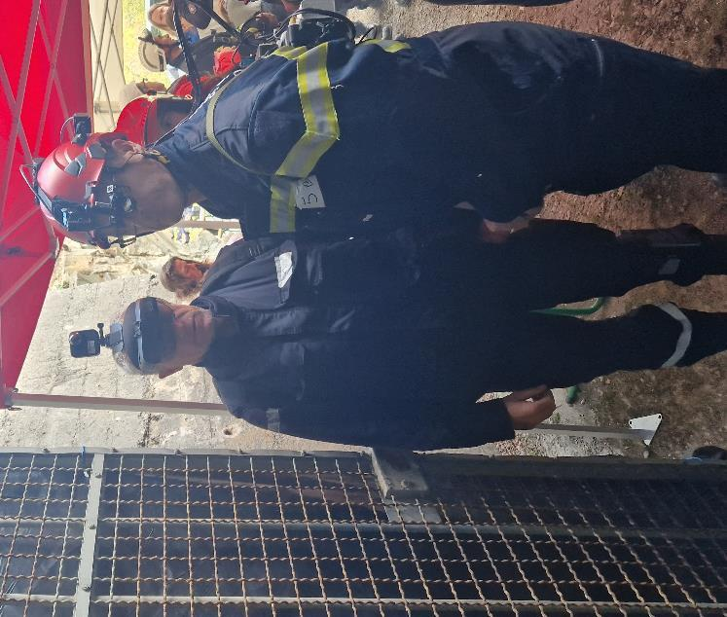
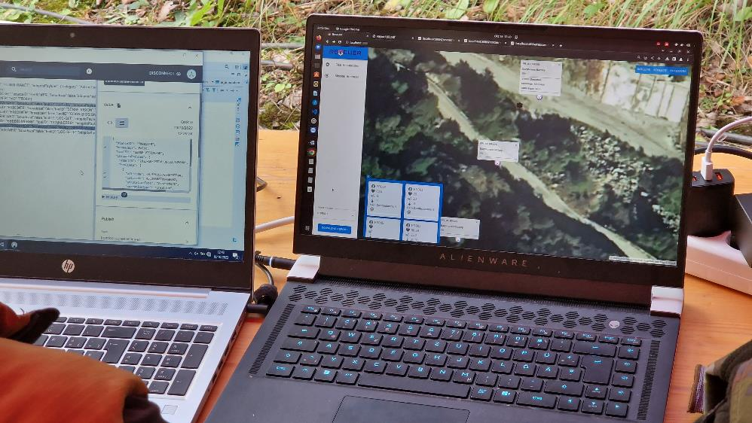
possibility to participate/contribute to project activites during AB and/or user group meetings, respectivelly another related disseminatin activities.(webinars, conferences, etc.)

Slide 10
Introducing PROTECT
Jozef Kubinec

Slide 11
What is PROTECT about and who is it for?
An Horizon Europe (HE) CSA project aimed at raising public and private buyers’ awareness, building their capacity, and preparing them for undertaking a joint cross-border Pre-Commercial Procurement (PCP) fully funded under another HE PCP call.
Key actors:
Buyers – public authorities (regions, cities, national and regional agencies, etc.) that may be interested in exploring innovative procurement for tackling adaptation and mitigation issues.
EO-based climate services providers willing to collaborate with the public demand to overcome pressing challenges in the area of climate adaptation by co-designing a new solution ‘climate service’ based on EO data NOT YET AVAILABLE on the market.
An innovative and strategic public governance and procurement approach to climate change adaptation and mitigation

Slide 12






Process towards the 4 OMCs and the PCP call
Mapping of climate challenges at EU regional level
Consultations with buyers to identify
4 pressing challenges and finetune their needs
4 Open Market Consultations on key challenges to inform market providers
Mapping of EO climate service providers at EU level
E-pitching sessions with EO climate service providers to complement the SOTA analysis
Identifying lead buyers to build 4 consortia of buyers willing to prepare a joint cross-border PCP application

Slide 13








4 pressing challenges identified
Lead buyer identified
Mapping and predicting FLOODS (marine, riverine and other sources)
Prediction and prevention of FIRES and tracing and tracking responsible sources (waste, forest/nature, other)
Climate resilient WATER solutions (prediction, connecting data, planning, supply-demand)
Sustainable & resilient INFRASTRUCTURE (sustainable re-development, buildings restoring & adaptation).
Notes:
The OMC will allow the Public Buyers Group (PBG) organised under the PROTECT project to inform market operators regarding the upcoming Pre-Commercial Procurement (PCP) of Research and Development (R&D) services for the “Customisation/pre-operationalisation of prototypes end-user services in the area Climate Change Adaptation and Mitigation”, also to inform relevant stakeholders, users and market players to gather their input about the PROTECT challenges on:

Slide 14


What is the PCP call about?
The Pre-Commercial Procurement (PCP) call “Customisation/pre-operationalisation of prototypes end-user services in the area Climate Change Adaptation and Mitigation” is open and available on the Funding and Tenders Portal: here.
The PCP should deliver successful innovative and fully tested product(s) and/or service(s) that meet the common needs of a buyers' group (consortium of procurers) to procure research, develop innovative marketable solutions, speed up the time-to-market, and provide best value for money.
19M EUR FULLY funded by Horizon Europe programme
PROTECT supports the preparation of future candidate applications to the PCP call by working both with the demand (buyers) and supply side (providers) of Earth Observation (EO)-based climate services.
Opened on 17 October 2023
Close on 28 February 2024 at 17:00 CET
Estimate start of the PCP: Sep 2024
Notes:
Build on the Copernicus^{[2]} Services that respond to the common needs and beyond state-of-the-art performance targets of the buyers group;
Reduce the fragmentation of demand for innovative solutions by enabling public procurers to collectively implement a Pre-Commercial Procurement (PCP) in the area of climate adaptation and mitigation, which, due to their nature, are better addressed jointly, or which they would not have been able to tackle independently;
Create New opportunities for wide market uptake and economies of scale for the supply side through the use of joint specifications, wide publication of results and – where relevant – contribution to standardization, regulation or certification to remove barriers for introduction of innovations into the market and creation of new products, processes and/or services ready for market uptake, leading to viable new businesses, jobs and sustainable economic growth.

Slide 15
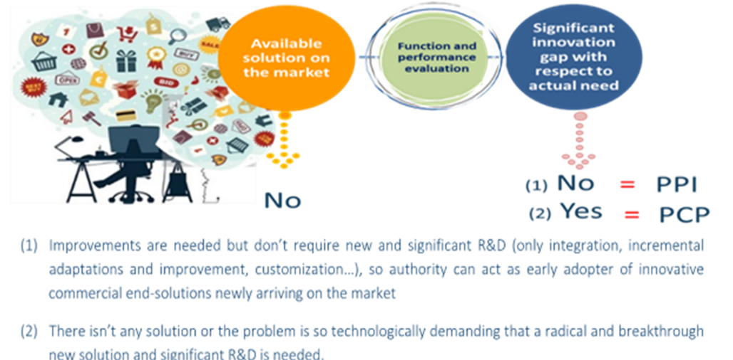
PCP approach
R&D is needed to identify an innovative solution to satisfy public procurers’ needs.
No solutions exist yet on the market that meet public procurers’ needs and based on a search conducted by the procurers, it does not seem that such a solution will be available on a short-term notice.

Slide 16
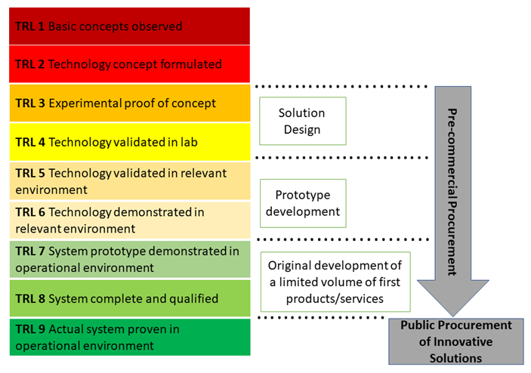
Pre-Commercial Procurement (PCP): TRL 3 - 8

Slide 17
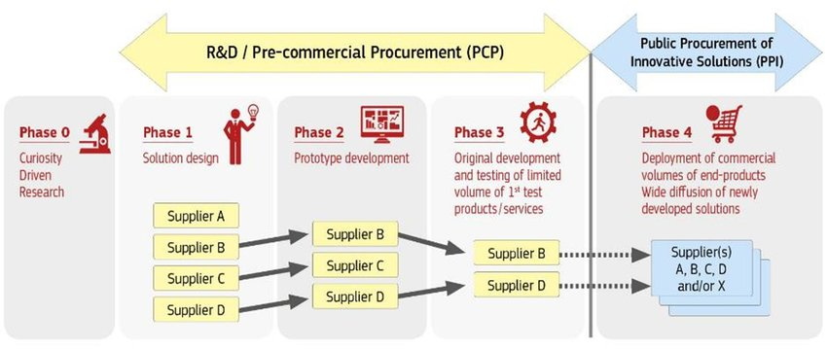
Pre-Commercial Procurement (PCP)
Innovation Procurement happens when public buyers acquire the development or deployment of pioneering innovative solutions to address specific mid-to-long term public sector needs.

Slide 18
Next steps
Publication of the OMC report – 25 Nov 2023
Final webinar with providers – Jan/ Feb 2024
Building consortium/a of buyers & aggregation of needs – up to Feb 2024
Final PROTECT Project event – Q1 2024

Slide 19




Thank you for your attention!
Contact: Martin Kostolný
+421 910 850 285
kostolny@isemi.sk
www.isemi.sk
Contact: Jozef Kubinec
+421 908 055 878
jozef.kubinec@minv.sk

