Slide 1
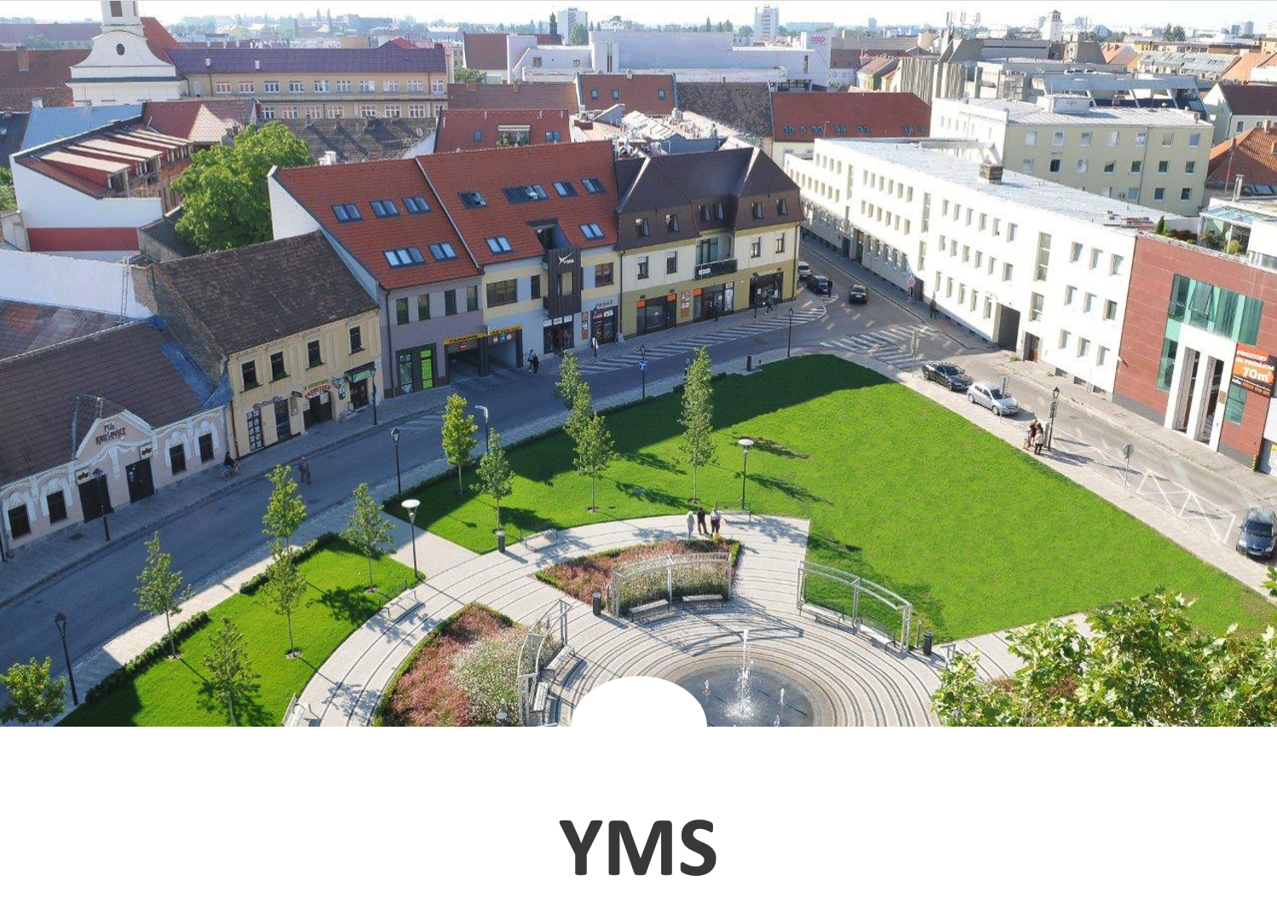
Satellite-based Services for Disaster Risk Management

Slide 2
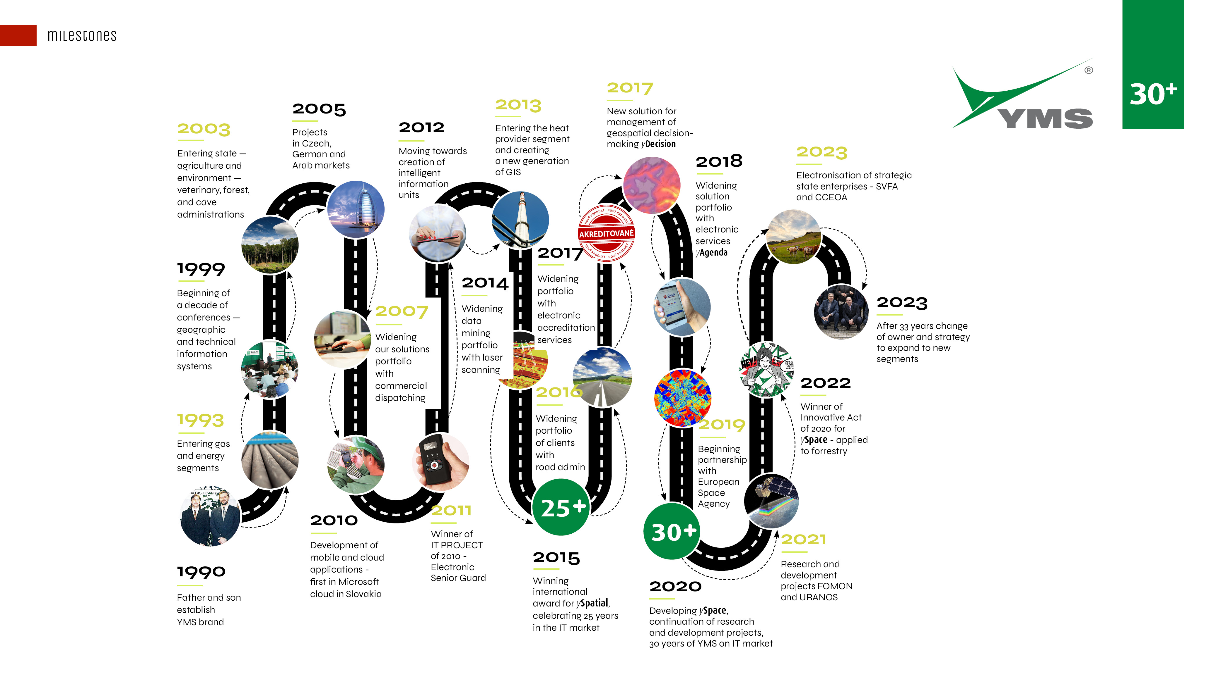

Slide 3
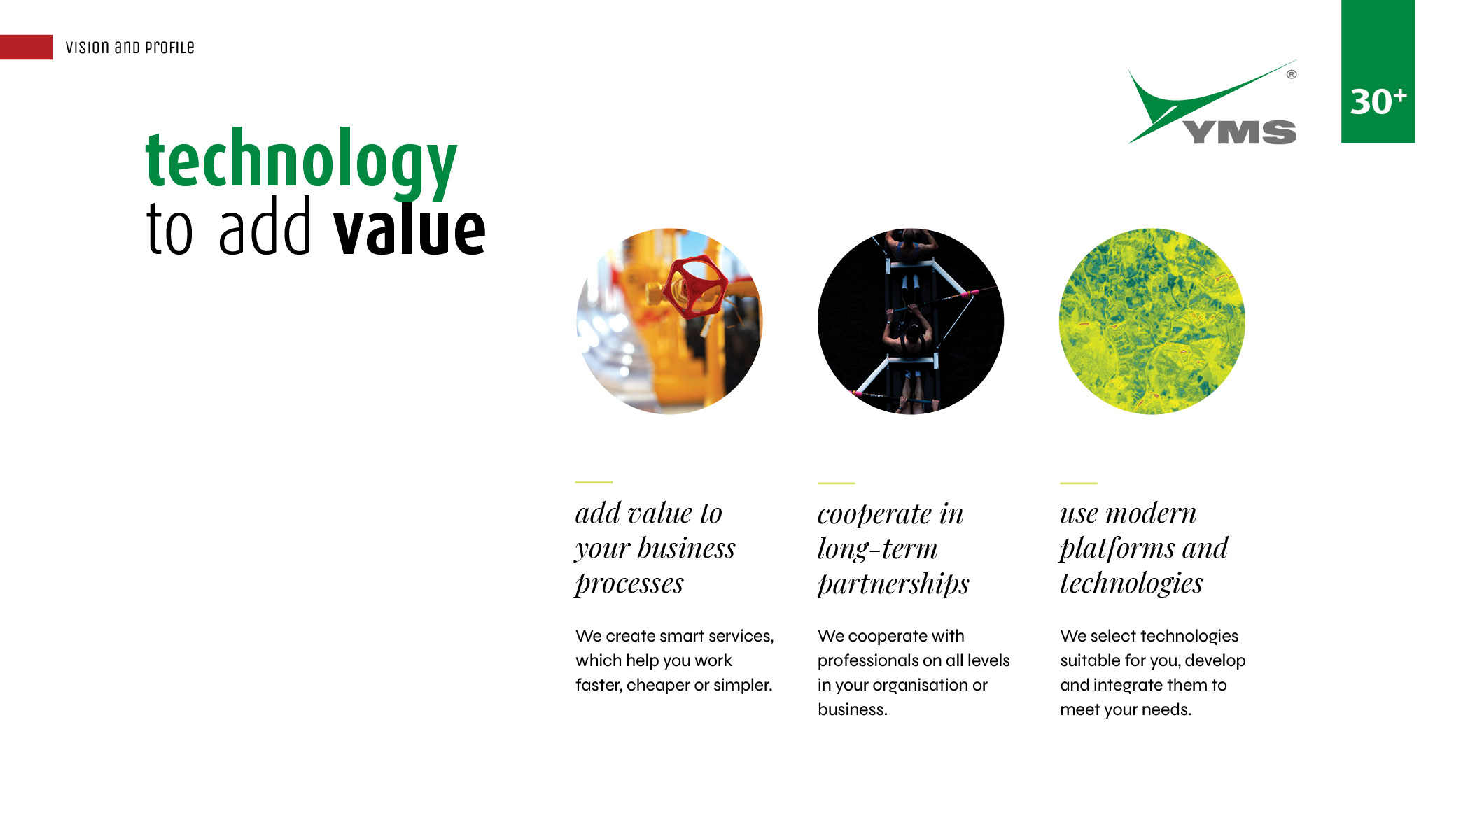

Slide 4
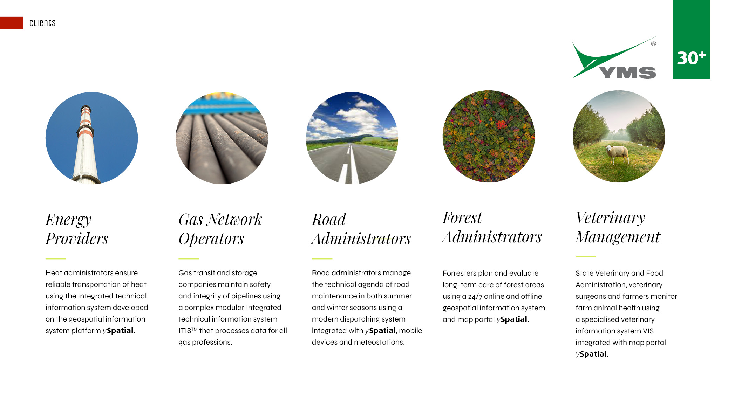

Slide 5
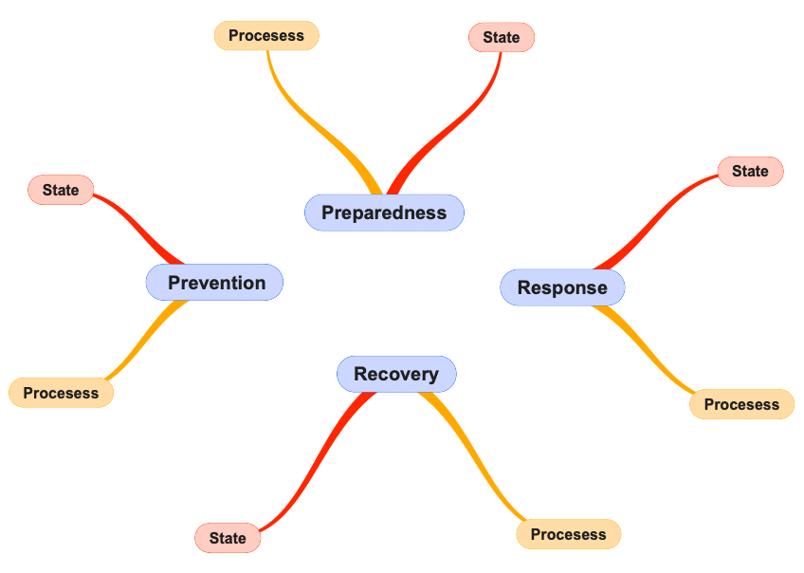
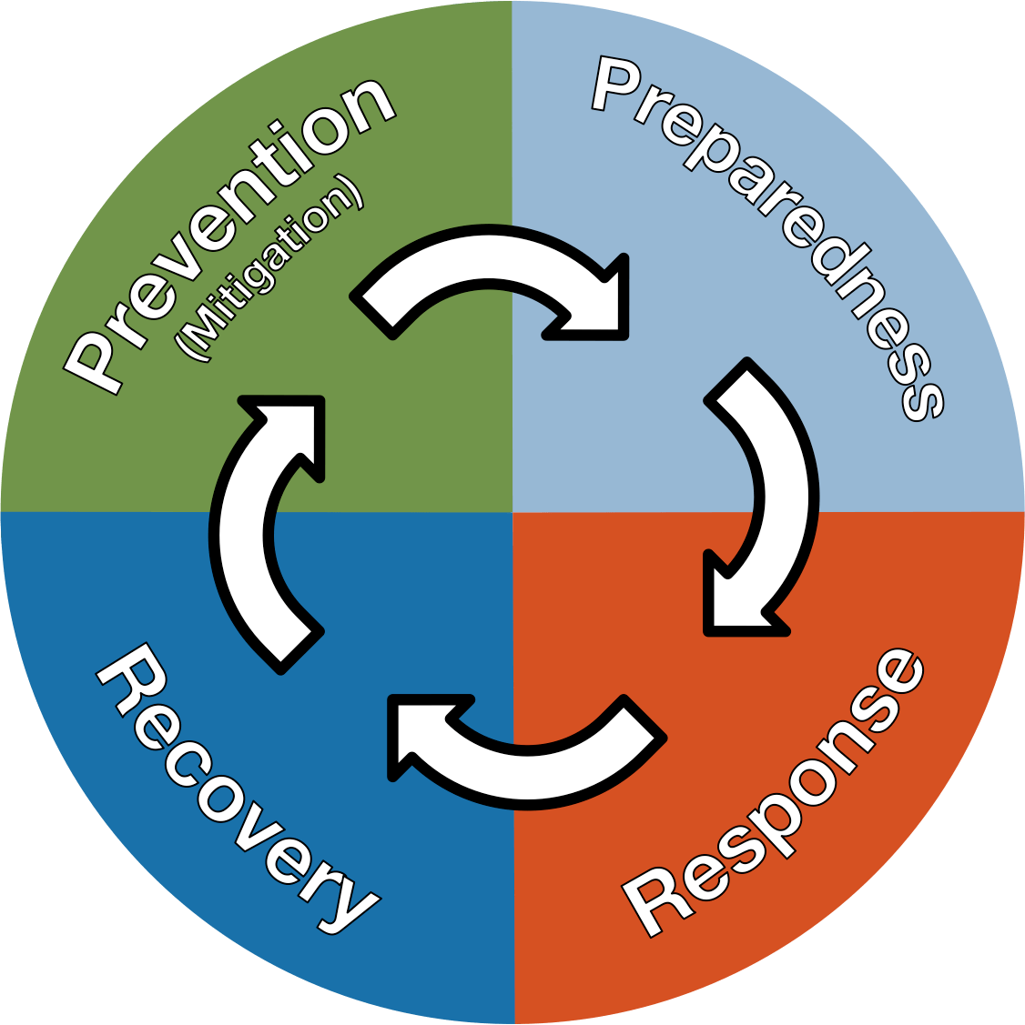
Disaster Risk Reduction cycle

Slide 6



Prevention – time for research,
science, planning ...
Risk assessment
Preparation and development of monitoring and evaluation systems
"Public awareness and education"
Land use planning
Building resilient infrastructure
Ecosystem services

Slide 7
Preparedness – eyes open ...
Early warning systems monitor statuses as well as processes
Remote sensing of the Earth
Carriers of drones, satellites, airplanes, balloons, airships ....
Camera systems
Internet of Things - IoT
Artificial intelligence – AI / ML / DL
Interoperability
Forecasting and warning systems
Models
Artificial intelligence – AI / ML / DL
Digital twins
IS with connection to "real time" data

Slide 8

Response – speed, efficiency
Real time systems…
Remote sensing of the Earth
  Carriers: drones, satellites, airplanes, balloons, airships ....
  Camera systems
Internet of Things - IoT
Artificial intelligence – AI / ML / DL
Interoperability
Coordination
Availability
Comprehensibility
Spatial Decision Support Systems

Slide 9
Recovery - prioritization, complexity
Data capture
“on-site“ mapping
Mobile mapping
Satellites
Drones
...
Data sharing
Geoportals
services (WMS, WFS ...)
...

Slide 10

Developed Platforms

Slide 11
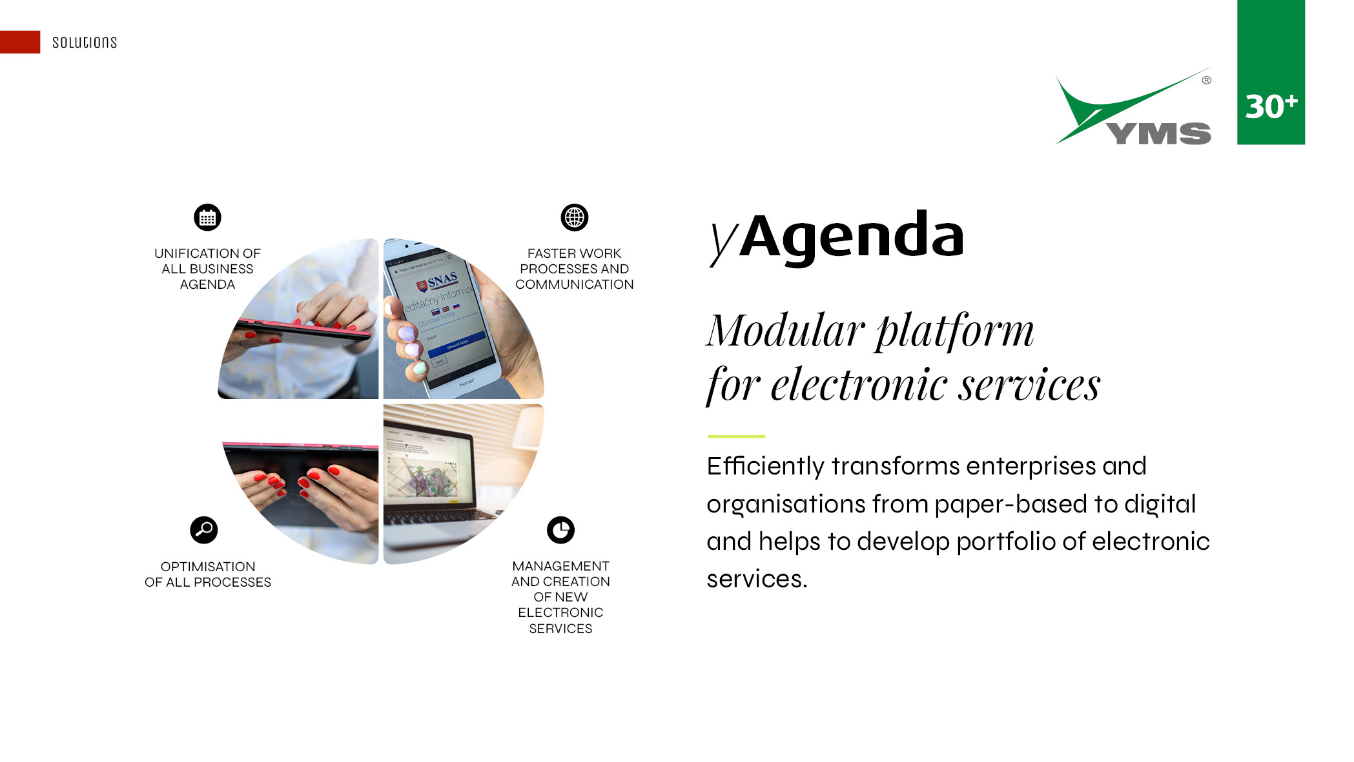

Slide 12
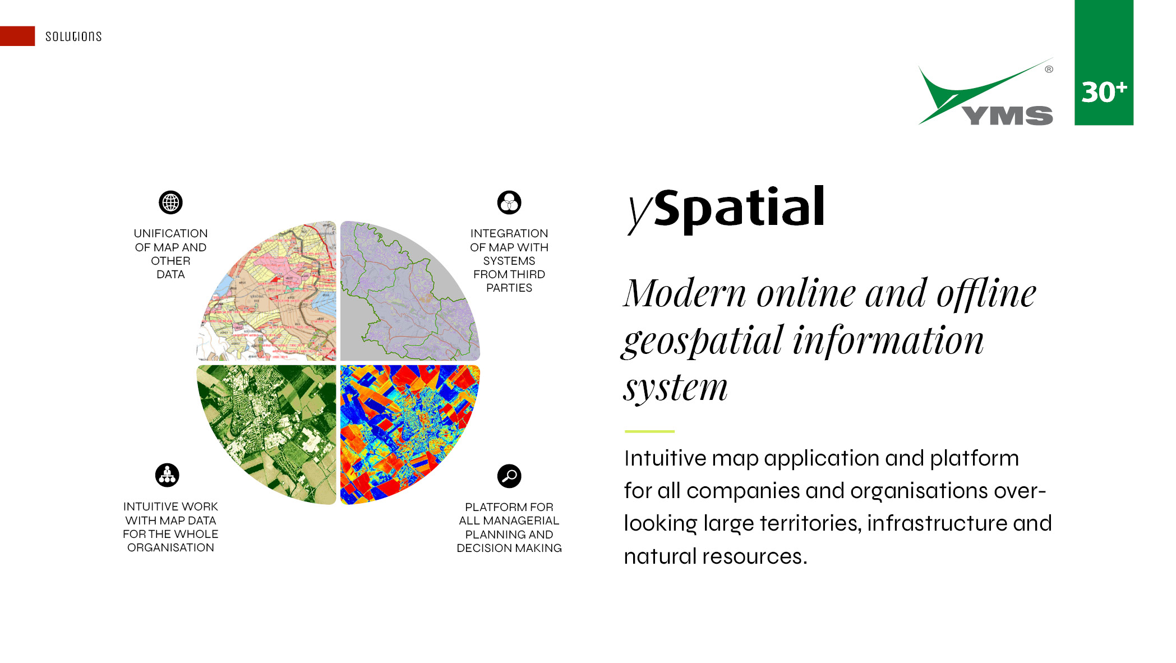

Slide 13
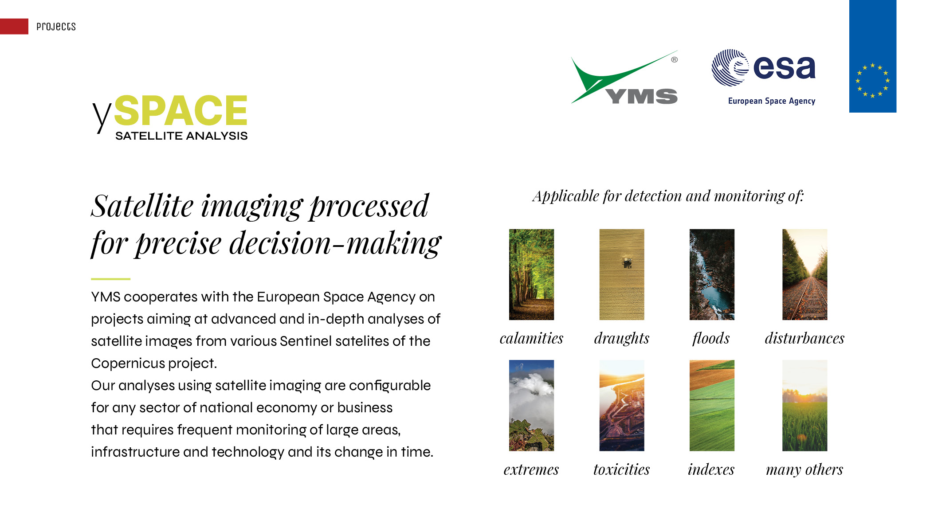

Slide 14
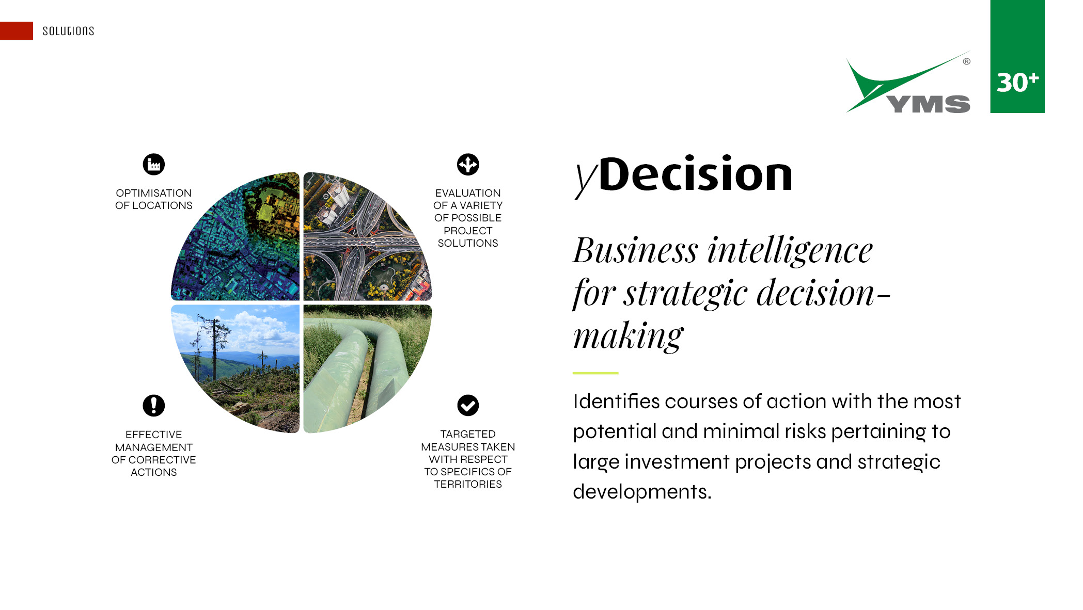

Slide 15
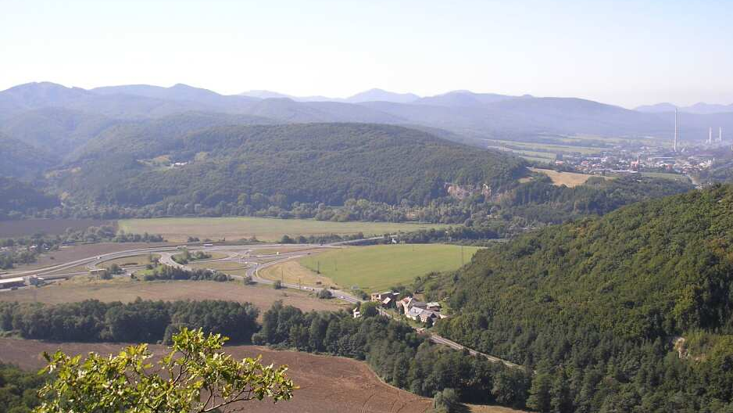

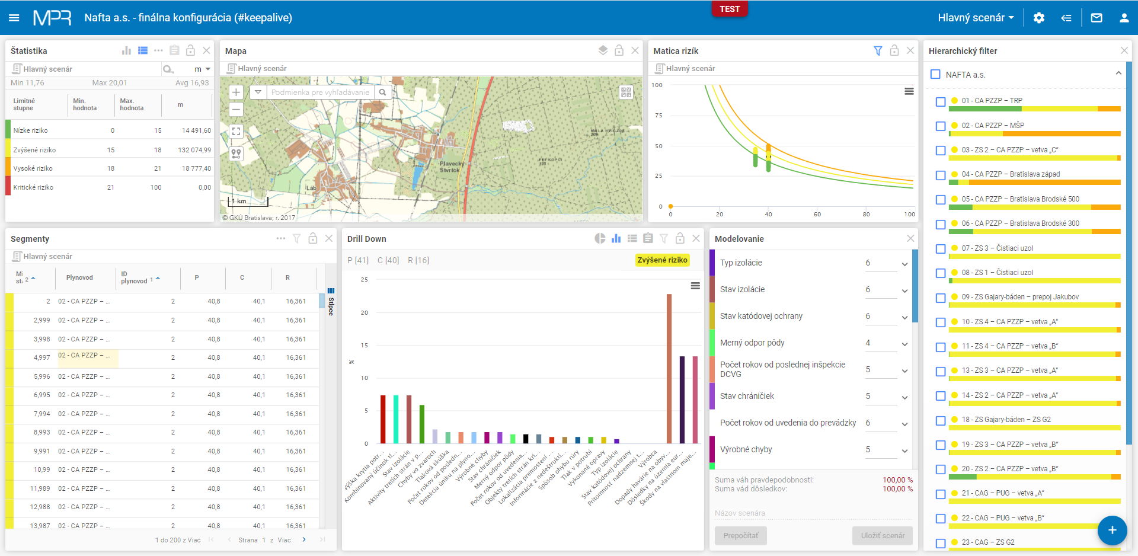
yDecision – example

Slide 16
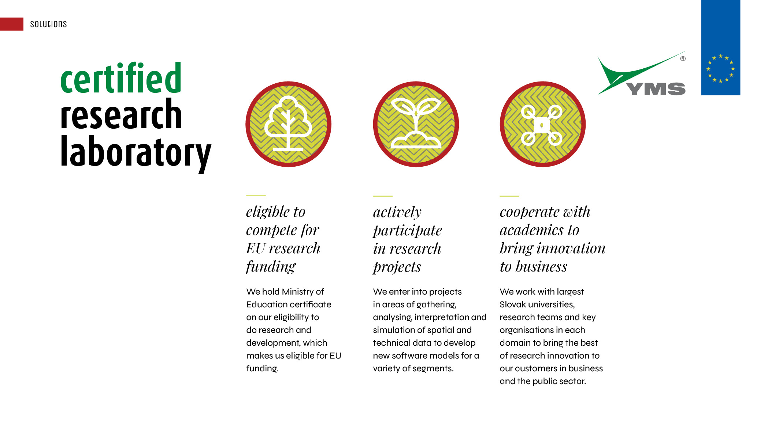

Slide 17
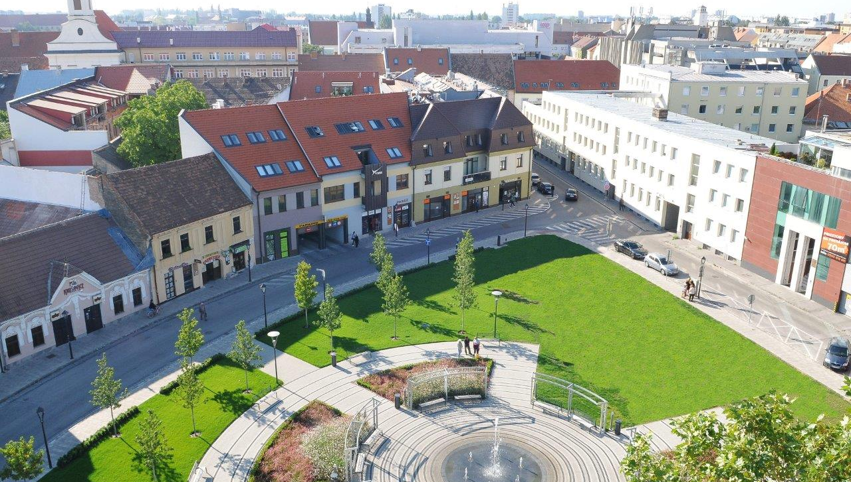
Thank you for your attention
radovan.hilbert@yms.sk https:\\www.yms.sk GSM:+421 903 909 803

