Slide 1

Remote sensing as a tool for climate risk assessment
kajoservices.com
martin.kuban@kajoservices.com
milan.kalas@kajoservices.com

Slide 2
Remote sensing and Climate risk assessment
CLIMAAX – Climate risk assessments for every European region
  Sentinel2 data – Normalized Difference Vegetation Index
  Landsat8 – Land surface temperature
Zilina Region - Change in forest Cover in Zilina Region
  Sentinel2 – Enhanced Vegetation Index
MedEWSa – Innovative use of EO data in forecasting, detecting and managing natural disasters.
Consultancy activities for Copernicus Emergency Management Service

Slide 3


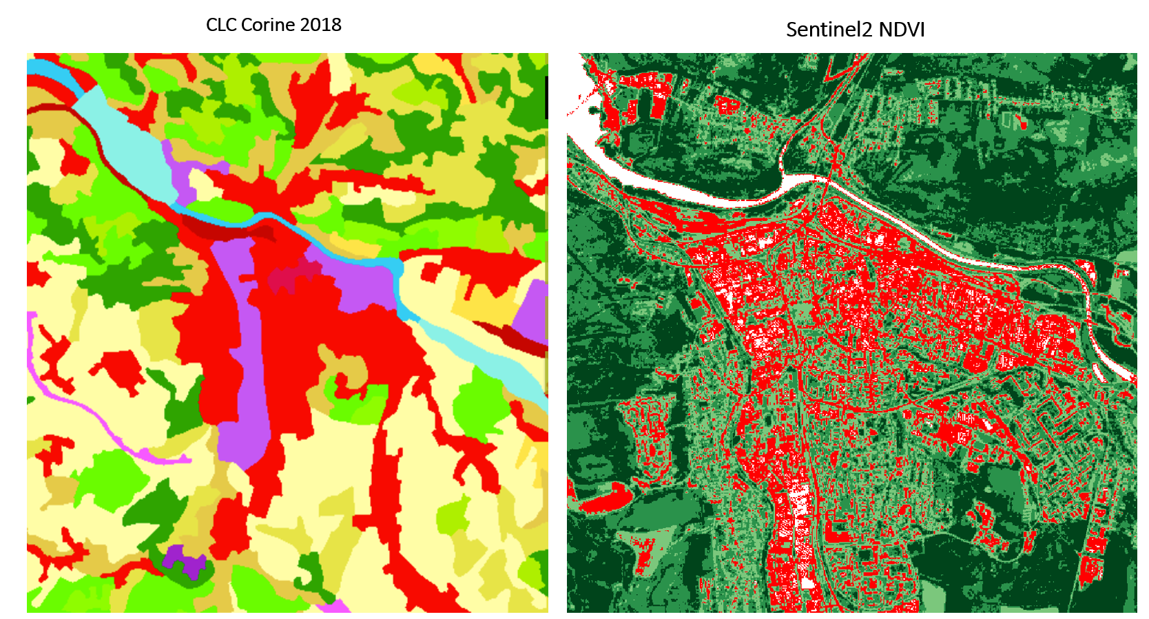
CLIMAAX
Horizon Europe / 19 partners / 5 Pilot sites
Climate risk assessment for every European region
Harmonized methodology for the climate risk assessment
Toolbox in Jupyter notebook
  Manuals and tools for using the Remote sensing data
    Sentinel2 (10x10m) – NDVI, NDWI, EVI – identification of the vegetation (adaptation measures)
    Landsat8 (30x30m) – LST identification of the overheated areas (heat islands) in the cities
www.climaax.eu

Slide 4
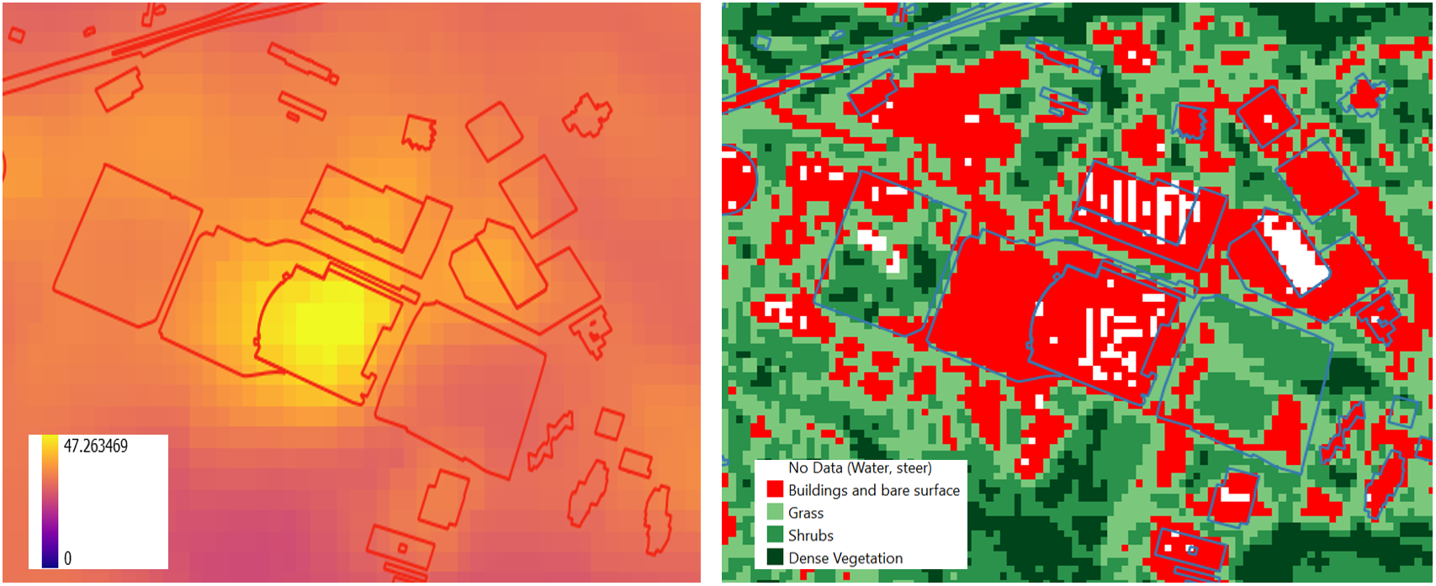
CLIMAAX
Landsat8 LST (30m)
Sentinel2 NDVI (10m)

Slide 5
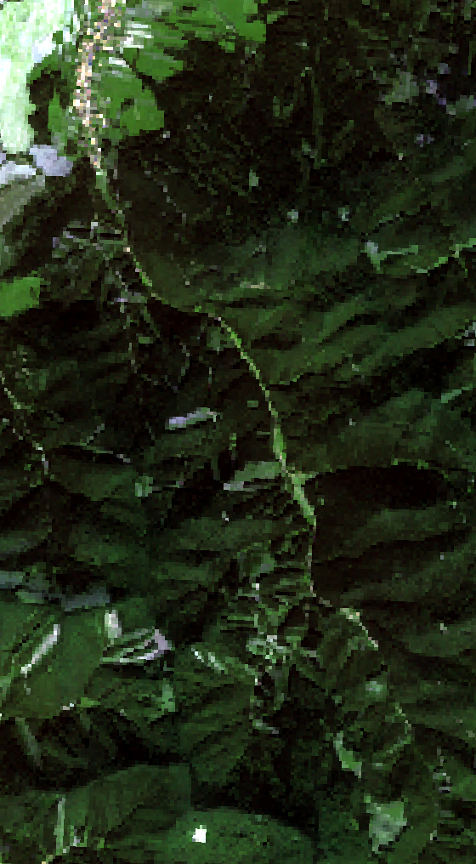
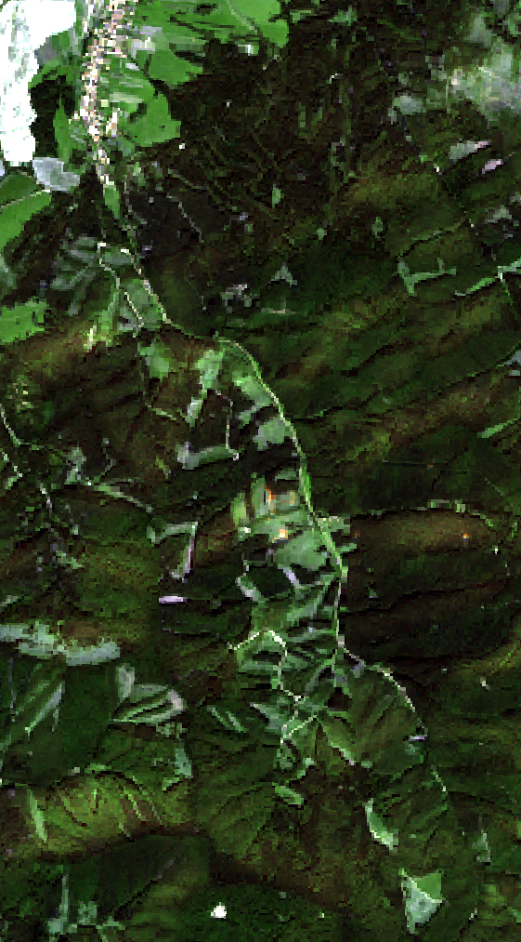
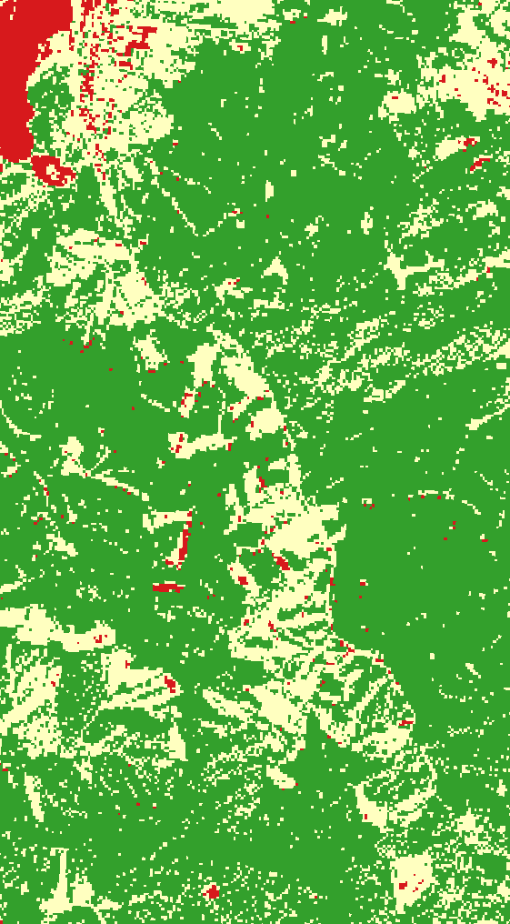
Zilina Region EVI
Differences in forest cover, Forest as a flood mitigation measure
Suitable places for the flood mitigation measures
Near real-time forest cover (changes)
Enhances Vegetation Index for the classification of the forest cover
2016
2023
EVI

Slide 6
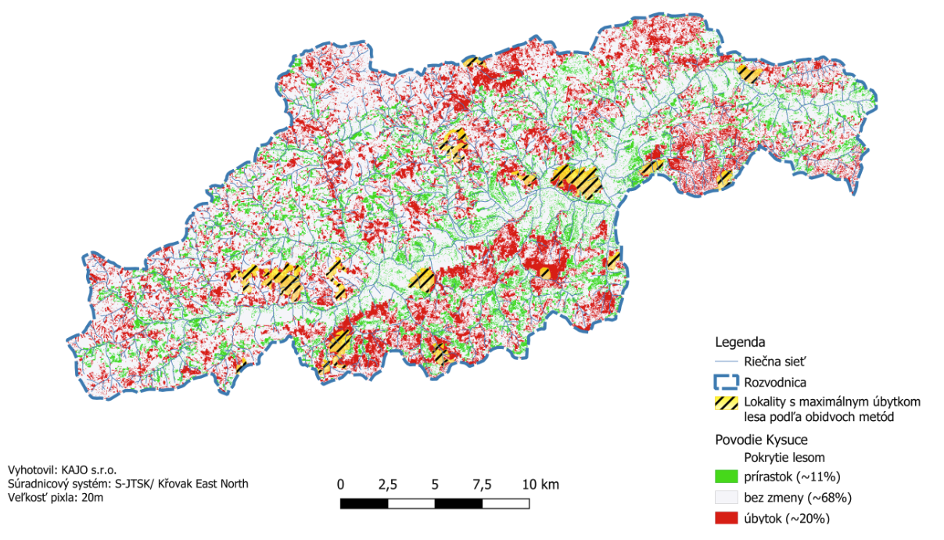
Zilina Region EVI

Slide 7

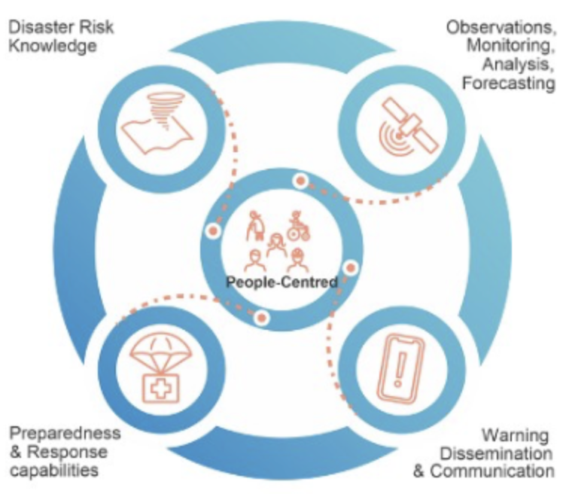
MedEWSa
Horizon Europe / 30 partners / 15 Countries
alignment with UN initiative EarlyWarnins4all
Innovative use of EO data in forecasting, Detecting and managing natural disasters
KAJO responsible for:
  Integration with Copernicus EMS
  Automated triggering of remote data acquisition based on early warnings (before the emergency)
  technological support to flood forecasting and landslides impact-based forecasting for the Slovak pilot area in Kosice

Slide 8
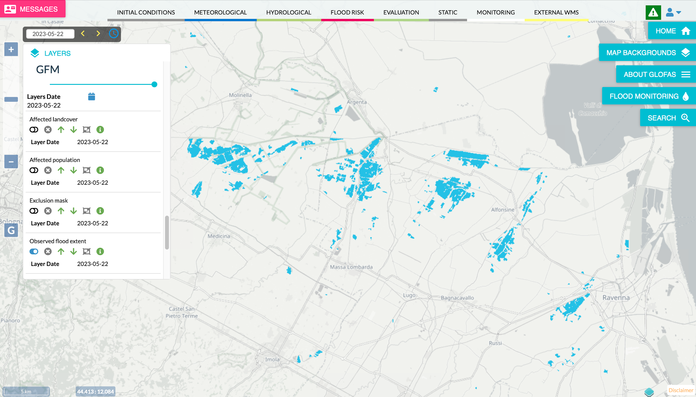
Consultancy activities for Copernicus Emergency Management Service:
development of European & Global Flood Awareness System
Product design for Global Flood Monitoring (near real time Sentinel based flood detection at global scale)
Dissemination/product tailoring for Disaster Risk Management in support for European Civil Protection and Humanitarian Aid Operations

Slide 9

Thank you for your attention!

